Slide 1
Phylum Mollusca
Unit 4

Slide 2
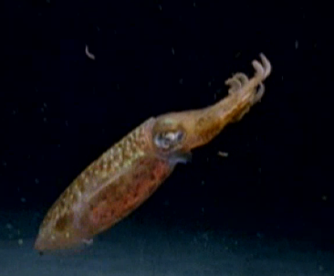
Mollusk Introduction

Slide 3
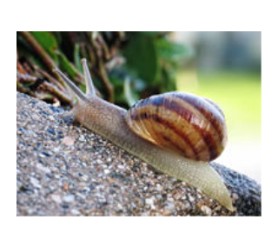
Phylum Mollusca
Molluscus = soft
Soft-bodied animals that usually have an internal or external shell.
Includes snails, slugs, clams, squids, and octopi.
True coelom
Complex, interrelated organ systems

Slide 4
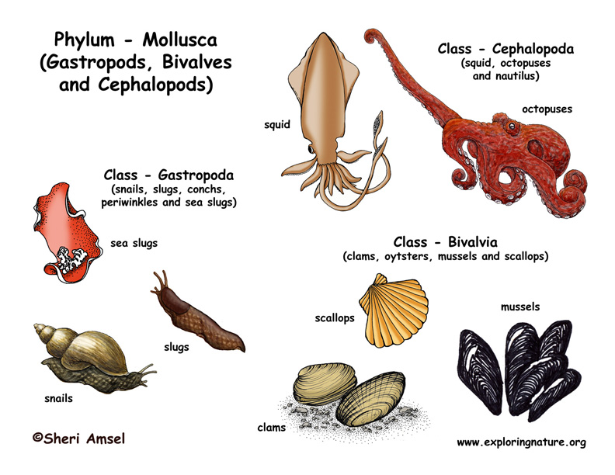

Slide 5
Body Plan
The body plan of most mollusks have 4 main parts:
foot
mantle
shell
visceral mass
Foot: muscular; may be used for crawling, burrowing, or tentacles for capturing prey
Mantle: thin tissue layer that covers the body (cloak)
Shell: made by glands in the mantle that secrete calcium carbonate
Visceral mass: internal organs

Slide 6
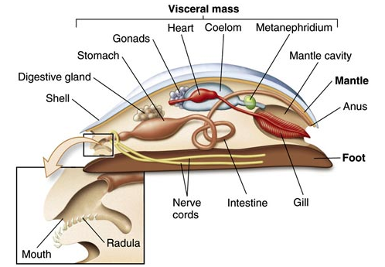
Body Plan

Slide 7
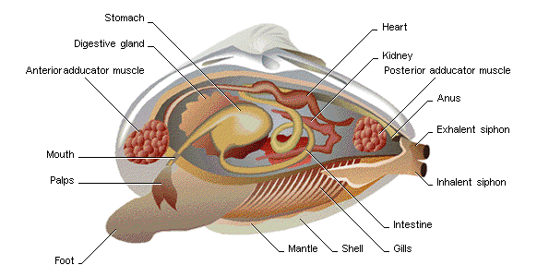
Body Plan

Slide 8
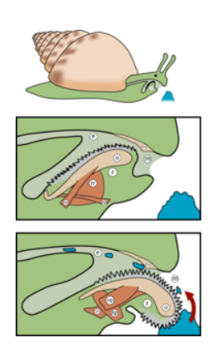
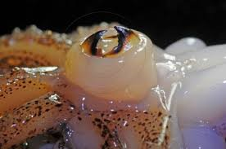
Feeding
Many (snails, slugs) use radula: flexible, tongue-shaped structure with hundreds of tiny teeth to scrape food, or drill into other animals
Octopus: sharp jaws to eat prey

Slide 9
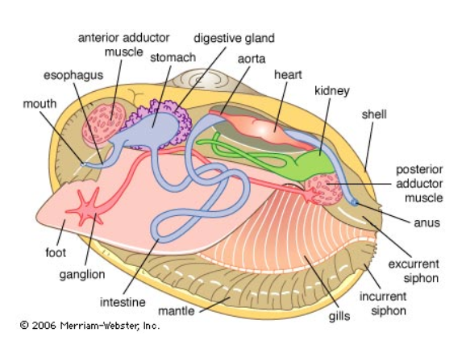
Feeding
Clams, oysters, scallops: filter feeders; use siphon – tube-like structure through which water flows

Slide 10
Respiration
Aquatic mollusks use gills
Land mollusks use mantle cavity; large surface area lined with blood vessels. It is kept moist and oxygen diffuses across.

Slide 11
Circulation
Open circulatory system:(snails, clams) blood is pumped through vessels by a simple heart and works its way into the sinuses; blood then passes to the gills, where oxygen and carbon dioxide are exchanged.
Closed circulatory system: (octopi, squid) capable of transporting blood faster

Slide 12
Open vs. Closed

Slide 13
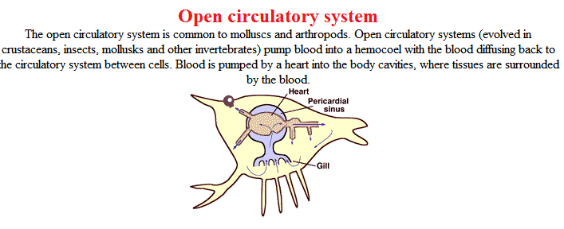
Open vs. Closed

Slide 14
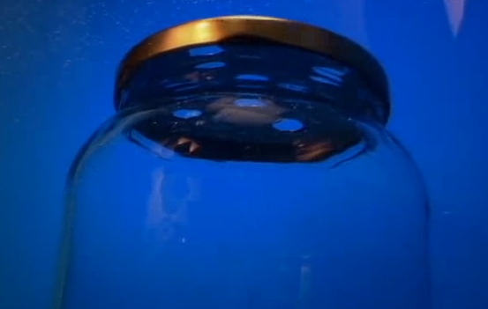
Response
Clams (bivalves): simple nervous system, small ganglia, nerve cords and simple sense organs (eyespots, chemical receptors)
Octopi: active predators; most highly developed nervous system of all invertebrates; well-developed brains; capable of complex behaviour, such as opening jars, responding to rewards.

Slide 15
Reproduction
Variety of methods; snails and bivalves reproduce sexually by external fertilization
External fertilization: large number of eggs are released into the water, then fertilized by sperm; develop into free-swimming larvae.
Tentacled mollusks: internal fertilization
Some are hermaphrodites

Slide 16
Groups of Mollusks
There are 3 groups of mollusks, they are:
Gastropods: shell-less or one shell, ventral foot.
Bi-valves: Two shells
Cephalopods: Head attached to foot.

Slide 17
Practice
Read pages 701-706
Questions
Pg 708: #1,2,3
Pg 711: #8,10

Slide 18
Warm-Up!
Label the 4 main parts of any mollusk.

