Slide 1
B.F. Skinner

Slide 2
Operant Conditioning
By the 1920s, John B. Watson and other behaviorists were becoming influential, proposing new forms of learning other than classical conditioning. Perhaps the most important of these was B.F. Skinner
Skinner's views were slightly less extreme than those of Watson (1913). Skinner believed that we do have such a thing as a mind, but that it is simply more productive to study observable behavior rather than internal mental events.

Slide 3
The work of Skinner was rooted in a view that classical conditioning was far too simplistic to be a complete explanation of complex human behavior. He believed that the best way to understand behavior is to look at the causes of an action and its consequences. He called this approach operant conditioning.

Slide 4
Operant Conditioning deals with operants - intentional actions that have an effect on the surrounding environment. Skinner set out to identify the processes which made certain operant behaviours more or less likely to occur.
Skinner's theory of operant conditioning was based on the work of Thorndike (1905). Edward Thorndike studied learning in animals using a puzzle box to propose the theory known as the 'Law of Effect'.

Slide 5
Skinner is regarded as the father of Operant Conditioning, but his work was based on Thorndike’s law of effect. Skinner introduced a new term into the Law of Effect - Reinforcement. Behavior which is reinforced tends to be repeated (i.e. strengthened); behavior which is not reinforced tends to die out-or be extinguished (i.e. weakened).

Slide 6
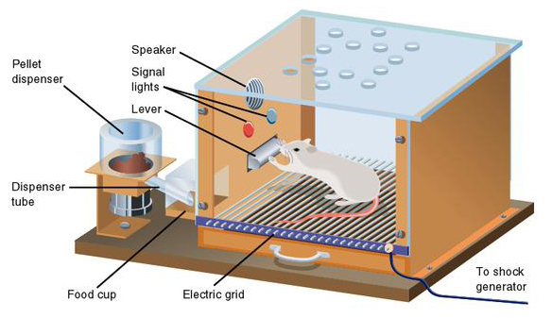
Skinner (1948) studied operant conditioning by conducting experiments using animals which he placed in a
'Skinner Box' which was similar to Thorndike’s puzzle box.

Slide 7
B.F. Skinner (1938) coined the term operant conditioning; it means roughly changing of behavior by the use of reinforcement which is given after the desired response. Skinner identified three types of responses or operant that can follow behavior.
• Neutral operants: responses from the environment that neither increase nor decrease the probability of a behavior being repeated.

Slide 8
• Reinforcers: Responses from the environment that increase the probability of a behavior being repeated. Reinforcers can be either positive or negative.
• Punishers: Responses from the environment that decrease the likelihood of a behavior being repeated. Punishment weakens behavior.

Slide 9
We can all think of examples of how our own behavior has been affected by reinforcers and punishers. As a child you probably tried out a number of behaviors and learned from their consequences.

Slide 10
Positive Reinforcement
Skinner showed how positive reinforcement worked by placing a hungry rat in his Skinner box. The box contained a lever on the side and as the rat moved about the box it would accidentally knock the lever. Immediately it did so a food pellet would drop into a container next to the lever. The rats quickly learned to go straight to the lever after a few times of being put in the box. The consequence of receiving food if they pressed the lever ensured that they would repeat the action again and again.

Slide 11
Positive reinforcement strengthens a behavior by providing a consequence an individual finds rewarding. For example, if your teacher gives you £5 each time you complete your homework (i.e. a reward) you will be more likely to repeat this behavior in the future, thus strengthening the behavior of completing your homework.

Slide 12
Negative Reinforcement
The removal of an unpleasant reinforcer can also strengthen behavior. This is known as negative reinforcement because it is the removal of an adverse stimulus which is ‘rewarding’ to the animal or person. Negative reinforcement strengthens behavior because it stops or removes an unpleasant experience.

Slide 13
For example, if you do not complete your homework, you give your teacher £5. You will complete your homework to avoid paying £5, thus strengthening the behavior of completing your homework.

Slide 14
Skinner showed how negative reinforcement worked by placing a rat in his Skinner box and then subjecting it to an unpleasant electric current which caused it some discomfort. As the rat moved about the box it would accidentally knock the lever. Immediately it did so the electric current would be switched off. The rats quickly learned to go straight to the lever after a few times of being put in the box. The consequence of escaping the electric current ensured that they would repeat the action again and again.

Slide 15
In fact Skinner even taught the rats to avoid the electric current by turning on a light just before the electric current came on. The rats soon learned to press the lever when the light came on because they knew that this would stop the electric current being switched on.
These two learned responses are known as Escape Learning and Avoidance Learning.

Slide 16
Punishment (weakens behavior)
Punishment is defined as the opposite of reinforcement since it is designed to weaken or eliminate a response rather than increase it. It is an aversive event that decreases the behavior that it follows
Like reinforcement, punishment can work either by directly applying an unpleasant stimulus like a shock after a response or by removing a potentially rewarding stimulus, for instance, deducting someone’s pocket money to punish undesirable behavior.

Slide 17
There are many problems with using punishment, such as:
Punished behavior is not forgotten, it's suppressed - behavior returns when punishment is no longer present.
Causes increased aggression - shows that aggression is a way to cope with problems.

Slide 18
Creates fear that can generalize to undesirable behaviors, e.g., fear of school.
Does not necessarily guide toward desired behavior - reinforcement tells you what to do, punishment only tells you what not to do.

Slide 19
Schedules of Reinforcement
Imagine a rat in a “Skinner box". In operant conditioning if no food pellet is delivered immediately after the lever is pressed then after several attempts the rat stops pressing the lever (how long would someone continue to go to work if their employer stopped paying them?). The behavior has been extinguished.

Slide 20
Behaviorists discovered that different patterns (or schedules) of reinforcement had different effects on the speed of learning and on extinction. Ferster and Skinner (1957) devised different ways of delivering reinforcement, and found that this had effects on
1. The Response Rate - The rate at which the rat pressed the lever (i.e. how hard the rat worked).
2. The Extinction Rate - The rate at which lever pressing dies out (i.e. how soon the rat gave up).

Slide 21
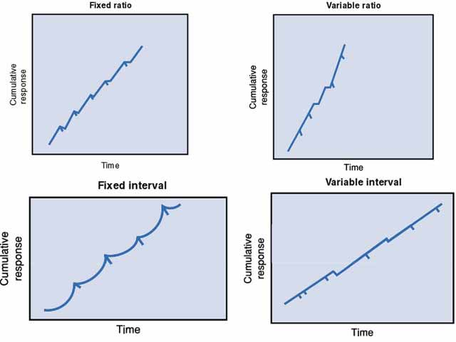
.

Slide 22
Skinner found that the type of reinforcement which produces the slowest rate of extinction (i.e. people will go on repeating the behavior for the longest time without reinforcement) is variable-ratio reinforcement. The type of reinforcement which has the quickest rate of extinction is continuous reinforcement.

Slide 23
(A) Continuous Reinforcement
An animal/human is positively reinforced every time a specific behaviour occurs, e.g. every time a lever is pressed a pellet is delivered and then food delivery is shut off.
Response rate is SLOW
Extinction rate is FAST

Slide 24
(B) Fixed Ratio Reinforcement
Behavior is reinforced only after the behavior occurs a specified number of times. E.g. one reinforcement is given after every so many correct responses, e.g. after every 5th response. For example a child receives a star for every five words spelt correctly.
Response rate is FAST
Extinction rate is MEDIUM

Slide 25
(C) Fixed Interval Reinforcement
One reinforcement is given after a fixed time interval providing at least one correct response has been made. An example is being paid by the hour. Another example would be every 15 minutes (half hour, hour, etc.) a pellet is delivered (providing at least one lever press has been made) then food delivery is shut off.
Response rate is MEDIUM
Extinction rate is MEDIUM

Slide 26
(D) Variable Ratio Reinforcement
Behavior is reinforced after an unpredictable number of times. For examples gambling or fishing.
Response rate is FAST
Extinction rate is SLOW (very hard to extinguish because of unpredictability )

Slide 27
(E) Variable Interval Reinforcement
Providing one correct response has been made, reinforcement is given after an unpredictable amount of time has passed, e.g. on average every 5 minutes. An example is a self-employed person being paid at unpredictable times.
Response rate is FAST
Extinction rate is SLOW

Slide 28
Behavior Shaping
A further important contribution made by Skinner (1951) is the notion of behaviour shaping through successive approximation. Skinner argues that the principles of operant conditioning can be used to produce extremely complex behaviour if rewards and punishments are delivered in such a way as to encourage move an organism closer and closer to the desired behaviour each time.

Slide 29
In order to do this, the conditions (or contingencies) required to receive the reward should shift each time the organism moves a step closer to the desired behaviour.
According to Skinner, most animal and human behaviour (including language) can be explained as a product of this type of successive approximation.

Slide 30
Behavior Modification
Behavior modification is a set of therapies / techniques based on operant conditioning (Skinner, 1938, 1953). The main principle comprises changing environmental events that are related to a person's behavior. For example, the reinforcement of desired behaviors and ignoring or punishing undesired ones.

Slide 31
This is not as simple as it sounds — always reinforcing desired behavior, for example, is basically bribery.
There are different types of positive reinforcements. Primary reinforcement is when a reward strengths a behavior by itself. Secondary reinforcement is when something strengthens a behavior because it leads to a primary reinforce i.e., token economy

Slide 32
Token Economy
Token economy is a system in which targeted behaviors are reinforced with tokens (secondary reinforcers) and later exchanged for rewards (primary reinforcers).
Tokens can be in the form of fake money, buttons, poker chips, stickers, etc. While the rewards can range anywhere from snacks to privileges or activities.

Slide 33
Token economy has been found to be very effective in managing psychiatric patients. However, the patients can become over reliant on the tokens, making it difficult for them to adjust to society once they leave prisons, hospital etc.
Teachers also use token economy at primary school by giving young children stickers to reward good behavior.

Slide 34
Operant Conditioning in the Classroom
In the conventional learning situation operant conditioning applies largely to issues of class and student management, rather than to learning content. It is very relevant to shaping skill performance.
A simple way to shape behavior is to provide feedback on learner performance, e.g. compliments, approval, encouragement, and affirmation. A variable-ratio produces the highest response rate for students learning a new task, whereby initially reinforcement (e.g. praise) occurs at frequent intervals, and as the performance improves reinforcement occurs less frequently, until eventually only exceptional outcomes are reinforced.

Slide 35
For example, if a teacher wanted to encourage students to answer questions in class they should praise them for every attempt (regardless of whether their answer is correct). Gradually the teacher will only praise the students when their answer is correct, and over time only exceptional answers will be praised.
Unwanted behaviors, such as tardiness and dominating class discussion can be extinguished through being ignored by the teacher (rather than being reinforced by having attention drawn to them).

Slide 36
Knowledge of success is also important as it motivates future learning. However it is important to vary the type of reinforcement given, so that the behavior is maintained. This is not an easy task, as the teacher may appear insincere if he/she thinks too much about the way to behave.

