Slide 1
Maslow

Slide 2
Maslow wanted to understand what motivates people. He believed that people possess a set of motivation systems unrelated to rewards or unconscious desires.
Maslow (1943) stated that people are motivated to achieve certain needs. When one need is fulfilled a person seeks to fulfill the next one, and so on.
The earliest and most widespread version of Maslow's (1943, 1954) hierarchy of needs includes five motivational needs, often depicted as hierarchical levels within a pyramid.

Slide 3
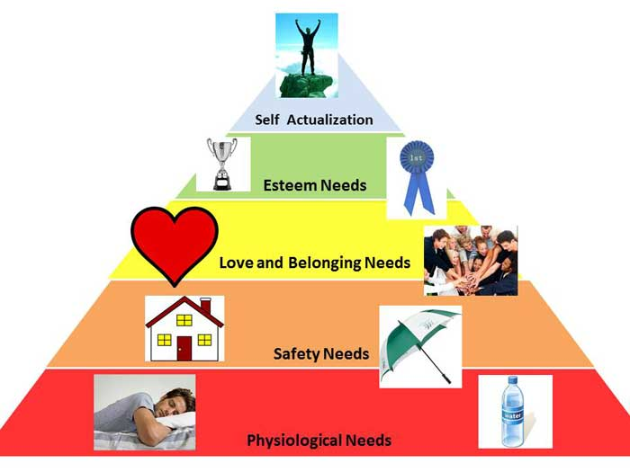
Maslow’s Hierarchy of Needs

Slide 4
This five stage model can be divided into basic (or deficiency) needs (e.g. physiological, safety, love, and esteem) and growth needs (self-actualization).
The deficiency, or basic needs are said to motivate people when they are unmet. Also, the need to fulfil such needs will become stronger the longer the duration they are denied. For example, the longer a person goes without food the more hungry they will become.

Slide 5
One must satisfy lower level basic needs before progressing on to meet higher level growth needs. Once these needs have been reasonably satisfied, one may be able to reach the highest level called self-actualization.
Every person is capable and has the desire to move up the hierarchy toward a level of self-actualization. Unfortunately, progress is often disrupted by failure to meet lower level needs. Life experiences, including divorce and loss of job may cause an individual to fluctuate between levels of the hierarchy.

Slide 6
Maslow noted only one in a hundred people become fully self-actualized because our society rewards motivation primarily based on esteem, love and other social needs.
1. Biological and Physiological needs - air, food, drink, shelter, warmth, sleep.
2. Safety needs - protection from elements, security, order, law, stability, freedom from fear.
3. Love and belongingness needs - friendship, intimacy, affection and love, - from work group, family, friends, romantic relationships.

Slide 7
4. Esteem needs - achievement, mastery, independence, status, dominance, prestige, self-respect, respect from others.
5. Self-Actualization needs - realizing personal potential, self-fulfillment, seeking personal growth and peak experiences.
Psychologist Abraham Maslow (1943, 1954) stated that human motivation is based on people seeking fulfillment and change through personal growth. Self-actualized people are those who were fulfilled and doing all they were capable of.

