Slide 1
Mindful Seeing

Slide 2
Mindful Seeing
Mindful seeing enables us to better observe ourselves, other people, and our surroundings to more fully enjoy and learn from them
Mindful seeing helps sharpen your focus by calling on one sense to very purposefully observe an object

Slide 3
Linking to the brain
Emotions shape behaviour and learning
The amygdala, that reactive watchdog of the brain, elicits the same fear response for perceived danger as for genuine danger
The behaviour of an individual who feels unsafe, threatened, inadequate, judged or vulnerable to ridicule is driven by his or her brain’s reaction to threat

Slide 4
Individuals who feel continually “on alert” are unable to engage in mindful behaviour because their amygdala blocks incoming stimuli from reaching the rational prefrontal cortex
The brain gives priority to emotions because they matter
Emotions are associated with the places and people in your lives

Slide 5
People who learn to associate school with a feeling of safety become confident enough to move out of their comfort zone
They feel safe expressing their ideas, working together, asking questions, and trying new things-even if it means making mistakes
They train the amygdala to remain calm, keeping the pathways to their higher brain open

Slide 6
The more you feel safe, the stronger those neural pathways become
The chain of neurons that result in a feeling of safety become more efficient, passing the message along faster.

Slide 7
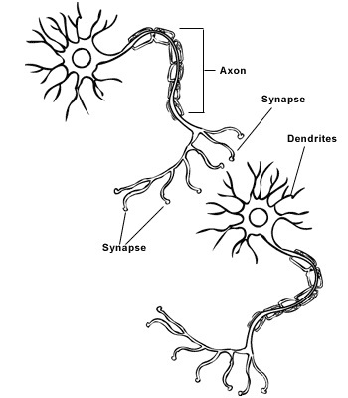
Neurons connect axon to dendrite, passing messages along via gap-jumping electrochemical exchanges called synapses.

Slide 8
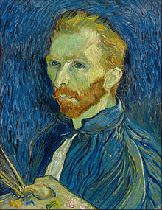

Slide 10
Journal Writing
Reflect on what you have learned about mindful seeing
Write down any questions you have
Take a minute to look at a spot in the classroom. For the next minute, list as many details as you can about this spot
Think about your favorite article of clothing. List the details that make it visually appealing to you
Chose an item in the classroom and describe every aspect of it (color, shape, size)

