Slide 1
Mindful Smelling

Slide 2
What is mindful smelling?
Just by catching a whiff of a familiar scent, our brain can call to mind the people, places, or things we associate with it
Mindful smelling – using our sense of smell to be more aware of our environment – can help us to keenly observe our world and sharpen our memory

Slide 3
Linking to the brain
Dopamine: the chemistry of pleasure and reward
Our brains have more than four dozen types of neurotransmitters, chemicals that allow signals to pass between neurons
One of these transmitters, dopamine, plays a role in producing and regulating positive feelings such as pleasure, hopefulness, optimism, and keen interest

Slide 4
When we have sufficient levels of this “feel-good” neurotransmitter in our brain, we are more able to maintain motivation, delay gratification, and feel rewarded and content
As levels of dopamine in the brain change, so does our outlook on life
Dopamine release is triggered during pleasure-inducing experiences including smelling and eating a favorite food, seeing friends, enjoying sports, etc.

Slide 5
People who learn at a young age to connect the “feel-good” times with positive behaviours are better able to access the self-soothing, internal reward system that comes as standard equipment in every human brain
As young people mature, they are less likely to seek the dopamine surges that come with high risk behaviours like drugs, alcohol, reckless driving and overeating

Slide 6
We can help our brains release dopamine and create positive feelings with activities that give us pleasure and a feeling of accomplishment
What are some activities that you find both enjoyable and rewarding?
Can you give an example of a time when you felt better after doing an activity such as dancing, playing sports, going for a walk, music, art, talking to friends?

Slide 7
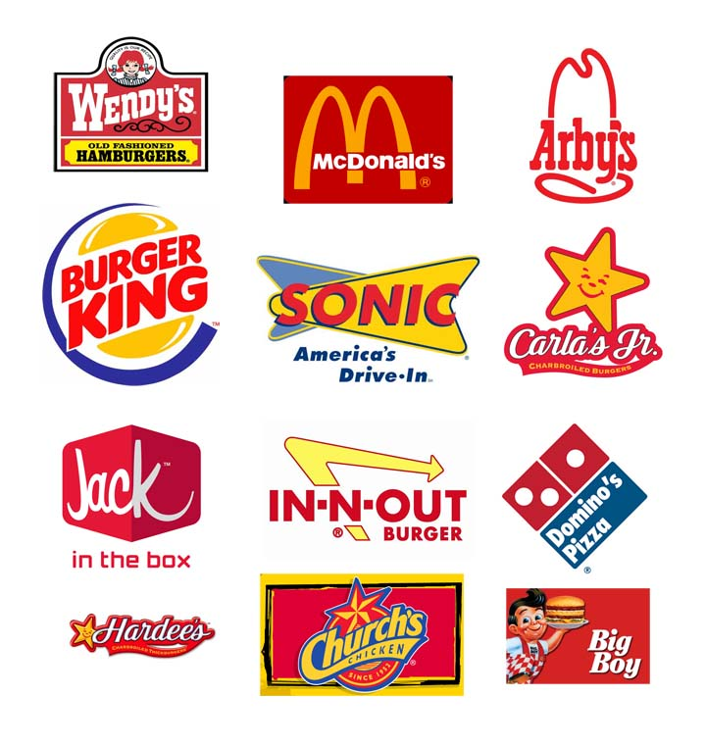
What scent comes to mind?

Slide 9
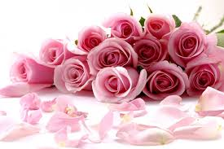

Slide 10
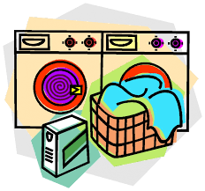

Slide 11
Think of your favorite special meal
How does your brain use what you smell to help make a meal memorable?

Slide 12
Journal writing
Reflect on what you have learned about mindful smelling
Write down any questions you might have
List 3-5 of your least favorite smells (wet dog, smelly socks, etc)
What are your favorite smells in the morning? Breakfast cooking, coffee, etc.

