Slide 1
Mindful Tasting

Slide 2
Mindful Tasting
To fully appreciate the food we eat – whether it’s a complex treat or a simple bowl of oatmeal – requires mindful tasting, or slowing down to savor our food and notice its flavor, texture, and temperature
Eating is something that is rarely done mindfully

Slide 3
Linking to the brain
Neurotransmitters are key to the dynamic and ever-changing ecosystem of our brain
These chemical messengers influence a wide range of feelings and behaviours and are affected by sensory input and general health
Stress – real or perceived – causes changes in levels of neurotransmitters, including these three:
Dopamine plays a crucial role in motivation, pleasure and addiction and influences paying attention, planning and moving the body

Slide 4
Serotonin contributes to the regulation of appetite, sleep, aggression, mood and pain
Norepinephrine is important for attentiveness, emotions, sleeping, dreaming, and learning
Increases and/or decreases in the level of one or more of these neurotransmitters affect our mental state and the feelings and behaviours generated by it
Attentiveness, engagement, competence and achievement are only possible when a learner’s brain is in a receptive state, allowing for calm and mindful response

Slide 5
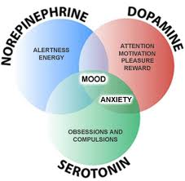

Slide 6
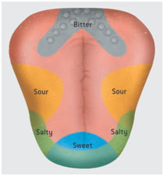
Taste buds

Slide 7
Journal writing
Reflect on what you have learned about mindful tasting and write down any questions you may have
List several foods that you enjoy. Use vivid language to describe how each food looks, smells and tastes
On a scale of 1 to 10, with 1 being very unmindful, how would you rate each meal you have in a typical day? What do you do to make eating that meal more or less mindful?
If you were a chef, what kind of food would you like to cook? What style or nationality of food? Bakery, deli or fancy restaurant?

