Slide 1
Pavlov

Slide 2
Ivan Pavlov
Like many great scientific advances, Pavlovian conditioning (aka classical conditioning) was discovered accidentally.
During the 1890s Russian physiologist Ivan Pavlov was looking at salivation in dogs in response to being fed, when he noticed that his dogs would begin to salivate whenever he entered the room, even when he was not bringing them food. At first this was something of a nuisance (not to mention messy!).

Slide 3
Pavlovian Conditioning
Pavlov (1902) started from the idea that there are some things that a dog does not need to learn. For example, dogs don’t learn to salivate whenever they see food. This reflex is ‘hard wired’ into the dog. In behaviorist terms, it is an unconditioned response (i.e. a stimulus-response connection that required no learning). In behaviorist terms, we write:
Unconditioned Stimulus (Food) > Unconditioned Response (Salivate)

Slide 4
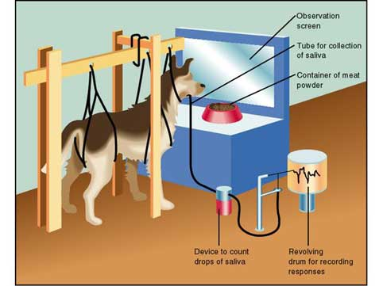
Pavlov showed the existence of the unconditioned response by presenting a dog
with a bowl of food and the measuring its salivary secretions (see image below).

Slide 5
However, when Pavlov discovered that any object or event which the dogs learnt to associate with food (such as the lab assistant) would trigger the same response, he realized that he had made an important scientific discovery. Accordingly, he devoted the rest of his career to studying this type of learning.
Pavlov knew that somehow, the dogs in his lab had learned to associate food with his lab assistant. This must have been learned, because at one point the dogs did not do it, and there came a point where they started, so their behavior had changed. A change in behavior of this type must be the result of learning.

Slide 6
In behaviorist terms, the lab assistant was originally a neutral stimulus. It is called neutral because it produces no response. What had happened was that the neutral stimulus (the lab assistant) had become associated with an unconditioned stimulus (food).
In his experiment, Pavlov used a bell as his neutral stimulus. Whenever he gave food to his dogs, he also rang a bell. After a number of repeats of this procedure, he tried the bell on its own. As you might expect, the bell on its own now caused an increase in salivation.

Slide 7
So the dog had learned an association between the bell and the food and a new behavior had been learnt. Because this response was learned (or conditioned), it is called a conditioned response. The neutral stimulus has become a conditioned stimulus.
Pavlov found that for associations to be made, the two stimuli had to be presented close together in time. He called this the law of temporal contiguity. If the time between the conditioned stimulus (bell) and unconditioned stimulus (food) is too great, then learning will not occur.
Pavlov and his studies of classical conditioning have become famous since his early work between 1890-1930. Classical conditioning is "classical" in that it is the first systematic study of basic laws of learning / conditioning.

Slide 8
To summarize, classical conditioning (later developed by John Watson)
involves learning to associate an unconditioned stimulus that already brings about a particular response (i.e. a reflex) with a new (conditioned) stimulus,
so that the new stimulus brings about the same response

Slide 9
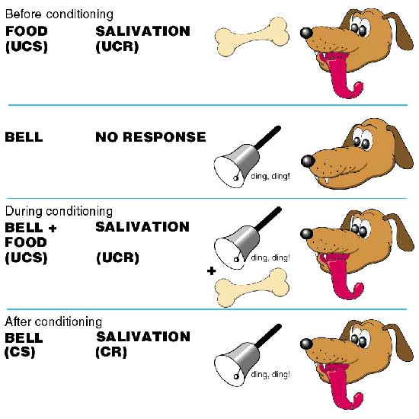
.

Slide 10
Pavlov developed some rather unfriendly technical terms to describe this process. The unconditioned stimulus (or UCS) is the object or event that originally produces the reflexive / natural response.
The response to this is called the unconditioned response (or UCR). The neutral stimulus (NS) is a new stimulus that does not produce a response.
Once the neutral stimulus has become associated with the unconditioned stimulus, it becomes a conditioned stimulus (CS). The conditioned response (CR) is the response to the conditioned stimulus.

