Slide 1
Sigmund Freud

Slide 2
Sigmund Freud explored the human mind more thoroughly than any other who became before him.
His contributions to psychology are vast.
Freud was one of the most influential people of the twentieth century
Freud believed that when we explain our own behaviour to ourselves or others (conscious mental activity) we rarely give a true account of our motivation.

Slide 3
Psychoanalysis
Freud was the founding father of psychoanalysis, a method for treating mental illness and also a theory which explains human behavior.
Psychoanalysis is often known as the talking cure. Typically Freud would encourage his patients to talk freely (on his famous couch) regarding their symptoms, and to describe exactly what was on their mind.

Slide 4
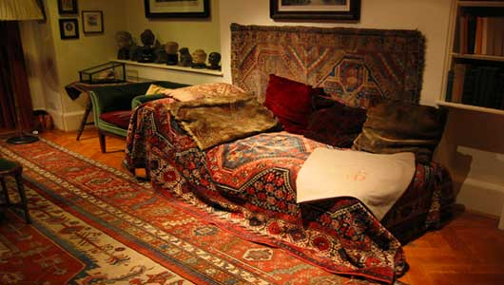

Slide 5
In 1895 Freud proposed that physical symptoms are often the surface manifestations of deeply repressed conflicts.
Freud’s clinical investigations and it led him to propose that there were at least three levels of the mind.

Slide 6
The Unconscious Mind
Freud (1900, 1905) developed a topographical model of the mind, whereby he described the features of the mind’s structure and function. Freud used the analogy of an iceberg to describe the three levels of the mind.
On the surface is consciousness, which consists of those thoughts that are the focus of our attention now, and this is seen as the tip of the iceberg. The preconscious consists of all which can be retrieved from memory. The third and most significant region is the unconscious. Here lie the processes that are the real cause of most behaviour. Like an iceberg, the most important part of the mind is the part you cannot see.

Slide 7
The unconscious mind acts as a repository, a ‘cauldron’ of primitive wishes and impulse kept at bay and mediated by the preconscious area. For example, Freud (1915) found that some events and desires were often too frightening or painful for his patients to acknowledge, and believed such information was locked away in the unconscious mind. This can happen through the process of repression.
Sigmund Freud emphasized the importance of the unconscious mind, and a primary assumption of Freudian theory is that the unconscious mind governs behavior to a greater degree than people suspect. Indeed, the goal of psychoanalysis is to make the unconscious conscious.

Slide 8
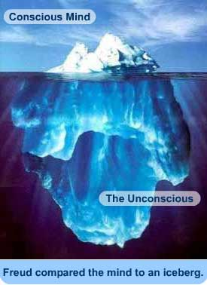

Slide 9
Freud (1923) later developed a more structural model of the mind comprising the entities id, ego and superego (what Freud called “the psychic apparatus"). These are not physical areas within the brain, but rather hypothetical conceptualizations of important mental functions.
Freud assumed the id operated at an unconscious level according to the pleasure principle (gratification from satisfying basic instincts). The id comprises two kinds of biological instincts (or drives) such as eating, and breathing

Slide 10
The ego develops from the id during infancy. The ego's goal is to satisfy the demands of the id in a safe a socially acceptable way. In contrast to the id the ego follows the reality principle as it operates in both the conscious and unconscious mind.
The superego develops during early childhood and is responsible for ensuring moral standards are followed. The superego operates on the morality principle and motivates us to behave in a socially responsible and acceptable manner.

Slide 11
The Psyche

Slide 12
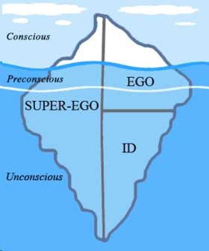

Slide 13
The basic dilemma of all human existence is that each element of the psychic apparatus makes demands upon us that are incompatible with the other two. Inner conflict is inevitable.
For example, the superego can make a person feel guilty if rules are not followed. When there is conflict between the goals of the id and superego, the ego must act as a referee and mediate this conflict. The ego can deploy various defense mechanisms (Freud, 1894, 1896) to prevent it from becoming overwhelmed by anxiety.

