Slide 1
Appreciating Happy Experiences

Slide 2
What Does It Mean to Appreciate Happy Experiences?
We can make ourselves laugh over the memory of a hilarious situation shared with friends or flood ourselves with a feeling of warmth by recalling the hug of a beloved grandparent.
To remember a happy experience fully and mindfully is to appreciate it and reap physical, emotional, and cognitive benefits

Slide 3
Remembering a happy memory releases in our brain the same “feel good” chemicals that flooded it at the time of the actual experience
We can practice mindfully recalling favorite memories as a strategy to achieve a variety of goals including cultivating optimism, alleviating negativity (boredom or anxiety), priming our brain for learning new materials, generating ideas from past experiences and boosting our physical health

Slide 4
Linking to the Brain
Remember the critical role of the neurotransmitter most associated with pleasure, attention, reward, motivation and perseverance – dopamine
Higher levels of dopamine in our brain result in feelings of hope, tolerance, motivation and a can-do-attitude – optimism

Slide 5
Dopamine release is triggered when we engage in pleasurable experiences such as fun activities, laughing, physical exercise, acts of kindness and positive social interactions
Brain scans show that dopamine is released not only when we engage directly in pleasurable experiences, but also when we reflect on and remember these salient moments

Slide 6
In fact, remembering a positive experience can trigger dopamine release as powerfully as the real thing
By repeatedly referencing past successes, we build confidence and are more able to rebuff the “I can’t” voice in our head
Happy memories can become a tool to prime the brain for new social, academic and physical challenges

Slide 7
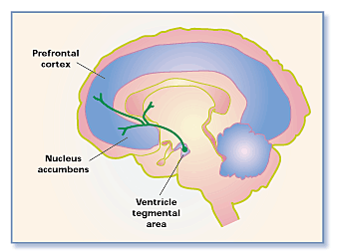

Slide 8
Activity
On a piece of paper, write something you would like to achieve, but feel in unattainable (i.e., getting marks in the 90s or running a km)
Then on the back of the paper write a related thing that you have accomplished (got one mark in the 90s last semester or can run further now than a month ago)

Slide 9
How did you feel when you wrote the “I can’t” side?
Did you feel differently after remembering what you had accomplished? How?

Slide 10
Class Activity
With a partner, share a happy memory from the past year
Share memories with the class
Discuss if the memories made you smile when you told them
What kind of situations produce really happy memories?
Why do you think some memories are stronger than others?

Slide 11
Journal Writing
Reflect on what you have learned
Recall a time when something you said or did gave another person a happy moment. Describe this.
Write about a time you felt sad. Then write about a happy memory that you could revisit the next time you felt sad.

