Slide 1
Expressing Gratitude

Slide 2
What is Gratitude?
Gratitude is a feeling of thankfulness and joy we feel in response to something we have received, whether the gift is tangible, such as a book, or intangible, such as a smile of encouragement from a loved one or a breathtaking view of a landscape

Slide 3
Why Practice Expressing Gratitude?
Simply focusing for a minute on the experiences in our lives we are grateful for shifts our thinking to a calmer, more content perspective, which immediately uplift and comfort us
When we make the expression of gratitude a regular practice- whether we make a daily written list or a mental tally of things we are grateful for as we start or end each day – we train our brain to shift to a positive mind-set more efficiently and maintain a healthier, more optimistic perspective

Slide 4
Linking to the Brain
Gratitude has powerful physiological effects on the brain and body
Researchers have found that when we think about someone or something we truly appreciate, our bodies calm themselves
The feelings that come with gratitude trigger the calming branch of the autonomic nervous system, the parasympathetic system

Slide 5
The sympathetic system is the “fight, flight or freeze” responder during emergencies, stress and intense activity
The counteracting parasympathetic system is all about “rest and digest”
It slows the heartbeat, shunts blood from the muscles to the organs and contracts the pupils of the eyes
Feeling appreciative also produces a more even heart rhythm, which may reduce the risk of heart attacks and relieve hypertension

Slide 6
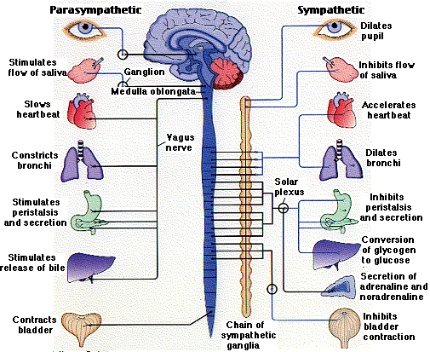

Slide 7
Feeling thankful and appreciative also affects levels of brain neurotransmitters, including releasing dopamine toward the prefrontal cortex where reasoning and logic occur
Dopamine not only fosters contentment, it is also the main player in the brain’s reward and motivation system
Experiments have shown that those who keep gratitude journals or lists feel more optimistic and make more progress toward their goals

Slide 8
People who do daily self-guided exercises in gratitude have higher levels of alertness, enthusiasm, determination, attentiveness and energy
Students who practice grateful thinking not only have a more positive attitude toward school, their brains are more ready to learn

Slide 9
The autonomic nervous system automatically controls many functions of our bodies, such as digestion, blood circulation, and breathing
In times of stress the fight, flight or freeze side of this system is in control
During sleep, rest and relaxation the calm side of the system takes over

Slide 10
Activity
Describe how you feel when stressed and when calm
Think about a number of situations (an upcoming test, receiving a compliment, remembering a kind act, speaking in front of the class)
Which system is likely engaged – the calm or stressed one?
What thoughts of thankfulness and appreciation help calm you?

Slide 11
Recall one or two times recently when you said thank-you
What are the types of things you are thankful for (polite gestures, kind acts and words, gifts, spending time or giving attention)
Are there things you are grateful for that you can’t buy in a store?
What are you most likely to say thank-you for?
Are there things you might be thankful for that you don’t usually say thank you for?

Slide 12
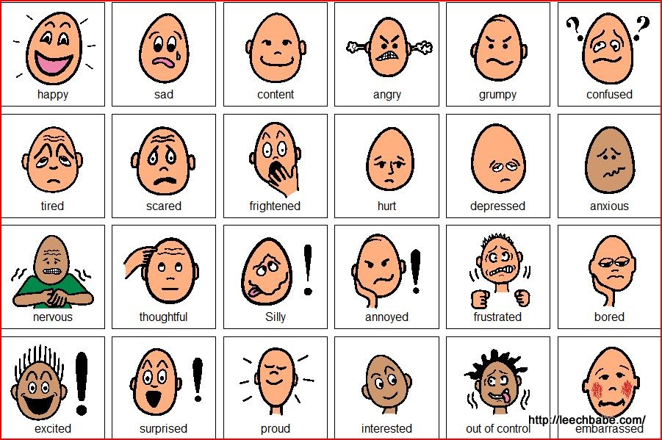
Emotions

Slide 13
Journal Writing
Reflect on what you have learned and write down any questions you might have
Make a “Top 10” list of things, events, and people in your life that you feel grateful for
Think about a new skill you recently learned from someone and express your gratitude
Think of ways you could become more grateful

