Slide 1
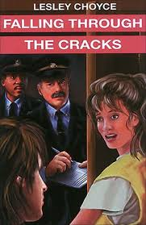
Falling Through The Cracks
By: Riley Russell and Sam Cormier

Slide 2
Text to text
PLOT - Long ways from home: this book I read back in middle school was about a kid that was abandon from his parents.
CHARACTER – same story that we mentioned in the plot
THEME/LESSON – never give up – same story

Slide 3
Text to world
Two years ago in Toronto we met this guy in real life that was 16 and he moved in with his friend and friend parents
Trent (a friend of mine) - long hair tall and skinny

Slide 4
Elements of craft
Flashbacks – the main characters conversation with the social worker made her think back to her problems with her parents
Book length
Every chapter has a title – gives an idea of what the chapter is about
First person point of view – it wouldn’t make sense if someone else told it because it happened to her

Slide 5
Our opinions
We thought it was a good book because it was a small simple book and easy to read for us Frenchmen

