Slide 1
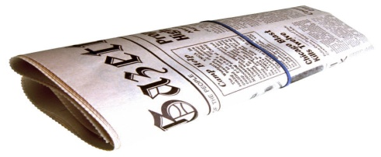
Newspaper Activity
With a partner or alone, create a newspaper advertisement for child care services. Decide on the type of program you will advertise and the special features your program will provide.
Include, on a separate piece of paper, a short explanation of which parents are most likely to respond to your ad and why.
Newspaper Ad: 12 Marks
Explanation: 3 Marks
Total Value: 15 Marks

