Slide 1
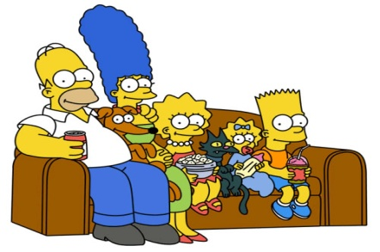
Television Families
Select a family you’ve seen on a television show and provide the following information:
Tell the members of the family and a bit of information about each one. (name, age, position in family, etc.)
Tell the type of family structure they have.
Are the relationships realistic? If not, why not?
How well do the families function?
Are there lessons that could be learned from how family members interact? What are they?
Value: 15

