Slide 1
“A Rose for Emily”
By William Faulkner

Slide 2
William Faulkner
The man himself never stood taller than five feet, six inches tall, but in the realm of American literature, William Faulkner is a giant. More than simply a renowned Mississippi writer, the Nobel Prize-winning novelist and short story writer is acclaimed throughout the world as one of the twentieth century’s greatest writers
Faulkner saw the first national publication of a short story he had written, “A Rose for Emily,” in Forum magazine. It would be followed that year by “Honor” in American Mercury, “Thrift,” and “Red Leaves,” both in the Saturday Evening Post. Over the coming years, as sales of his novels sagged, he would write numerous short stories for publication, especially in the Saturday Evening Post, as a principal means of financial support.

Slide 3
Gothic Style
Gothic style focused on the dark and bizarre the genre often featured certain set pieces and characters: drafty castles laced with cobwebs, secret passages, and frightened, wide-eyed heroines whose innocence does not go untouched. (Saint Michaels)
Southern Gothic writers were interested in exploring the extreme, antisocial behaviors that were often a reaction against a confining code of social conduct. Southern Gothic often hinged on the belief that daily life and the refined surface of the social order were fragile.

Slide 4
William Faulkner
“A Rose for Emily” reveals the influence that Southern Gothic had on his writing: this particular story has a moody and forbidding atmosphere; a crumbling old mansion; and decay. Faulkner’s work uses the sensational elements to highlight an individual’s struggle against an oppressive society that is undergoing rapid change.
Faulkner has appropriated the image of the damsel in distress and transformed it into Emily, a psychologically damaged spinster. Her mental instability made her a Southern Gothic heroine.

Slide 5
Colonial Style Homes

Slide 6
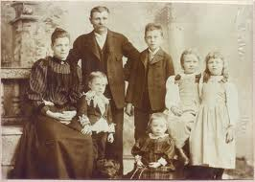
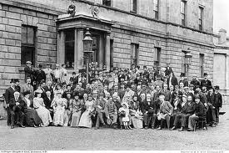
Images from 1894

Slide 7
Questions for “A Rose for Emily”
Describe Miss Emily’s upbringing and status in society?
Why did people find her unapproachable?
Give an example of Miss Emily’s neurotic behavior.
Where does the story take place? Collect some information about the setting.
Give reference from the text that support the idea that Miss Emily held power within the community, even though she was technically a pauper. (Reference your glossary we reviewed for unfamiliar words.)

Slide 8
Questions Continued
6. Why did Toby leave immediately after the ladies arrived?
7. After Miss Emily’s death, what do we discover in the room “which no one had seen in forty years”? Why is the second pillow on the bed important? What does it show us? Discuss Miss Emily’s motive for her action.
What atmosphere is created by the description of Miss Emily’s bedroom that the towns people entered?

Slide 9
Questions continued…
9. Find some references to social class in the story and discuss what these might indicate about the society at the time.
10. Why do you think the title of the story is “A Rose for Emily”? What does the rose symbolize?

