Slide 1
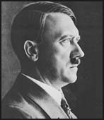
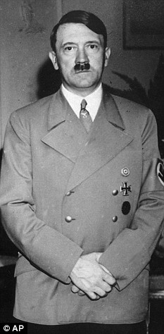
Adolf Hitler
By: Courtney Krygsveld

Slide 2
Quick Facts
Born: Braunau am Inn, Austria on April 20, 1889
Parents: Alois (1837-1903) and Klara (1860-1907) Hitler
Siblings: Paula (1896-1960), Gustav (1885-1887), Ida (1886-1888), Otto (1887), Edmund (1894-1900), one step-brother, Alois (b. 1882) and one step-sister, Angela (1883-1949)

Slide 3
Family
Paula was the only sibling of the family that survived through childhood, as the other four siblings died in their childhood. Hitler's father, Alois, was in his third marriage and fifty-one years old when Hitler was born. He was known as a strict man who retired from the civil service when Hitler was only six. Alois died when Hitler was only thirteen years old. Around the end of 1908, Hitler’s mother died of breast cancer. Hitler would’ve been around nineteen years old.

Slide 4
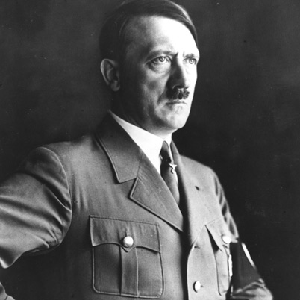
"Those who want to live, let them fight, and those who do not want to fight in this world of eternal struggle do not deserve to live.“ – Adolf Hitler

Slide 5
Life Goals, Dreams, and Ambitions
After the death of Hitler’s father, he dropped out of school. In Hitler’s youth years, his dream was to become an artist. He applied twice to the Vienna Academy of Art (once in 1907 and again in 1908) but was denied entrance both times. After his mother's death, Hitler spent four years living on the streets of Vienna, selling postcards of his artwork to make a little money.

Slide 6
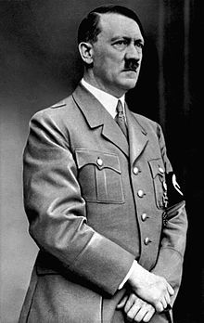
"If you want to shine like sun first you have to burn like it.“ –Adolf Hitler

Slide 7
Virulent Antisemitism
Adolf Hitler’s hate for the Jewish people was said to have started where his grandfather was possibly Jewish, which would make his father Jewish (his father was rather abusive). No one really knows for certain how his obsessive hate for Jews really happened, but rumors say the people that rejected him from art school were Jewish, there’s rumors his mom’s doctor when she had breast cancer was Jewish, and so on. It seemed as though everything that went wrong in Hitler’s life had something to do with a Jew.

Slide 8
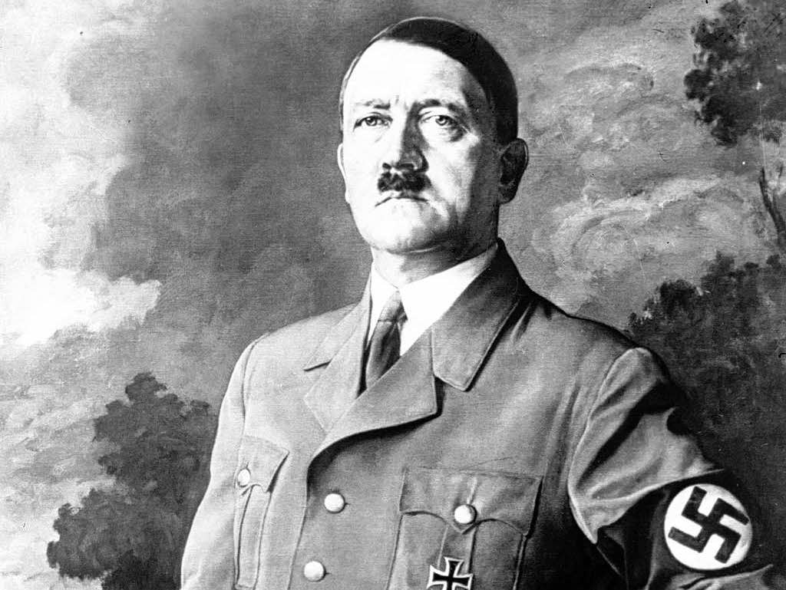
"Germany will either be a world power or will not be at all.“ – Adolf Hitler

Slide 9
Soldier in World War 1
Before Hitler was a chancellor and dictator he volunteered to serve in the German army in 1913. He survived four years of war and he was awarded two Iron Crosses for bravery. He had two injuries in the war. The first occurred in October 1916 when he was wounded by a grenade splinter. The other was on October 13, 1918, when a gas attack caused Hitler to go temporarily blind.

Slide 10
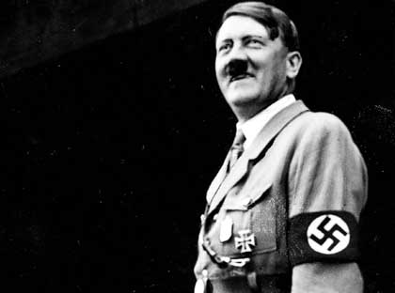
“I don't see much future for the Americans. In my view, it's a decayed country.” –Adolf Hitler

Slide 11
Entering Politics
Furious at Germany's surrender, Hitler returned to Munich after the end of World War I, determined to enter politics. Hitler became the 55th member of a small anti-Semitic party called the German Worker's Party. He then became leader of the party. Hitler’s excellent speaking skills gained him lots of attention, followers, and financial support. Hitler attempted to takeover the German government and was sentenced five years in prison. While he was in prison, he wrote a book called Mein Kampf (My Struggle). He only ended up staying in jail for nine months, and when he got out his goal was to take over the German government in a more legal way.

Slide 12
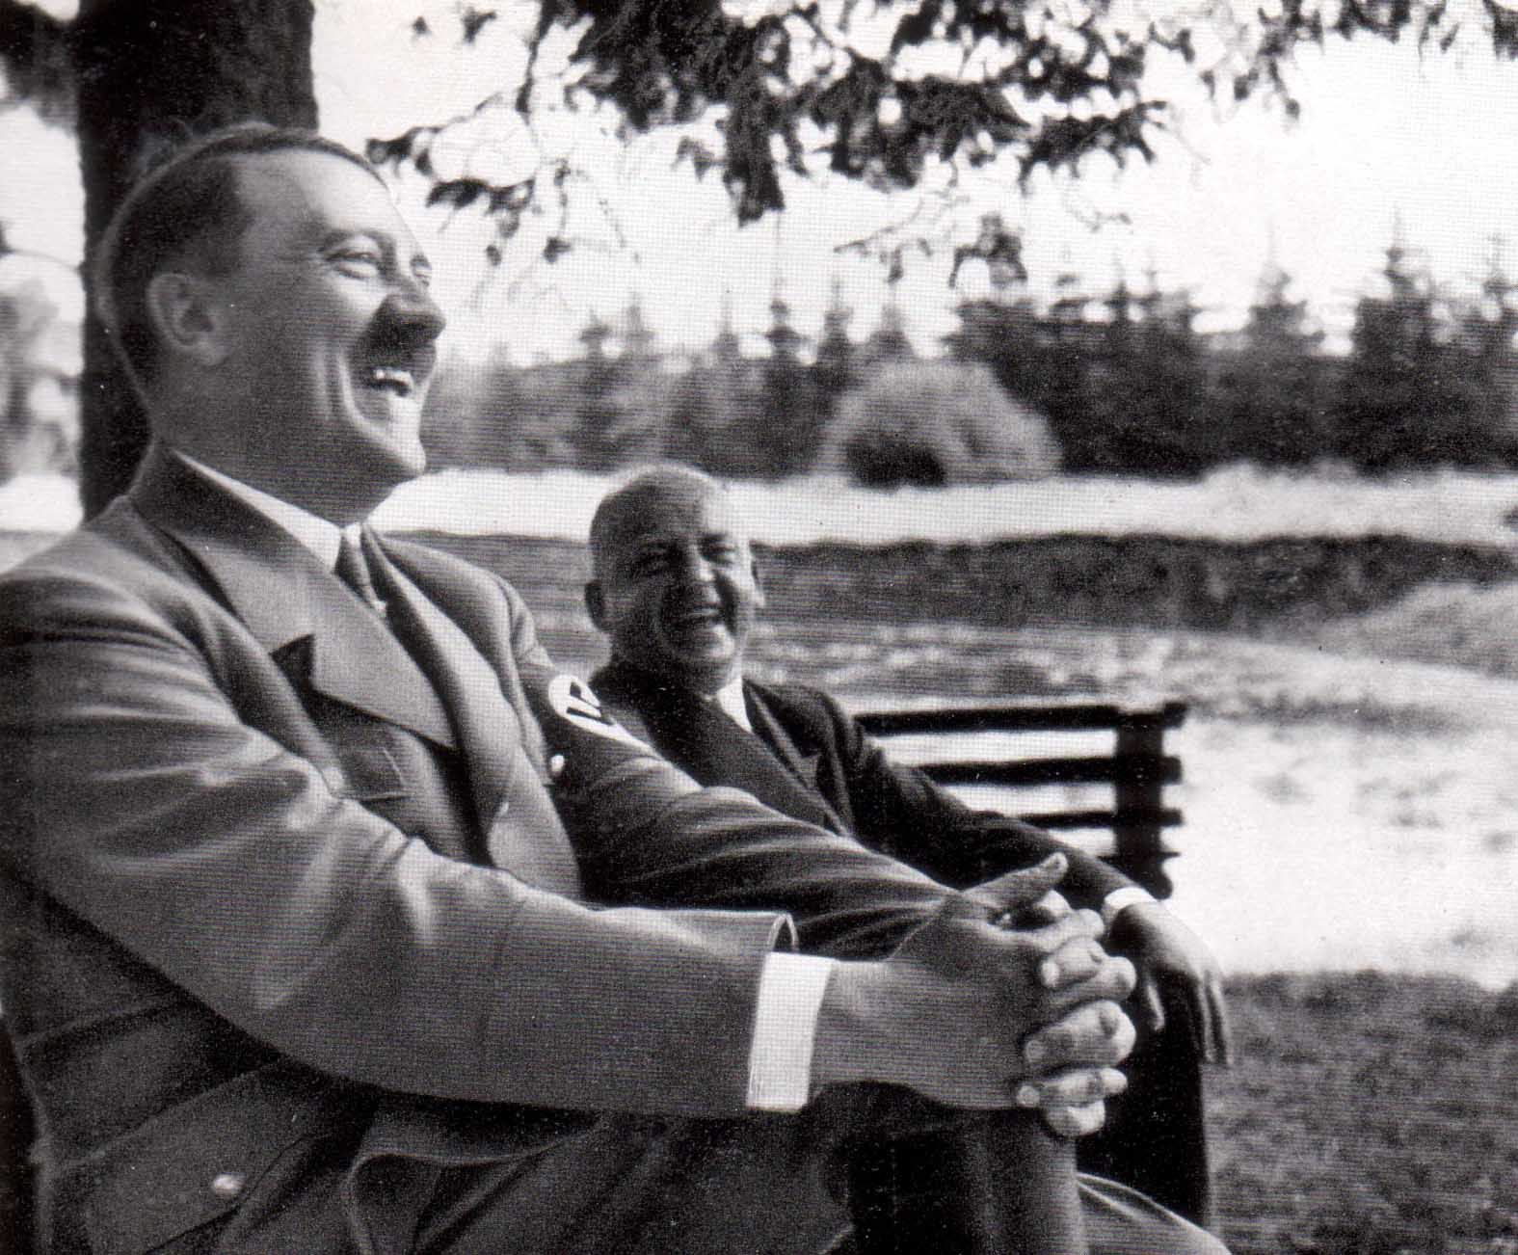
“Strength lies not in defense but in attack.” –Adolf Hitler

Slide 13
Becoming Chancellor
In 1932, Hitler was granted German citizenship. On January 30, 1933, Hitler was appointed chancellor, which he took advantage of to have full power over Germany. When Germany’s president died in 1934, he was able to do so. Adolf Hitler then became Leader and Reich Chancellor.

Slide 14
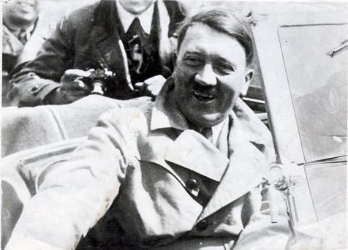
“We will meet propaganda with propaganda, terror with terror, and violence with violence.” – Adolf Hitler

Slide 15
Dictator
As Hitler was then dictator of Germany, his plan was to expand Germany’s land and expand strengthen their army. Even though it was breaking the Treaty of Versailles, other countries still allowed it to avoid a European war and he was able to get away with his plans. The Nazi Germany attacked Poland on September 1, 1939, and then World War 2 began. One of Hitler’s top military officers had placed a suitcase bomb under the table during a conference meeting at Hitler's Wolf's Lair, causing him to lose a lot of his hearing and injure his arm. Hitler got lucky, a lot of other people in the room were injured much worse or died.

Slide 16
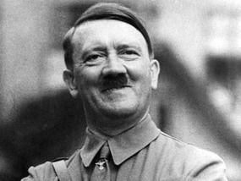
“All propaganda has to be popular and has to accommodate itself to the comprehension of the least intelligent of those whom it seeks to reach.” – Adolf Hitler

Slide 17
Love Life
Hitler kept his love life with Eva Braun mostly a secret. She was rarely seen or heard of in public. They met when Eva was only 17 and were together for about 15 years. Eva was extremely in love with Hitler, it almost seems kind of obsessive from what I’ve read. Hitler did not seem to show as much feelings for her, as she had for him. She once wrote him a letter that included the words “I only live for your love.” and she threatened to commit suicide several times over him. On April 29, 1945, Hitler married his long-time mistress, Eva Braun, and on the following day, April 30, 1945, Hitler and Eva committed suicide together.

Slide 18
Interesting Facts
Hitler never visited even one Concentration camp.
Hitler’s first love was a Jewish girl, but he never had the guts to talk to her.
Hitler had chronic flatulence and took 28 different kinds of drugs to fight it.
In World War 1, a British soldier spared the life of Hitler.
Hitler was a vegetarian and made laws against animal cruelty.
Hitler was saved from drowning by a priest when he was four years old.
When Hitler was in prison, he wrote to a Mercedes dealership and begged for a car loan.
Hitler was nominated for a Nobel Peace Prize in 1939.
When Hitler was a child, he wanted to be a priest.
Hitler's mustache has also been nicknamed the "toothbrush mustache"
When Hitler’s associate Ernst Hanfstaengl told him that his short mustache was unfashionable, Hitler replied: “If it is not the fashion now, it will be because I wear it.”
In 2009, DNA tests reveled that the skull fragment long thought to have been Hitler’s is that of an unknown woman under 40. Scientists don’t believe the skull belongs to Evan Braun because she committed suicide by cyanide rather than with a gun.
Hitler’s parents were second cousins.
Hitler was born on Easter.
Hitler murdered 11 million people, which includes 6 million Jews. Overall, between 50-70 million people died during WWII.
Hitler apparently ate up to two pounds of chocolate a day.
Hitler was said to of had Parkinson’s disease.

Slide 19
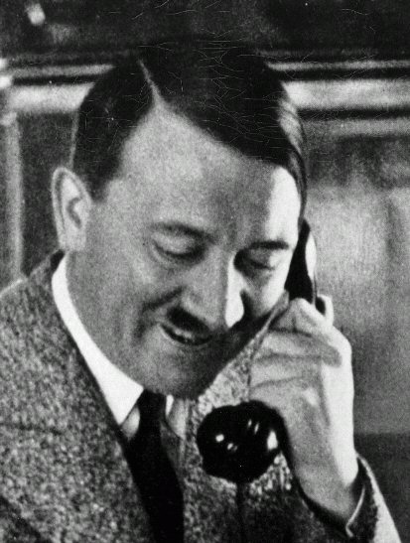
"It is not truth that matters, but victory.“ – Adolf Hitler

Slide 20
Sources
http://history1900s.about.com/od/hitleradolf/a/Hitler-Facts.htm
http://www.biography.com/people/adolf-hitler-9340144
http://www.history.ucsb.edu/faculty/marcuse/classes/33d/projects/naziwomen/eva.htm
http://www.factslides.com/s-Hitler

