Slide 1
D-Day

Slide 2
Invasion Of Normandy
The Invasion of Normandy was the invasion and establishment of Western Allied forces in Normandy, during Operation Overlord in 1944 during World War II. At the time it was the largest amphibious invasion to ever take place.
D-Day, the date of the initial assaults, was Tuesday 6 June 1944 and Allied land forces that saw combat in Normandy on that day came from Canada, the Free French Forces, the United Kingdom, and the United States. In the weeks following the invasion, Polish forces also participated, as well as contingents from Belgium, Czechoslovakia, Greece, and the Netherlands.

Slide 3
Planning Of Invasion
Allied forces rehearsed their roles for D-Day months before the invasion. On 28 April 1944, in south Devon on the English coast, 638 U.S. soldiers and sailors were killed when German torpedo boats surprised one of these landing exercises, Exercise Tiger.
In the months leading up to the invasion, the Allied forces conducted a deception operation, Operation Fortitude, aimed at misleading the Germans with respect to the date and place of the invasion.

Slide 4
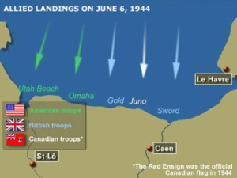
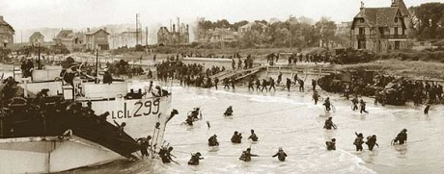

Slide 5
Statistics
There were about 155,000 soldiers, 5,000 ships and landing craft, 50,000 vehicles and 11,000 planes set for the coming battle.
For Canada, 14,000 soldiers were to land on the beaches; another 450 were to drop behind enemy lines by parachute or glider. The Royal Canadian Navy supplied ships and about 10,000 sailors.

Slide 6
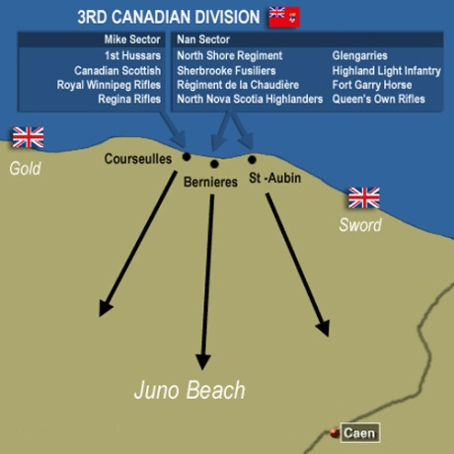

Slide 7
Code Names
The Allies assigned codenames to the various operations involved in the invasion. Overlord was the name assigned to the establishment of a large-scale lodgment on the northern portion of the Continent. The first phase, the establishment of a secure foothold, was codenamed Neptune. According to the D-day museum:

Slide 8
Naval Participants
The invasion fleet was drawn from eight different navies, comprising 6,939 vessels: 1,213 warships, 4,126 transport vessels (landing ships and landing craft), and 736 ancillary craft and 864 merchant vessels.
The overall commander of the Allied Naval Expeditionary Force, providing close protection and bombardment at the beaches, was Admiral Sir Bertram Ramsay.

Slide 9
Atlantic Wall
Standing in the way of the Allies was the English Channel, a crossing which had eluded the Spanish Armada and Napoleon Bonaparte's Navy. Compounding the invasion efforts was the extensive Atlantic Wall, ordered by Hitler in his Directive 51. Believing that any forthcoming landings would be timed for high tide (this caused the landings to be timed for low tide), Hitler had the entire wall fortified with tank top turrets and extensive barbed wire, and laid a million mines to deter landing craft. The sector which was attacked was guarded by four divisions.

Slide 10
Facts
The Nazi controlled or occupied much of Europe (East and West) plus Northern
Africa. The Germans had attacked Britain by air and Russia with land forces.
The German invasion of Russia was unsuccessful, and by 1943, the Russia
counterattacked and they were moving towards Germany.
The Allies had successfully landed in Italy in 1942. The Fascists in Italy had
surrendered Canadians and USA troops were advancing northward.
The German advance in North Africa had been stopped.

Slide 11
Facts Continued
A third front was needed in Western Europe. On 6 June 1944, combined forces from
countries such as Britain, Canada, France, Poland and USA attacked Normandy in
France. The project was called Overlord.
Canadians attacked the Juno Beach section of Normandy between British forces
30,000 Canadian troops were involved. The Canadians were the smallest force In total,
150,000 Allied troops attacked Normandy on D-Day.

Slide 12
Canadian Casualties
On 6 June 1944, Canadians suffered 340 killed, 574 wounded and 47 captured.

Slide 13
Results
The Allies succeeded in capturing the Normandy beach and establishing a beachhead
in France, creating a new front to launch an offensive attack in Western Europe that
would eventually lead to the liberation of Europe and the end of WWII in Europe.

Slide 14
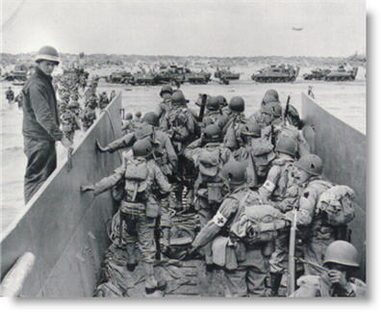
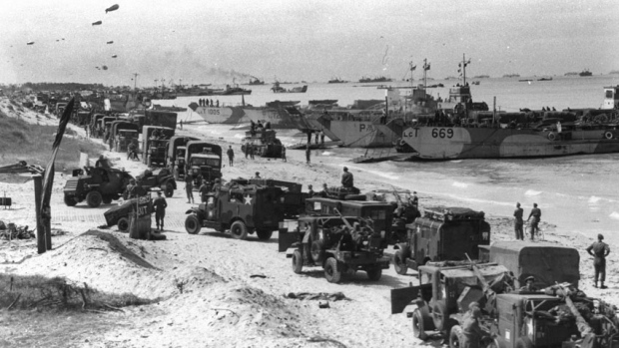
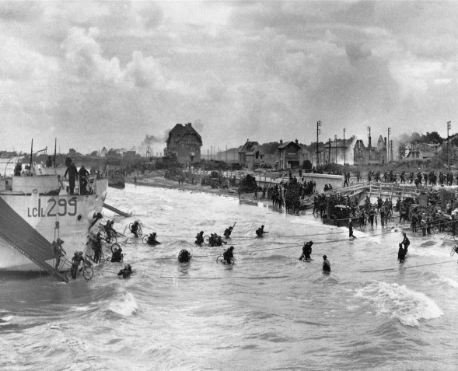
Pictures

Slide 15
Sources
http://fcweb.limestone.on.ca/
http://www.historyguy.com/normandy_links.html
http://www.history.navy.mil/photos/events/wwii-eur/normandy/normandy.htm
http://www.thecanadianencyclopedia.com/articles/normandy-invasion

Slide 16
BY: AUSTIN

