Slide 1
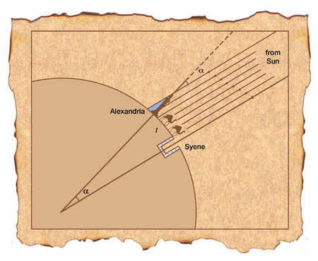
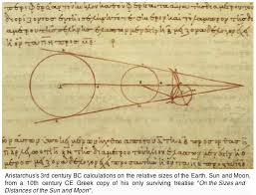
Greek science

Slide 2
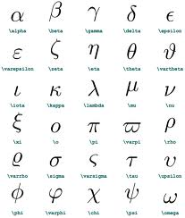
Ancient Greek mathematicians
As the Egyptians and other country's at the time the Greeks had their own writing style that was similar to the Phoenician alphabet.

Slide 3
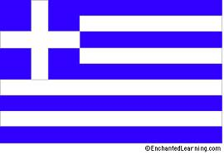
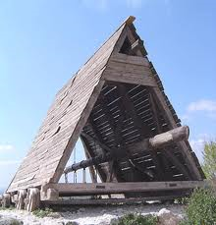
Engineers
One of the engineers was named Epimachus of Athens he built unique siege weapons these siege weapons was a large battering ram over 60 meters long, and are were a head of the other sieges technology of it time giving the Greeks an advantage in the wars to come.

Slide 4
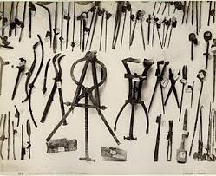
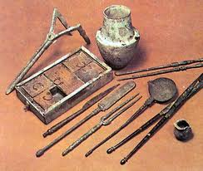
The ancient Greeks looked at illnesses as a punishment, and healing was a gift from the gods. and by the 5th century they tried to recognize the medical cure for a illnesses rather then spiritual ones and this helped to a move them away from the fantasy of gods controlling the health of a person.
Medicine

Slide 5
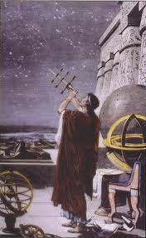
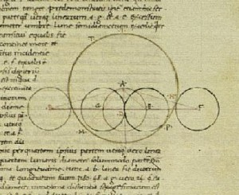
Astronomy
Astronomy is one of the Greeks strong points. Observational astronomy, was the key form of astronomy somewhere else, but was taken a step further in Greece: they tried to build a model of the universe so they could improve their findings.

Slide 6
The end

