Slide 1
Hiroshima and Nagasaki
Laura Watt

Slide 2
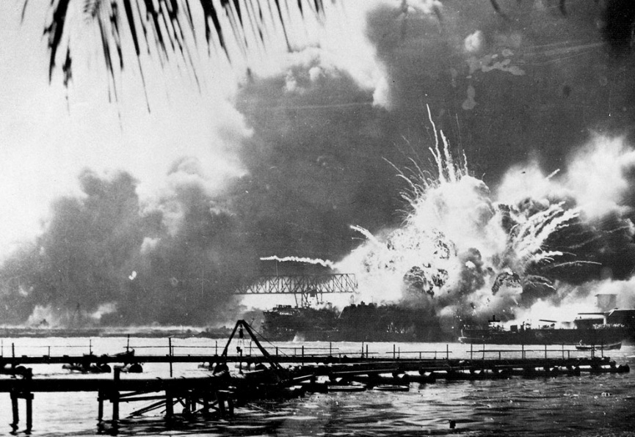
Background Information
Pearl Harbor was a United States Navy deep-water naval base.
Japan bombed Pearl Harbor, Hawaii, in December 7, 1941.
The main goal of the attack was to destroy American
fleet units, preventing the
Pacific Fleet from interfering
with the Japanese invasion of
the Dutch East Indies and
Malaya.

Slide 3
Manhattan Project
The Manhattan Project was a research and development project that produced the first atomic bombs during World War II.
On December 8, 1941, President Roosevelt signed the declaration of war.
Following the attack on Pearl Harbor, The U.S. launched the “Manhattan Project”.
The “Manhattan Project” was a top-secret program established in August 1942, to develop an atomic bomb.

Slide 4
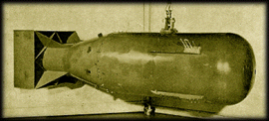
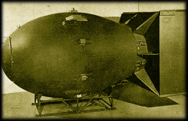
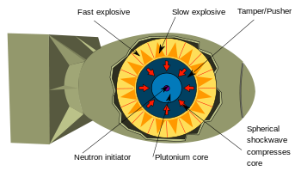
Atomic Bomb

Slide 5
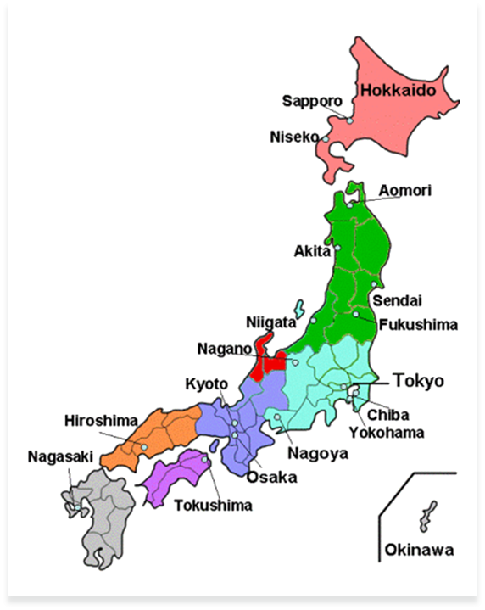
Location
Hiroshima and Nagasaki are two cities in Japan.
They were two of the four options(Kokura and Niigata were the other two).

Slide 6
Hiroshima
Japan refused to agree to the Potsdam Declaration, an ultimatum for Japan to surrender completely or be faced with “prompt an utter destruction”, issued by President Harry S. Truman and allied leaders Josef Stalin and Clement Attlee.
Hiroshima was bombed by the U.S. Army Air Forces on August 6, 1945.
The Enola Gay dropped the atomic bomb Little Boy on Hiroshima.
Hiroshima was named the primary target on August 2, because it was thought to be the only city without Allied prisoner-of-war camps.
On August 6, the sky above Hiroshima was clear.

Slide 7
Hiroshima: The Aftermath
62 000 buildings destroyed
20 of 200 doctors were alive or capable of working
150 of 1 780 nurses remained alive or capable of working
Around 80 000 people were killed instantly.
The radiation and injuries brought the death total to about 90 000 – 140 000 by the end of the year
An estimated 69% of the city’s buildings were completely destroyed, and another 7% damaged.

Slide 8
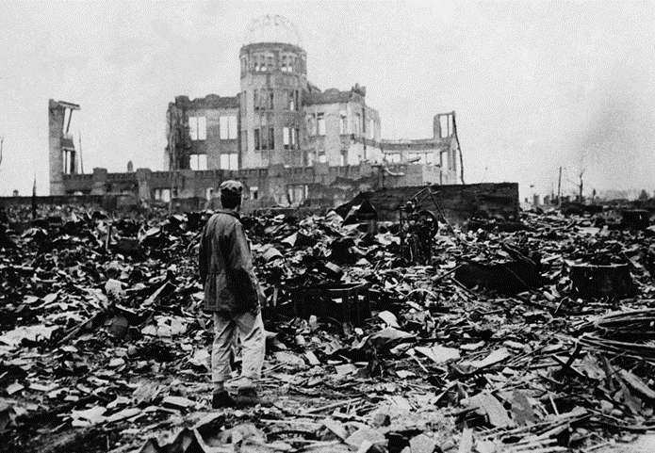
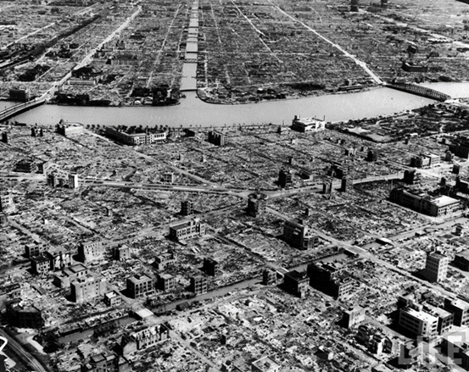
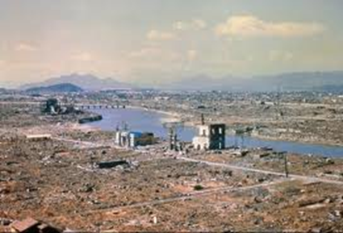
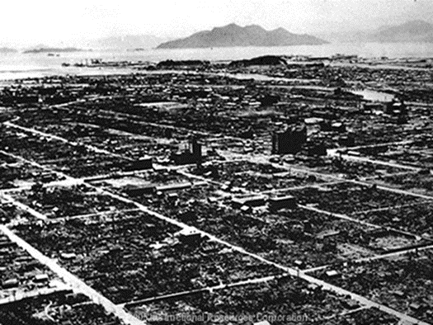
Hiroshima: The Aftermath

Slide 9
Nagasaki
After the bombing of Hiroshima, Japan still refused to agree with the Potsdam Declaration.
On August 9, 1945, The second atomic bomb was dropped on Nagasaki.
The plane Bockscar dropped the atomic bomb Fat Man on Hiroshima.
Following the Nagasaki bombing, Japan agreed to the Potsdam terms and surrendered to the U.S. on August 14.

Slide 10
Nagasaki: The Aftermath
Following the Nagasaki bombing, Japan agreed to the Potsdam terms and surrendered to the U.S. on August 14.
August 14 is known as V-J Day(Victory in Japan), marking the end of World War 2.
87 000 people died in the bombing and the next few years following the bombing
70% of the city's industrial zone destroyed

Slide 11
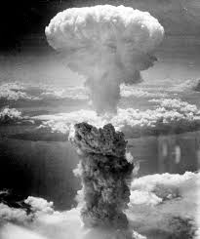
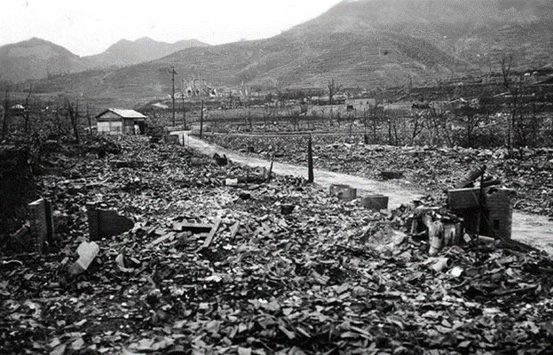
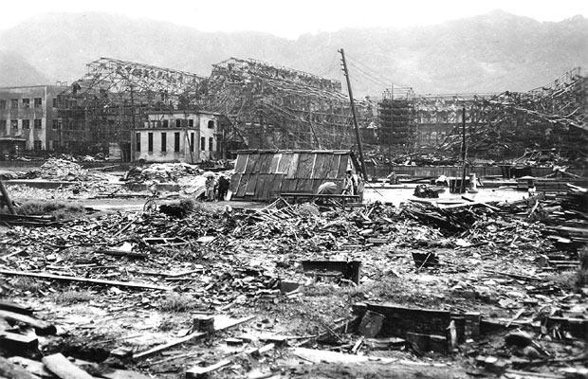
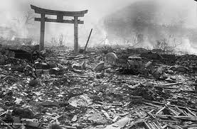
Nagasaki: The Aftermath

Slide 12
Sources
http://history1900s.about.com/od/worldwarii/a/hiroshima.htm
http://www.history.com/this-day-in-history/american-bomber-drops-atomic-bomb-on-hiroshima
http://en.wikipedia.org/wiki/Atomic_bombings_of_Hiroshima_and_Nagasaki
http://www.eyewitnesstohistory.com/hiroshima.htm
http://en.wikipedia.org/wiki/Hiroshima
http://en.wikipedia.org/wiki/Nagasaki
http://learning.blogs.nytimes.com/2011/08/09/aug-9-1945-u-s-drops-atomic-bomb-on-nagasaki-japan/?_r=1
http://www.pcf.city.hiroshima.jp/virtual/VirtualMuseum_e/visit_e/est_e/panel/A2_2/2201.htm
http://www.theatlantic.com/infocus/2011/10/world-war-ii-the-fall-of-imperial-japan/100175/
http://en.wikipedia.org/wiki/Pearl_Harbor
http://www.historylearningsite.co.uk/bombing_of_nagasaki.htm

