Slide 1
Olympia games
By: Robbie, Tim and Catherine

Slide 2
History
The first Olympic Games can be traced all the way back to 776 BC.
They continued for about 12 centuries, until Emperor Theodosius decreed in 393 A.D. that all "pagan cults" were banned
The Olympic Games were closely linked to the religious festivals of the cult of Zeus

Slide 3
Mythology
Zeus- was considered the most important of all the Olympic gods. He was originally worshipped as a god of meteorological change
Hera- was the sister and wife of Zeus and was worshipped all over Greece, but especially in the region of Argos.
Athena-The ancient Greeks believed that Athena was miraculously born out of the head of Zeus. She was first worshipped in the palaces of the Achaean rulers in the Pre-Hellenistic period
Apollo- was the god of moral order and music, but his main capacity was to protect the art of divination. This is revealed by the plethora of oracles in various regions of Greece, the most famous being the oracle of Delphi, in Fokis.

Slide 4
Olympic Games
The ancient Olympic Games were initially a one-day event until 684 BC, when they were made to three days. In the 5th century B.C., the Games were then made to cover five days.
The ancient Games included running, long jump, shot put, javelin, boxing, pankration and equestrian events.

Slide 5
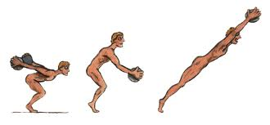
Jumping
Athletes used stone or lead weights called halteres to increase the distance of a jump. They held onto the weights until the end of their jump, and then threw them backwards.

Slide 6
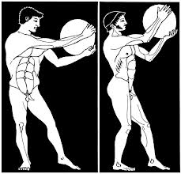
Discus throw
The discus was originally made of stone and later of iron, lead or bronze. The technique was very similar to today's freestyle discus throw.

Slide 7
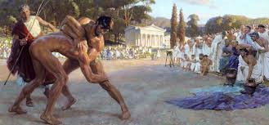
Wrestling
This was highly valued as a form of military exercise without weapons. It ended only when one of the contestants admitted defeat or even death

Slide 8
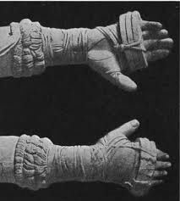
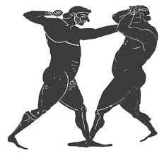
Boxing
Boxers wrapped straps around their hands to strengthen their wrists and steady their fingers. Initially, these straps were soft but, as time progressed, boxers started using hard leather straps, often causing the opponents face to be disfigured.

