Slide 1
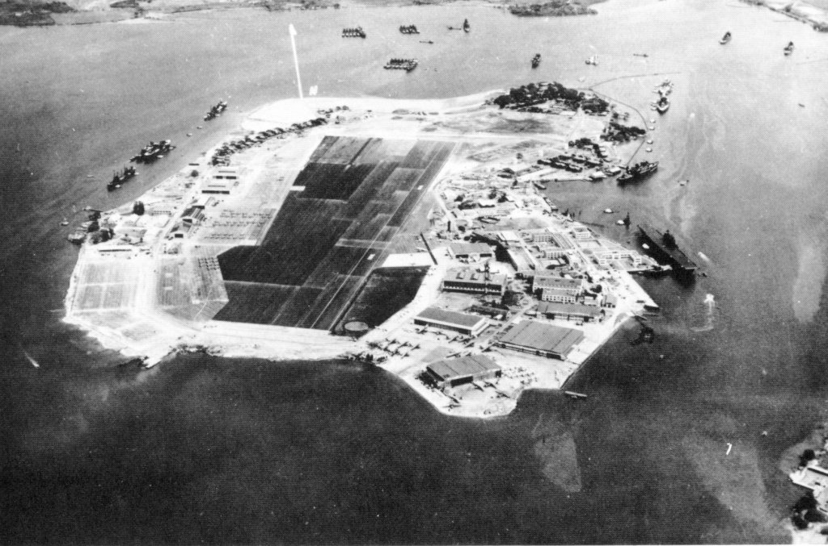
Pearl Harbor
By: Jenna Porter

Slide 2
Before
19th century, wasn’t used for large ships
Its entrance was too shallow
It was used for whaling and trading ships.
In 1841 the naval base was made for protection for whaling ships.
In 1896 the harbor was given 50,000 by congress to deepen the harbor.

Slide 3
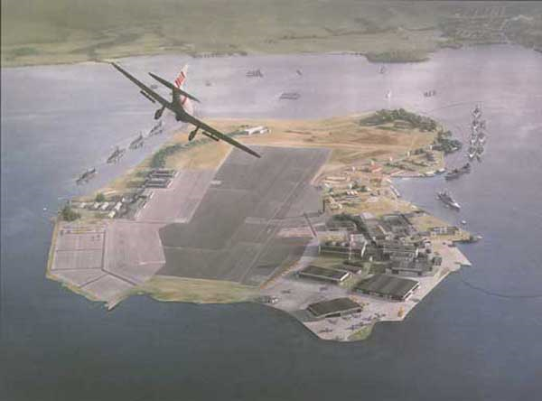
What is it?
Largest natural harbor in Hawaii
United States deep water navy base
also a
headquarters
and Pacific
Fleet

Slide 4
Where is it?
island of Oahu, Hawaii
west of Honolulu
Surrounding lands of the harbor is a US Navy deep water naval base.

Slide 5
The Attack
The attack was by the Empire of Japan
Sunday December 7. 1941
It lasted 2 hours but was devastating
Brought the United States into WWII
Day after President Franklin D. Roosevelt asked to declare war on Japan.

Slide 6
The attack
Surprise attack by the Imperial Japanese Navy
The attack came in two waves first was at around 7.45 am 7 ships destroyed also hitting airfields destroyed many air craft.
Second wave more planes attacked also more ships were bombed again for 2nd time.

Slide 7
Reason for attack
Japan was at war with China and they used most of their resources during this time
Most resources were coming from the US
US declared an embargo on Japan which means they would stop supplying Japan with materials
Japan had to find resources elsewhere so they decided they would attack the Dutch East Indies

Slide 8
Continued..
US wouldn’t approve of this and Japan knew this would bring US into war
This attack was a way to prevent the US from fighting until Japan got the Dutch East Indies

Slide 9
The Damage
Destroyed 20 American naval vessels
8 battleships
200 airplanes
2000 American soldiers and sailors died and an addition 1000 were wounded

Slide 10
USS Arizona Memorial
Built in 1962
Remains a military base, headquarters, pacific Fleet and historical landmark
Marks the resting place of 1102 sailors and marines killed
It holds the sunken hull of the battleship

Slide 11
Parts of the memorial
Entry: has 3 anchors of the Arizona displayed
Assembly room: contains large open windows to commemorate the date, total of 21 windows
Shrine: contains a marble wall that has all the names of those who were killed, there's also a plaque which has the names of the 30 survivors
Opening in the floor overlooking the sunken deck

Slide 12
Interesting Facts
The design of the memorial has two peaks at each end and a sag in the center
This represents the pride before the war, the sudden depression of the attack and the rise of power after the war
Pearl harbor was originally called Wai Nomi (meaning “pearl water”)

Slide 13
Sources
http://www.history.com/topics/pearl-harbor
http://www.pearlharboroahu.com/attack.htm
http://en.wikipedia.org/wiki/Pearl_Harbor
http://en.wikipedia.org/wiki/USS_Arizona_Memorial

