Slide 1
Propaganda
By: Taylor and Donelle

Slide 2
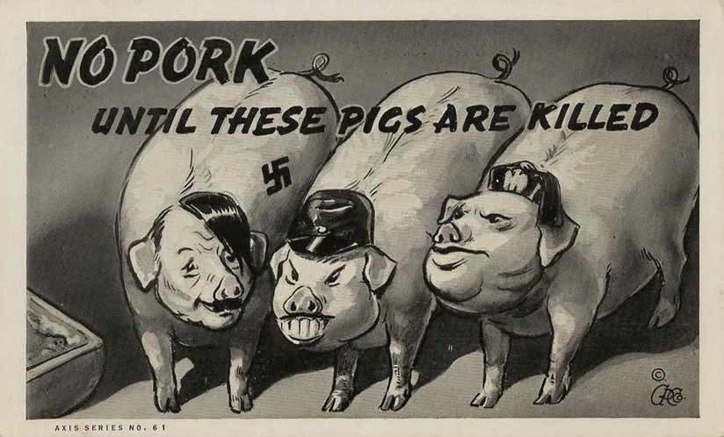
What is propaganda?
Propaganda is certain information of a misleading nature, used to promote a political cause or point of view
A political strategy
Spreading of a rumor for a purpose of helping or injuring a person/cause
Ideas or allegations spread for ones cause to deliberately damage opposing side

Slide 3
Forms of Propaganda
Bandwagon – high value of “joining the party”
Name calling – degrading opponents
Testimonial – an independent person being seen as trustworthy
Transfer – Associate the leader with trusted others
Plain Folk – use of everyday people for the selling of a product or service
Glittering Generalities – Act of referring to words that have a positive emotional response from an audience
Card Stacking – Showing the products best features and telling half-truths by lying about its potential problems

Slide 4
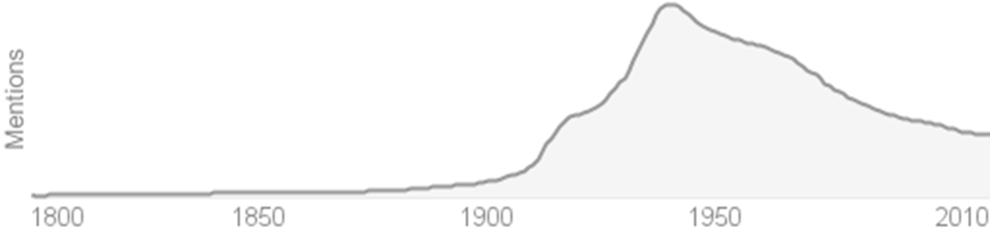
How did it start?
Needed people to join the army
Couldn’t make people join so they persuaded them through propaganda
Wars had good reason to use propaganda
Persuaded people to join and hid the horrors and failure at the front lines (used to mislead and distract people from the truth)

Slide 5

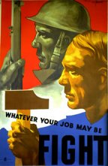


Canada and propaganda
Canada was very unprepared for a second World War in 1939, and had just begun to recover from the severe 10-year depression
The Bureau of Public Information and later the Wartime Information Board undertook a propaganda campaign for support of the upcoming war
Inexpensive to make and produced in a short period of time
over 700 posters were printed in sizes that appeared on everything
The posters were very successful and eleven Victory Bond campaigns raised over $8,000,000,000 for support of the war
1,086,343 men and women to work full time in three
services
1,239,327 working in war industries
Notes:
billboards, shop windows, streetcars, buses, theatres, and matchbox covers

Slide 6
Modern day propaganda
http://www.youtube.com/watch?v=PDT-LN5-Edw

Slide 7
References
http://quizlet.com/2472312/7-types-of-propaganda-flash-cards/
http://www.airmuseum.ca/postscan.html
http://library.thinkquest.org/C0111500/ww2/app.htm

