Slide 1
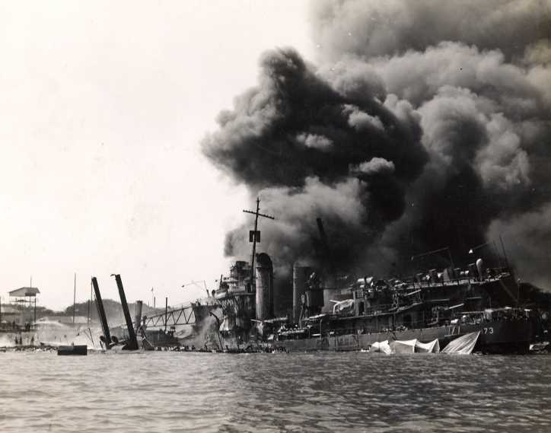
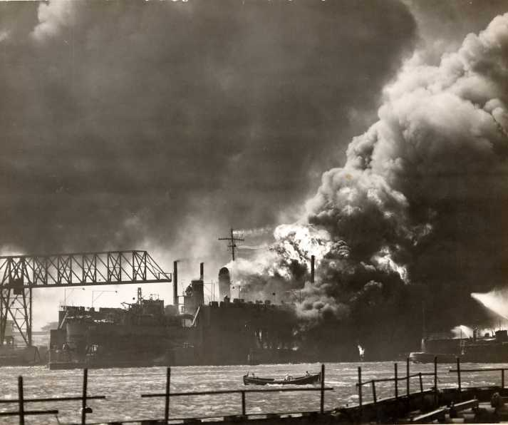
Pearl Harbor Bombing
Liam and Christopher

Slide 2
Video
http://military.discovery.com/tv-shows/world-war-ii-in-color/videos/world-war-ii-in-color-pearl-harbor-attacked.htm

Slide 3
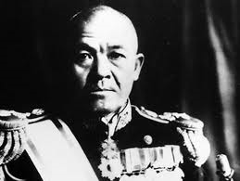
Information
December 7th 1941 was a day no American will forget
Japan launched a surprise military strike on the U.S Naval base at Pearl Harbor in Hawaii.
Japanese commander Admiral Nagumo, was expecting to hit the entire fleet on the base.
Fortunately for the U.S, not all of the aircraft carriers, and one of the battle ships were not in port.
Aircraft Carriers were his main target.

Slide 4
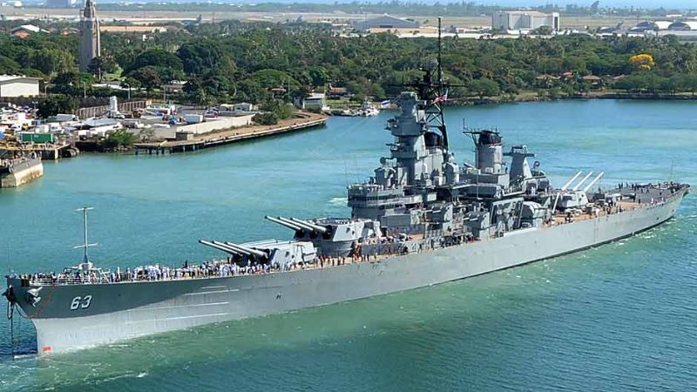
Bombs Away
Continued to attack and was about to launch his 1st wave of the 2 waves to be sent at the port.
First wave consisted of 183 fighters and torpedo bombers.
They struck the fleet in pearl harbor and they had also attacked the airfields in Hickam, Kaneohe and Ewa.
Second wave had been released and had 167 aircrafts, which then struck the exact same places as the first wave.

Slide 5
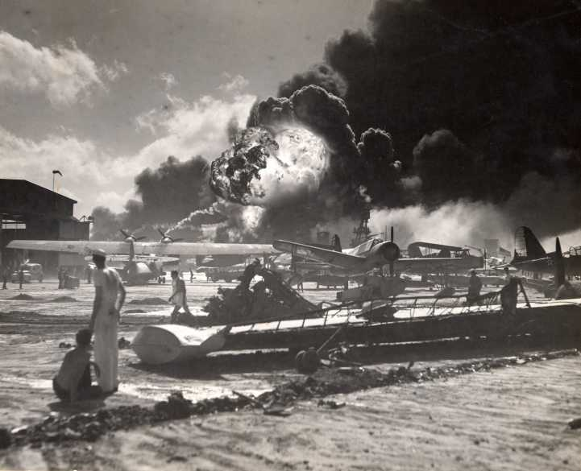
After 2 hours of bombing, more than 2400 Americans had died.
21 ships had either been sunk or damaged.
More than 188 U.S Aircrafts were destroyed.

Slide 6
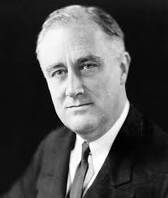
This attack on Pearl Harbor was how the United States entered Word War II.
President Roosevelt declared war the following day Japan had bombed them.

Slide 7
Japan attacked because they were tired of the negotiations with the U.S
But the main reason for the attack was over economic issues.
Negotiation's weren’t going so well
The Japanese were interested in the Hawaiian islands since the islands were especially important to the U.S. since 1898.

Slide 8
Japan wanted to continue their expansion on Asia, while the United States were placing restrictions on them, hoping to stop Japans aggression.
Although the attack on Pearl Harbor was a surprise from the Japanese the U.S and Japan were edging towards war for decades.

Slide 9
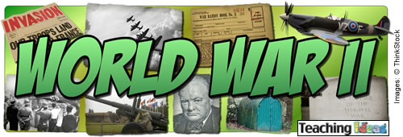
3 days later, on December 11th, Japans biggest allies, Germany and Italy declared war on the United States
The U.S responded immediately by declaring war on Germany and Italy.

Slide 10
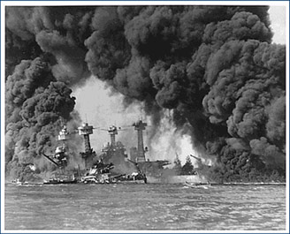
Pearl Harbor Bombing Scene
http://www.youtube.com/watch?v=Sv1niwxQgoY

Slide 11
Sources
http://history1900s.about.com/od/worldwarii/a/Attack-Pearl-Harbor.htm
http://en.wikipedia.org/wiki/Attack_on_Pearl_Harbor
http://www.defraudingamerica.com/navy_japanese_attack.html
http://military.discovery.com/tv-shows/world-war-ii-in-color/videos/world-war-ii-in-color-pearl-harbor-attacked.htm
http://www.youtube.com/watch?v=Sv1niwxQgoY

