Slide 1
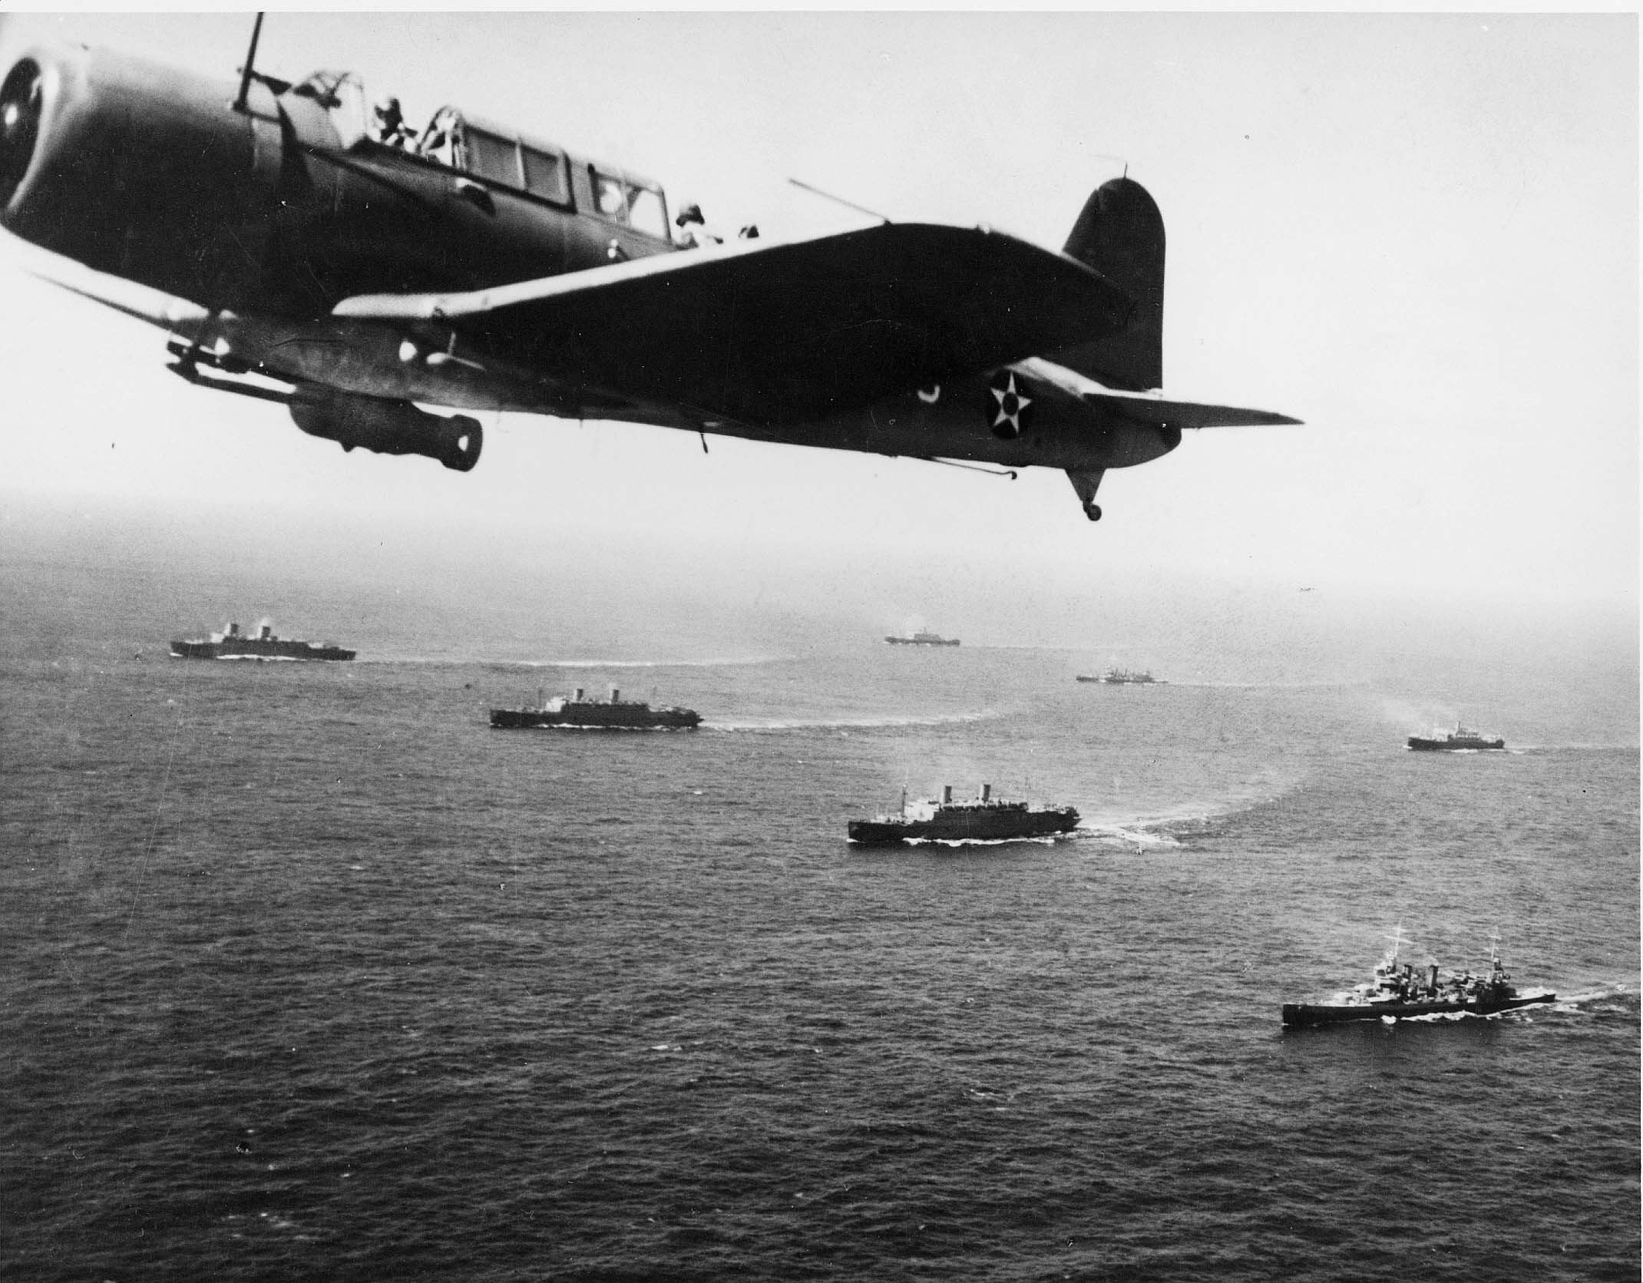
The Battle of the North Atlantic
By: Matthew Dickson

Slide 2
The Objective and how it Started.
Since America became allies with Great Britain, The U.S was bringing supplies over to them.
Germany wanted to stop the merchant transport to great Britain.
They thought that Britain would run out of supplies and starve. This would force them to surrender.
On September 3 1939, just after Britain declared war on Germany, German submarines sunk the British passenger ship Athenia. Killing 112 British civilians. This was the beginning of the actual Battle of the Atlantic.

Slide 3
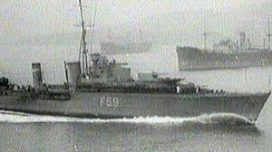
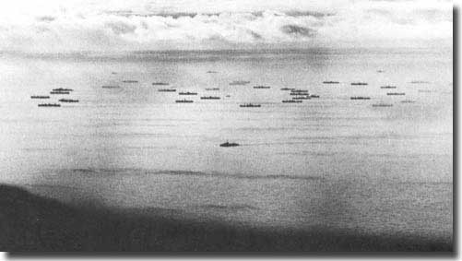
Length and Basic info
The Battle of the North Atlantic was one of the longest battles of the second world war, and one of the most important. The war broke out in September 1939 and ended in August 1945.

Slide 4
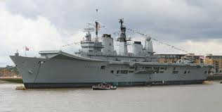
Info continued
Germany realised how critical the shipping lanes were between America and the U.K. They realised that if they could sink and stop ships from bringing goods and food over to Britain that Britain would have nothing. Britain also knew how critical , being the island that they are, that if it was cut off, they would have no access to anything other than by ship.
German U-boat U-47 snuck
into British naval base, sinking
the famous HMS Royal Oak,
killing 833 people.

Slide 5
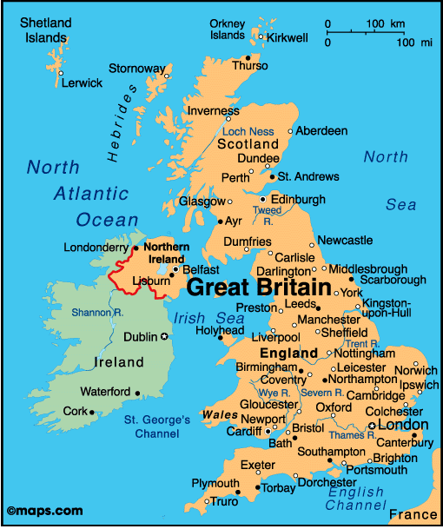
Island of the U.K

Slide 6
Info continued
In 1940 the fall of France gave Germany an all new place to dock and manufacture U-boats. It was closer to the Atlantic and gave Hitler an all new view on how this war was going to plan out.
Since this was near the U.K and on the Atlantic ocean, this gave Hitler new opportunities to take out merchant ships going to the U.K.
By March of 1943, the German U-boats were matched. With Merchant ships armed and new sonar built, U-boats were one of the biggest targets, along with there building sites.

Slide 7
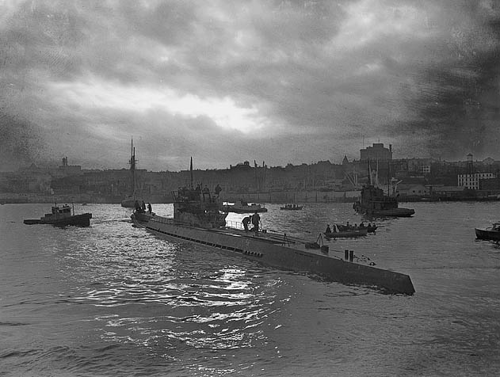
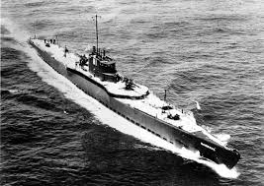
The Germans wolf pack
German submarines travelled in wolf packs. A wolf pack is a group of submarines. It can range from 5 to around 35 or 40 submarines. These wolf packs would sink merchant ships together making it easier to win the battle.
Over the winter of 1940-1941, German submarines sank roughly 250,000 tons of British shipping per month.
Merchant ships were usually unarmed, making them an easy target, and easy goods due to the wolf pack.

Slide 8
Continued.
Since there was only one type of sonar detection system then, (The Allied Submarine Detection Investigation Committee), it was very hard to spot these submarines in the water. When the U-boats are near the top of the water in the dark, or in the fog, it is nearly impossible to track them on radar or even see them.
When the war got tougher, Escort boats were assigned to convoys and were equipped with a higher level sonar that could detect U-boats anywhere. This could easily be told to other ships through radio communication. This nearly put the end to the German silent wolf packs.

Slide 9
Important events
Athenia, a British passenger ship is sunk (September 3rd 1939)
Only 27 U-Boats make up the German wolf pack at this time (January 1st 1940)
German boats begin launching from captured French Naval bases (July 6th 1940)
German U-boats are given the order to sink all Merchant Ships (August 17th 1940)
The first escorted convoy crosses the Atlantic to the U.K. (May 27th 1941)
German U-boat fleet has around 331 operational U-boats now. (January 1sst 1942)

Slide 10
Important Events continued
Most cargo lost in a month. 824, 000 tons of goods at the bottom of the Atlantic ocean. (June 1st to June 30th 1942)
American and British Aircraft are fitted with U-boat detecting systems. (May 1st 1943)
43 German U-boats are sank.(May 1st to May 31st)
German Admiral Karl Donitz backs off with the U-boats on (May 24th 1943) and puts them back out on (June 1st 1943)
D-day happens in France and leaves the U-boat bases there not able to operate.
By May 1st 1945 Germany is defeated in the Atlantic. Completing the Battle of the Atlantic. (May 1945)

