Slide 1
Hiroshima
By: Jalen Bowers

Slide 2
Before the Bombings
The US, with assistance from the UK, and Canada, developed the worlds first two atomic bombs, under what they called, ‘The Manhattan Project.’
The project employed over 130,000 people, and the US over $2 Billion dollars.
US President Truman made the decision to drop the bombs. He stated that his intention were to “Bring about a quick resolution of the war by inflicting destruction, and instilling fear of further destruction that was sufficient to cause Japan to surrender.

Slide 3
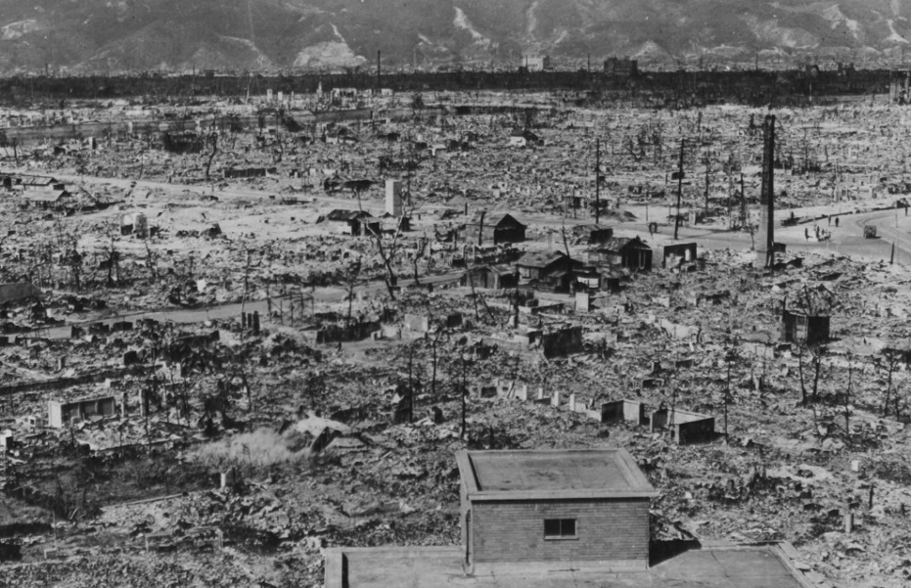
Hiroshima during WW2
During WW2, Hiroshima contained massive stockpiles of military supplies. It was also a very important communications center. It was also a key port for supplies.
Americans knew that the bombing of Hiroshima would result in the loss of WW2 for Japan. Which is why they decided to nuke it, and not another city, like Tokyo.

Slide 4
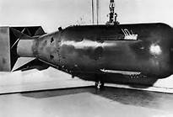
Reasoning for Using the Atom Bomb
The US decided on dropping Atom bombs on Japan for a few main reasons.
They didn’t want to invade, as it was apparent that thousands of American lives would be lost.
They had figured that this bomb would deliver massive damage to Japan, and that it would end WW2.
Japan had declined a declaration stating their surrender. The US’s ultimatum if they declined was that Japan would suffer “Prompt and Utter Destruction”

Slide 5
Delivery of the Bomb
A B-29 Super fortress bomber, named the “Enola Gay” was chosen to drop the first bomb on Hiroshima.
The bomb was dropped on August 6th, 1945, by Paul W. Tibbets & the crew of the Enola Gay.
The bomb was nicknames “Little Boy.” After Elisha Cook Jr.’s character, in the movie “The Maltese Falcon.”

Slide 6
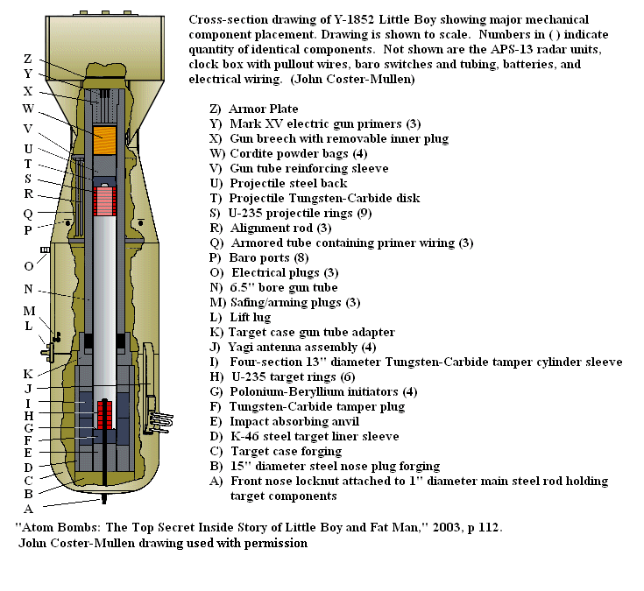

Slide 7
Aftermath
The estimated total of deaths from the bomb, was somewhere in the range of 230,000. Keep in mind this is from the explosion alone. A lot of these deaths occurred when peoples houses collapsed on them.
Of the cities 90,000 some buildings, around 60,000 were destroyed by the explosion. This left the wounded survivors left homeless.
Many died even years later after the bomb dropped, because the radiation was giving many people cancer, & other life threatening health issues.

Slide 8
