Slide 1
Weapons of WWII
By: Luc Manuel and Jacob Vance

Slide 2
World War II was the largest armed conflict in history, spanning the entire world and involving more countries than any other war, as well as introducing powerful new weapons, culminating in the first use of nuclear weapons.

Slide 3
Karabiner 98k
The Karabiner 98k was a bolt action rifle introduced in 1898. It holds 5 rounds of 7.9mm bullets on a stripper clip. It was the primary infantry weapon used by the Germans in both world wars. It has excellent accuracy and a range of 800 meters. Because of this, it was also used with a telescopic sight as a sniper rifle.

Slide 4
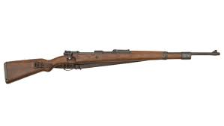
Karabiner 98k

Slide 5
Sturmgewehr 44
The Sturmgewehr 44 was introduced by the German army late in WWII, and was also the world’s first true assault rifle. It was nicknamed the SG44. If the war had continued another year, the SG44 would have took over every other rifle, light machine gun, and sub machine gun in the war. This would happen because the SG44 was a combination of the best elements of all the other guns.

Slide 6
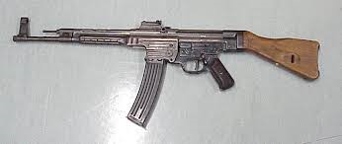
Sturmgewehr 44

Slide 7
MP38/MP40
The MP38 was the standard German sub machine gun of WWII. As the number in its name suggests, it was first issued in 1938. Two years later, the MP38 was replaced by the MP40, which was identical except used less expensive stamped metal for certain parts, which was more cost effective for a mass produced weapon.

Slide 8
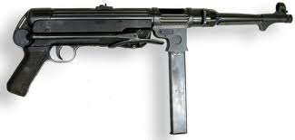
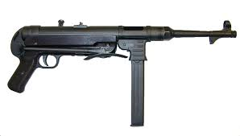
MP38/MP40

Slide 9
Thompson M1
The Thompson M1 was also known as “The Tommy Gun”. The Tommy Gun was designed during World War I by General John T. Thompson and it was available in the .45 caliber automatic colt pistol cartridge. It was used by the US Army during WWII. The Tommy Gun was a sub machine gun that became infamous during prohibition, when gangsters were using them.

Slide 10
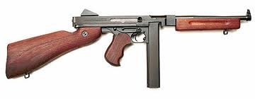
Thompson M1

Slide 11
M1 Garand
The M1Garand was the first semi-automatic rifle to be put in active military service. It was easy to maintain and simple to make, so this was a very convenient weapon. The M1 Garand was used during WWII and The Korean War. It was to the point where The Axis Powers were picking up the M1 Garand’s of dead soldiers and using them to fire at their opponents.

Slide 12
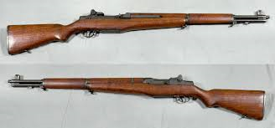
M1 Garand

Slide 13
M1 Carbine
The M1 Carbine is a carbine version of the M1 Garand.

Slide 14
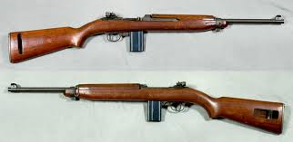
M1 Carbine

Slide 15
Colt M1911
The M1911 is a .45" caliber, single action, semi-automatic handgun, originally designed by John Browning, which was the standard-issue handgun in the combat arm of the US Armed Forces from 1911 to 1985.

Slide 16
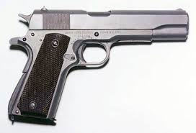
Colt M1911

Slide 17
Parabellum Luger P-08
The Parabellum Luger P-08 is a semi-automatic magazine fed pistol, that operates on the short-recoil principle. The pistol was the standard sidearm for the German Army during both World Wars.

Slide 18
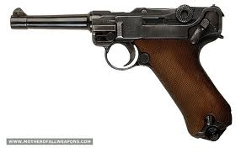
Parabellum Luger P-08

Slide 19
Bazooka
The Bazooka was one of the first ever anti-tank weapons ever used. It was used by the US Army in WWII and was nicknamed a “Bazooka” because of its resemblance to a musical instrument.

Slide 20
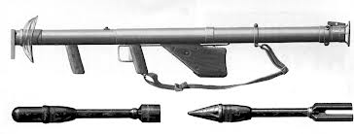
Bazooka

Slide 21
MG34
The Maschinengewehr 1934, known as the MG34, was a German machine gun that was first issued in 1934. The MG34 was used as the primary infantry machine gun during the 1930s, and it remained as the primary tank and aircraft defensive weapon until the end of WWII.

Slide 22
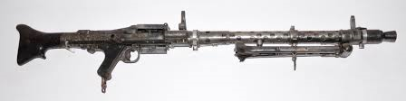
MG34

Slide 23
MG42
The Maschinengewehr 1942, known as the MG42, was the successor of the MG34, and was first manufactured in 1942. During WWII the MG42 fired at 1200 rounds per minute. When in use, the sound of the gun was described both as “ripping cloth” and “Hitler’s Buzzsaw”. They made over 400 000 of these guns during the war.

Slide 24
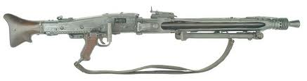
MG42

Slide 25
Bren
The Bren Gun was Britain’s primary light machine gun during WWII. It fired at a rate of 500 rounds per minute, which is much slower than the German’s MG34’s and MG42’s. The Bren Gun only accepted box or drum magazines, which means they also had to reload much more often.

Slide 26
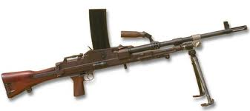
Bren

Slide 27
Sten
The Sten Gun is a submachine gun used by the British Army during WWII. It was super cheap to produce and was visually distinctive because of its very bare appearance, and also because the magazine stuck out horizontally rather than sticking out downwards.

Slide 28
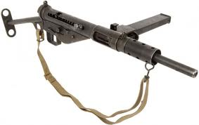
Sten

Slide 29
Lee-Enfield
The Lee-Enfield was the standard rifle for the British Army for much of the 20th century. It was a very simple, but very reliable bolt action rifle.

Slide 30
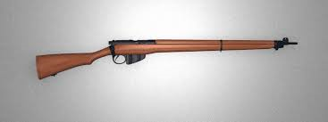
Lee-Enfield

Slide 31
THANKS
FOR
WATCHING

