Slide 1

Canada At War
By Alex Layton

Slide 2
Canada at War?
Canada entered the 1939-1945 War on 10th September 1939.
Canada wanted to remain out of war and appease the Nazi's like all the other governments did at that time realized reluctantly that they had to defeat Hitler at war
Royal Canadian Air Force (RCAF)

Slide 3

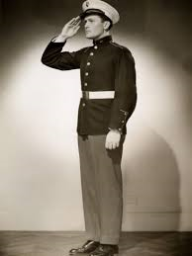
Canada’s commitment
When Britain was at war, Canada was also at war automatically. But Canadians would determine the extent of their own commitment.
In the war 619,000 Canadians in the Expeditionary Force
before Pearl Harbor, apparently a lot of US men went north to join up with the Canadians

Slide 4
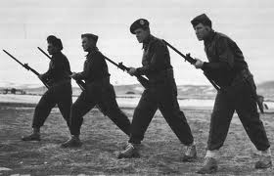
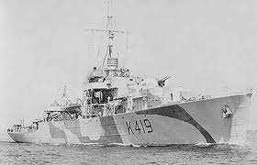
Canada War On Sea and land
the Royal Canadian Navy (RCN)
grew to a strength of nearly 100,000 personnel and nearly 400 vessels
Canada’s land force
The Cost of Battle
Some Canadian units played a prominent part in the liberation of the Netherlands while others went on to participate in the Battle of Germany

Slide 5
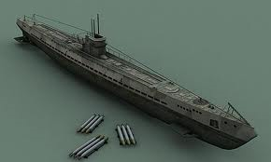
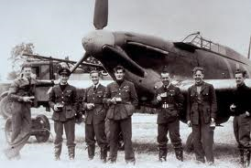
Canada’s Air Force
Royal Canadian Air Force (RCAF)
ran the Commonwealth Air Training Plan
based at home was the hunting of U-Boats in the North Atlantic, its most important area of operations was Europe
U-boat, a German submarine.

Slide 6
Canada’s Involvement
•The 1st Canadian Army was instrumental in the Liberation of Holland in May 1945
•More than one million Canadians served in the Second World War and approximately 45,000 gave their lives.
Video on WW2 http://www.youtube.com/watch?v=1ew20QbPvOE

Slide 7
Sources
http://www.warmuseum.ca/cwm/exhibitions/guerre/canada-at-war-e.aspx
http://www.mta.ca/library/courage/canadasroleinwwii.html
youtube.com

