Slide 1
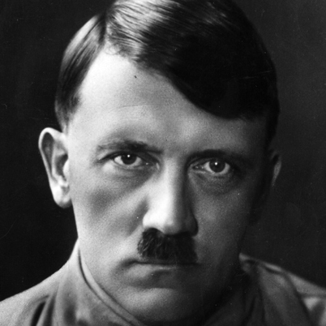
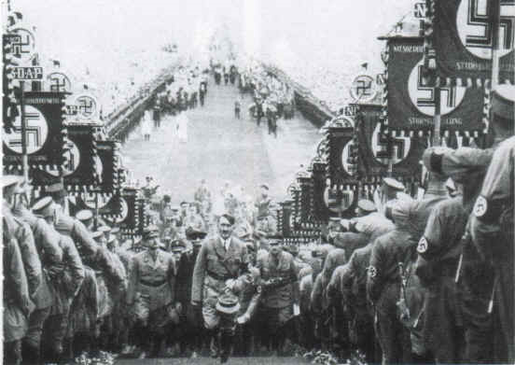
Adolf Hitler
By: Carlie and Alanna

Slide 2
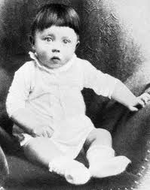
Background Info
Born in Braunau am Inn, Austria, on April 20, 1889
The young Hitler was a resentful, discontented child
Hitler was the son of a fifty-two-year-old Austrian customs official, Alois Schickelgruber Hitler, and his third wife, a young peasant girl, Klara Poelzl
Hitler had dreams of becoming a painter when he was sixteen.
In Vienna he got his first education in politics

Slide 3
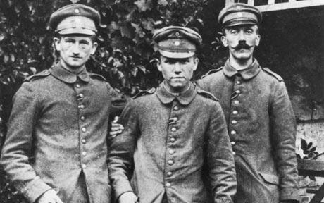
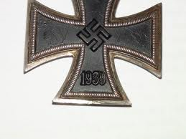
First World War
Hitler left Vienna for Munich in 1913
Hitler joined the Sixteenth Bavarian Infantry Regiment, when war broke out in 1914, (served as a dispatch runner.)
Hitler received the Iron Cross (First Class) for bravery, but he didn’t rise above Lance Corporal.
Hitler thought that fate chose him to rescue the nation from the Treaty of Versailles, and Jews.
Hitler was sent to investigate the German’s Workers Party, which led to him later become a part of it, and becoming chairman in 1921

Slide 4
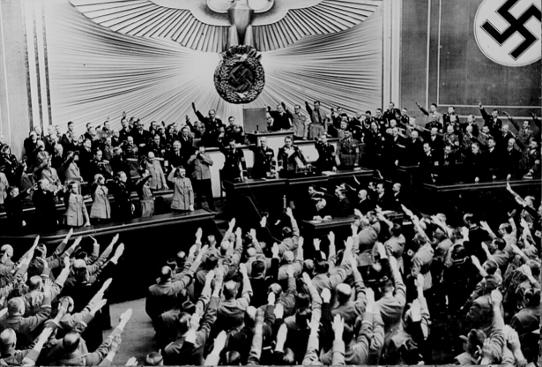
Hitler’s Rise to Power:
Chancellor
First Hitler was in jail for trying to overtake the government by force. While in jail, people began to fear communism because it was on the rise.
Once out of jail Hitler figured the only way he could take the government was by doing it the right way.
He built up an army, and while doing this he gained supporters due to the fact that he told the people he would use his army to protect them from communism.
Many people began to vote for the Nazi’s because of this, and Von Papen told Hindenburg that he Hitler should become chancellor.

Slide 5
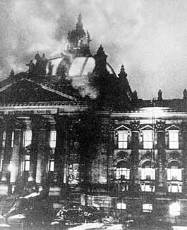
Hitler’s Rise to Power:
The Reichstag Fire
The Reichstag fire happened where the Reichstag building (government building) burnt down, and there was a communist found inside, who admitted to the crime.
Hitler convinced people that Communist were trying to gain power by terrorism.
Hitler got the communists banned from the Reichstag.

Slide 6
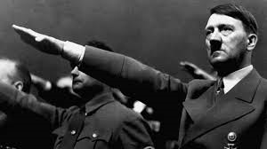
Hitler’s Rise to Power:
Enabling Act
Since the communists were banned from the Reichstag, Hitler was able to pass the Enabling Act.
The enabling Act stated that Hitler could rule by himself for up to four years without consulting the Reichstag.
This permitted him to create his own rules, one of which involved the banning of all other political parties.

Slide 7
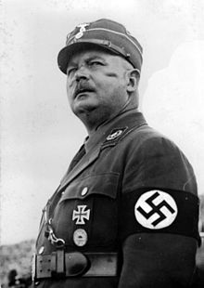
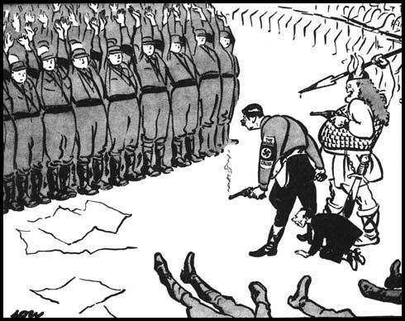
Hitler’s Rise to Power:
The Night of the Long Knives
On June 30th 1934, Hitler’s SS army killed over 1000 members of the SA, including his greatest opposition and old friend, Ernest Rohm.
After this Hitler gained the support of the military.

Slide 8
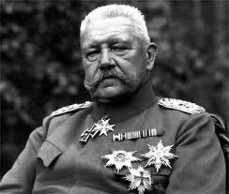
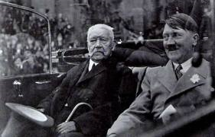
Hitler’s Rise to Power:
Death of President Hindenburg
In August 1934, President Hindenburg died allowing Hitler to take his position.
Hitler already being chancellor, and now president gave him the power he was striving for

Slide 9
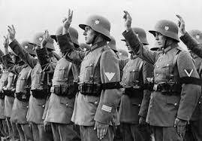
Hitler’s Rise to Power:
“Oath of Loyalty to Hitler”
Once Hitler had chancellor, and presidency and control over his army under his belt, he made all his army members swear their own personal oath of loyalty to him.
http://www.youtube.com/watch?v=HoZw9xz0OY4

Slide 10
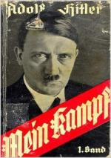
Mien Kampf
Mien Kampf was a book written by Hitler himself, it was published on July 18th, 1925.
Mien Kampf means “My Struggles.”
You can’t have Mein Kampf in some parts of Europe, and owning and buying the book is illegal in Germany, the Netherlands, and Austria and France.
Hitler uses Mien Kampf to describe and explain his plan ultimate plan
For example in Mein Kampf Hitler said that: “…If he won power Hitler promised to occupy Russian land that would provide protection and lebensraum (living space) for the German people. This action would help to destroy the Jewish/Marxist attempt to control the world” "The Russian Empire in the East is ripe for collapse; and the end of the Jewish domination of Russia will also be the end of Russia as a state.“
In Mien Kampf, Hitler never stated his hate for Jewish people straight out. However he does uses very hateful explanations throughout. For example, “to what an extent the Jew takes over foreign culture, imitating or rather ruining it…”.
http://www.hitler.org/writings/Mein_Kampf/

Slide 11
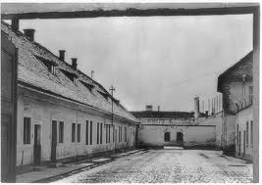
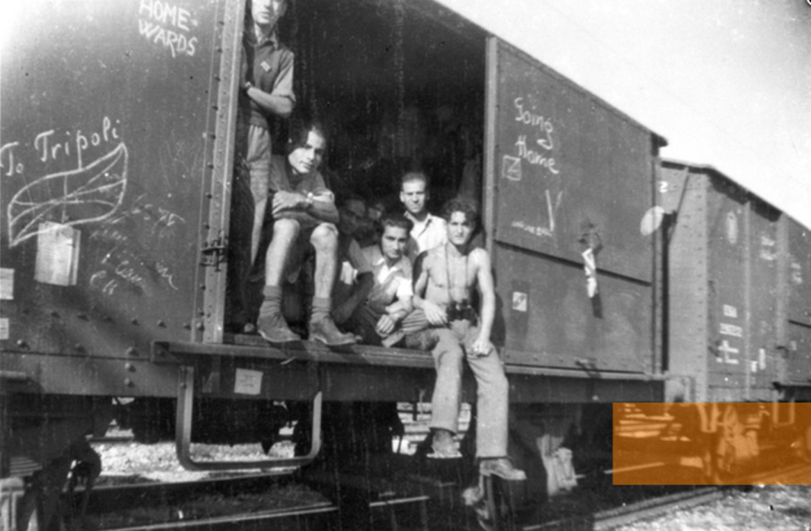
Basic Background on Hitler
and the Holocaust
The Holocaust began in 1933, following Hitler’s rise to power in Germany.
Holocaust means “sacrifice by fire.”
Hitler’s political party (Nazis), targeted Jews, Gypsies, homosexuals, Jehovah’s Witnesses, and disabled people.
Hitler had these people sent to concentration camps.
People who went against the Nazis were sent to these camps to be murdered or to do labor.
11 million people died in the Holocaust, and 6 million were Jewish.

Slide 12
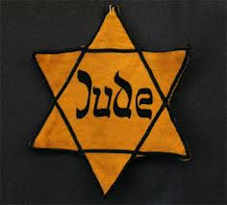
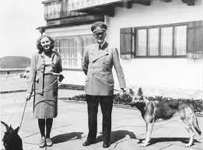
Facts About Adolf Hitler
Hitler had a great hatred to Jews.
Hitler loved art and was rejected from an art school in Vienna. He blamed it on the acceptance panel, saying they must have been Jewish.
In March 1938, Hitler was able to take over Austria into without firing a single shot.
On July 20, 1944, Hitler barely survived an assassination attempt. One of his best military officers had put a suitcase bomb under the table during a conference meeting.
April 30, 1945, Hitler and Eva committed suicide together.
Hitler left behind a legacy of killing millions of people, was a great dictator, and speaker.

Slide 13
Sources
http://www.jewishvirtuallibrary.org/jsource/Holocaust/hitler.html
Hitler dictator notes on JMH website
http://www.biography.com/people/adolf-hitler-9340144
http://homepage.eircom.net/~finnegam/war/adolf_hitler.htm
http://en.wikipedia.org/wiki/Mein_Kampf
http://history1900s.about.com/od/holocaust/a/holocaustfacts.htm
Mr. Gopee
http://answers.yahoo.com/question/index?qid=20081121131437AAKGiPI
http://history1900s.about.com/od/hitleradolf/a/Hitler-Facts.htm
http://ayay.co.uk/backgrounds/historical/nazi_third_reich/hitler-as-a-baby.jpg
http://www.telegraph.co.uk/culture/books/booknews/8006264/Adolf-Hitler-was-a-cowardly-pig-according-to-fellow-First-World-War-soldiers.html
http://sitemaker.umich.edu/rememberingnazism/popular_appeal
http://www.bbc.co.uk/history/people/adolf_hitler
http://www.educationforum.co.uk/long.jpg
https://wh2012mikedevinluke.wikispaces.com/The+West+Between+Wars
http://www.historyplace.com/worldwar2/triumph/tr-fuehrer.htm
http://www.frontpagemag.com/2013/dgreenfield/the-story-of-a-holocaust-survivor-from-benghazi/
http://www.loc.gov/rr/frd/Military_Law/NT-indictments-1.html
http://kosherdelight.com/Holocaust_Yellow_Star.shtm
http://hitlertriumphant.wordpress.com/hitler-becomes-fuhrer/

