Slide 1
The Battle of Stalingrad
By Luke

Slide 2
Case Blue
It all began with a German plane crashing near Red Army front lines. The pilot retaliated but was killed before he could destroy a case of information about an attack on Stalingrad codenamed Case Blue. Stalin however dismissed the plans because they needed all men to remain at their positions. On the 28th of June 1942 the German Wehrmacht division begins its campaign to seize Russian oil fields and cripple the soviet industry.

Slide 3
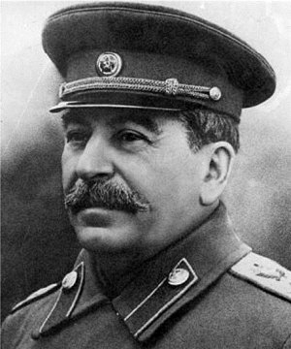
Order #227
The 1st and 4th Panzer division begin working its way through to the Volga river with huge amounts of Russian soldiers surrendering, Stalin, decides to give this order.
“All talk about us having plenty of room which to retreat endlessly, about our territory being vast, our country being large and rich, our population numerous and they’re bread in abundance. All this talk must be eliminated.”
“Panic mongers and cowards must be exterminated on the Spot.”

Slide 4
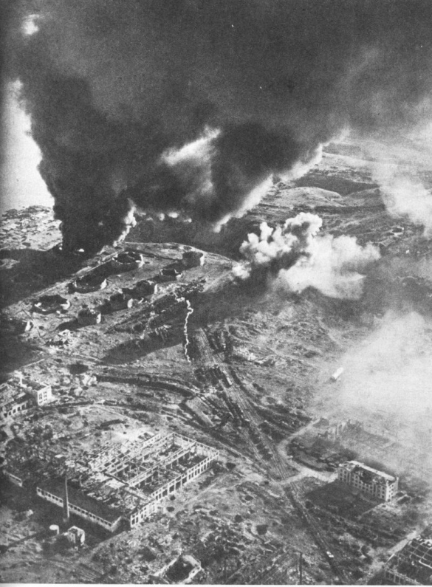
The bombing
The battle that ensued in Stalingrad is said to be one of the bloodiest conflicts of WWII. Only a 5th of the population had been evacuated before the Germans began to bomb the city destroying 80% of the buildings on the 1st day. The majority of the population thought the air raid sounds were only a test, it wasn’t until the shadow of 1’216 planes fell over the city did the inhabitants run for the shelters. It’s estimated that over 40’000 people died.

Slide 5
irony
Ironically the bombing completely undermined German tactics, tanks their main shock weapon would become stuck in the rubble and pelted from every corner by Molotov cocktails. Planes couldn’t differentiate targets from rubble and German foot soldiers weren't properly armed for the close quarters combat the Russians had perfected by that time.

Slide 6
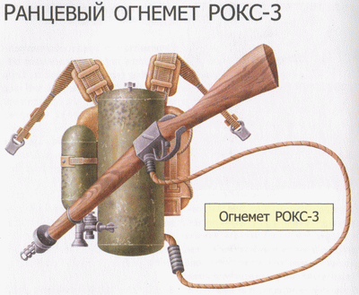
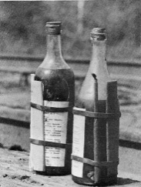
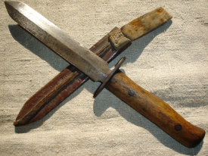
weapons
Russians devised special assault teams of the most experienced soldiers and were armed especially for the urban battlegrounds. The weapons they were armed with were-
PPSH
Grenades or Molotov cocktails
Snipers or Anti Tank Rifles
Knives and sharpened entrenching tools
Flamethrowers
German soldiers would often steal weapons off of dead Russian soldiers because they were more efficient in the fighting conditions.

Slide 7
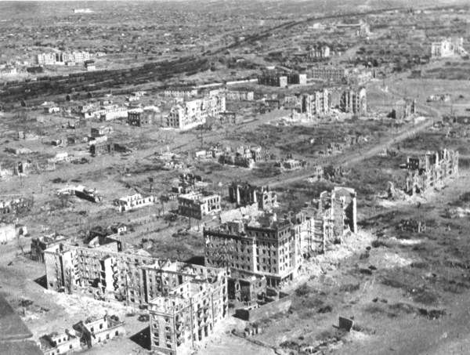
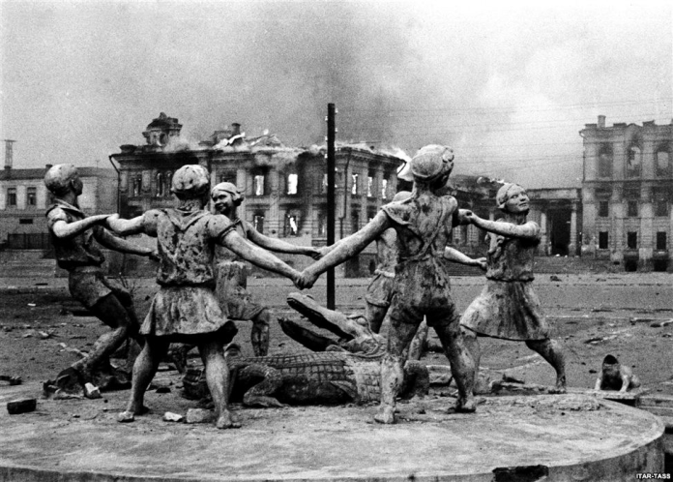
facts
To this into perspective about how hard the Russians fought for Stalingrad
Poland was occupied in 28 days; in Stalingrad Germans managed to take only a few buildings
France was occupied in 38 days; in Stalingrad Germans had only managed to cross the street

Slide 8
Helping Russia
Weapons
Better urban and close quarters combat
Fear tactics & psychological warfare
Volga river never being taken
Field mice chewing tank wires
Order 227
Staying close to German lines
Tunnels under buildings
Artillery across the Volga
Russian Winter

Slide 9
August 23, 1942 – February 2, 1943
German
Russian
est. 850,000 killed, missing or wounded
including 107,000 captured (only 6,000 survived being taken prisoner and returned home by 1955)
Approx. 1,120,000 killed, missing or wounded
(including 478,741 killed and missing
650,878 wounded and sick)
40,000 civilians dead

Slide 10
Sources
http://en.wikipedia.org/wiki/Battle_of_Stalingrad
http://www.historylearningsite.co.uk/battle_of_stalingrad.htm
http://www.youtube.com/watch?v=ynKTjCrvkig
http://www.britannica.com/EBchecked/topic/562720/Battle-of-Stalingrad
http://www.history.com/topics/battle-of-stalingrad

