Slide 1
Yalta conference
By: Keegan Manuel and Dyllen MacRae

Slide 2
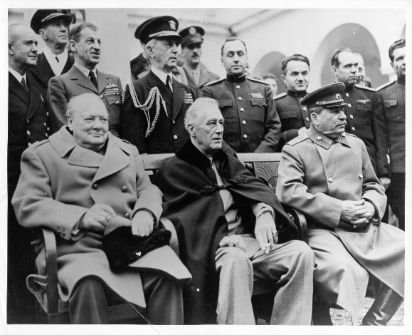
What is the yalta conference?
Meeting between Franklin Roosevelt (United States), Winston Churchill (Great Britain) and Joseph Stalin (USSR) that opened on February 4, 1945 in a neutral spot on the Black Sea resort of Yalta.
Meeting involved discussion of war strategy and issues that would affect the post war world.
Each leader came to Yalta with an agenda:
Roosevelt wanted Russian military support against Japan
Churchill wanted to secure free elections for soviet liberated countries in Eastern Europe
Stalin wanted to build a soviet sphere of influence around eastern Europe to prevent future threats.

Slide 3
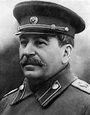
Joseph Stalin`s Points
Stalin took a firm stance on the issue with Poland (Poland was used as the invasion corridor by the Germans twice in the past thirty years)
He stated that he would not return the land added from Poland in 1939
He wanted the nation to be compensated with the land taken from Germany
While these terms were non-negotiable, Stalin was willing to agree with the free elections in Poland

Slide 4
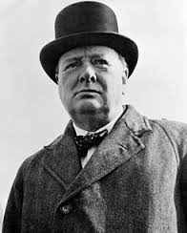
Winston Churchill`s Points
Churchill was pleased with Stalin`s points.
Its soon became clear to him that Stalin had no intention on honoring his promises.
It was agreed that the defeated nation (Germany) would be divided into three zones, one for each of the Allies, with a similar plan for the city of Berlin.
Churchill wanted a fourth spot for the French. (Stalin would only agree if the zones were taken from the British or American zones.

Slide 5
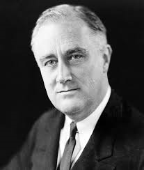
Franklin Roosevelt`s points
Roosevelt secured a promise from Stalin to enter their conflict with Japan ninety days after the defeat of Germany.
Roosevelt hoped to deal with the Soviets through the United Nations
Stalin also agreed to join after voting procedures in the security council were defined.

Slide 6
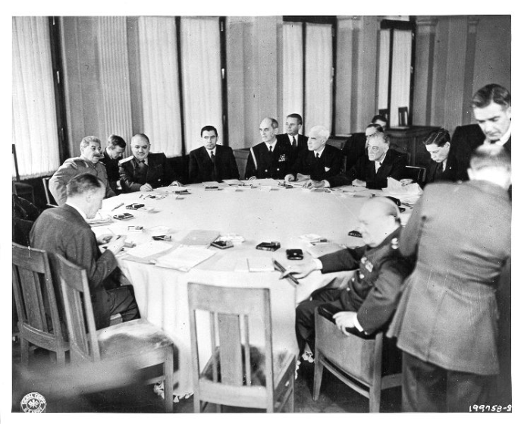
Conclusion
Conference finished February 11
The view of the conference was short lived as Roosevelt died two months later, and following his death (April 12) the relations between the Soviets and the west became increasingly intense
The leaders of the big three would eventually meet again that July at the Potsdam Conference (Potsdam Germany)

Slide 7
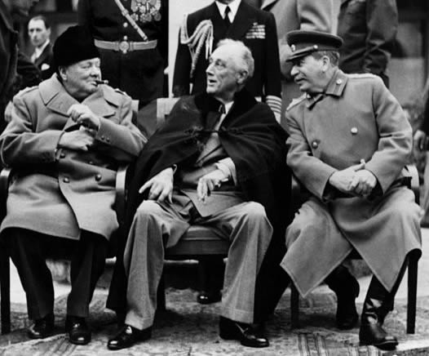
Video
http://www.youtube.com/watch?feature=player_embedded&v=ybnzMnFEWJY

Slide 8
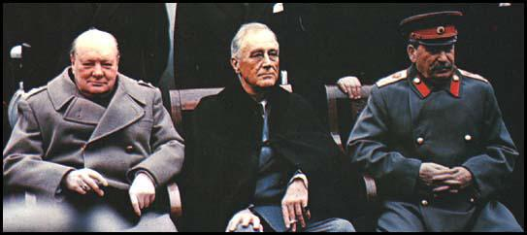
Sources
http://militaryhistory.about.com/od/worldwarii/p/yalta.htm
http://www.youtube.com/watch?feature=player_embedded&v=ybnzMnFEWJY
http://en.wikipedia.org/wiki/Yalta_Conference
http://www.spartacus.schoolnet.co.uk/2WWyalta.htm

