Slide 1
D-Day
By: Trevor Bowie
&
Evan Hubbard

Slide 2
Outline
What is D-Day?
Facts About the Invasion
Who Participated?
Locations of Attack
Canada’s Roles
Why was D-Day significant?
Video
Sources

Slide 3
What is D-Day?
“The Normandy Invasion”
D-Day is a day when an attack or operation is begun
The day before D-Day was known as D-1 (The day after D+1)
The most well known D-Day is the Normandy Invasion.

Slide 4
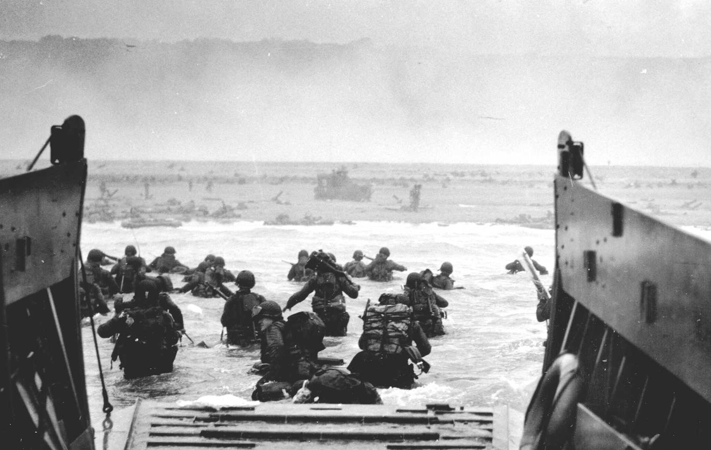
Facts About the Normandy Invasion
June 6 1944
Allies invaded Normandy in WW2
Operation Overlord
Take back control of Europe

Slide 5
About the Invasion
The invasion began with an airborne assault and naval bombardments shortly after midnight
Early that morning they had troops land by using ships
Germany was very deceived by Operation Bodyguard

Slide 6
Who Participated?
Allied forces versus Germany
Mostly Canada, Britain, and the United States
Australia, Belgium, Czechoslovakia, France, Greece, the Netherlands, New Zealand, Norway and Poland also helped the cause later on

Slide 7
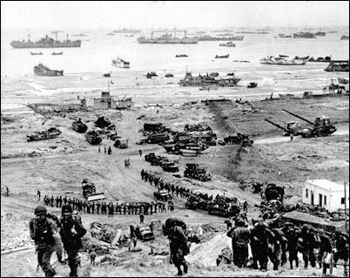
Locations of Attacks
America had beaches Omaha and Utah
Britain had beaches Gold and Sword
Canada had beach Juno

Slide 8
Canada's Role
The 3rd Canadian Infantry Division landed on Juno Beach.
3 000 troops on the first wave
14 000 troops overall
340 Canadian died and another 574 were wounded

Slide 9
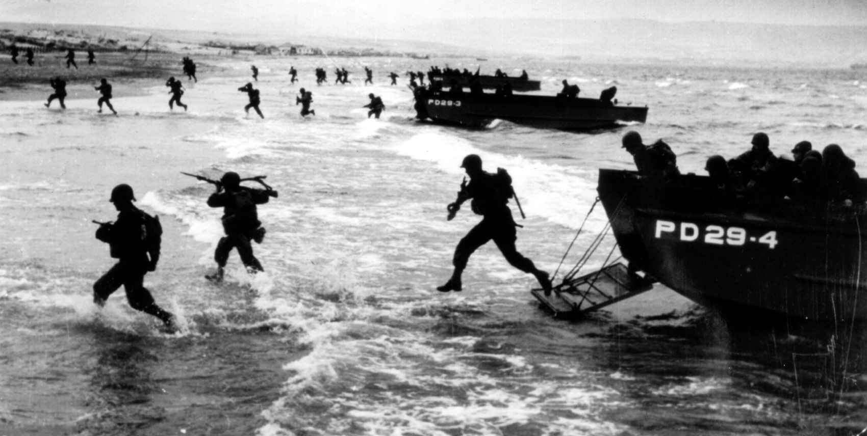
Why D-Day was Significant?
“Beginning of the end”
Turning Point
Devastating blow against the Axis forces

Slide 10
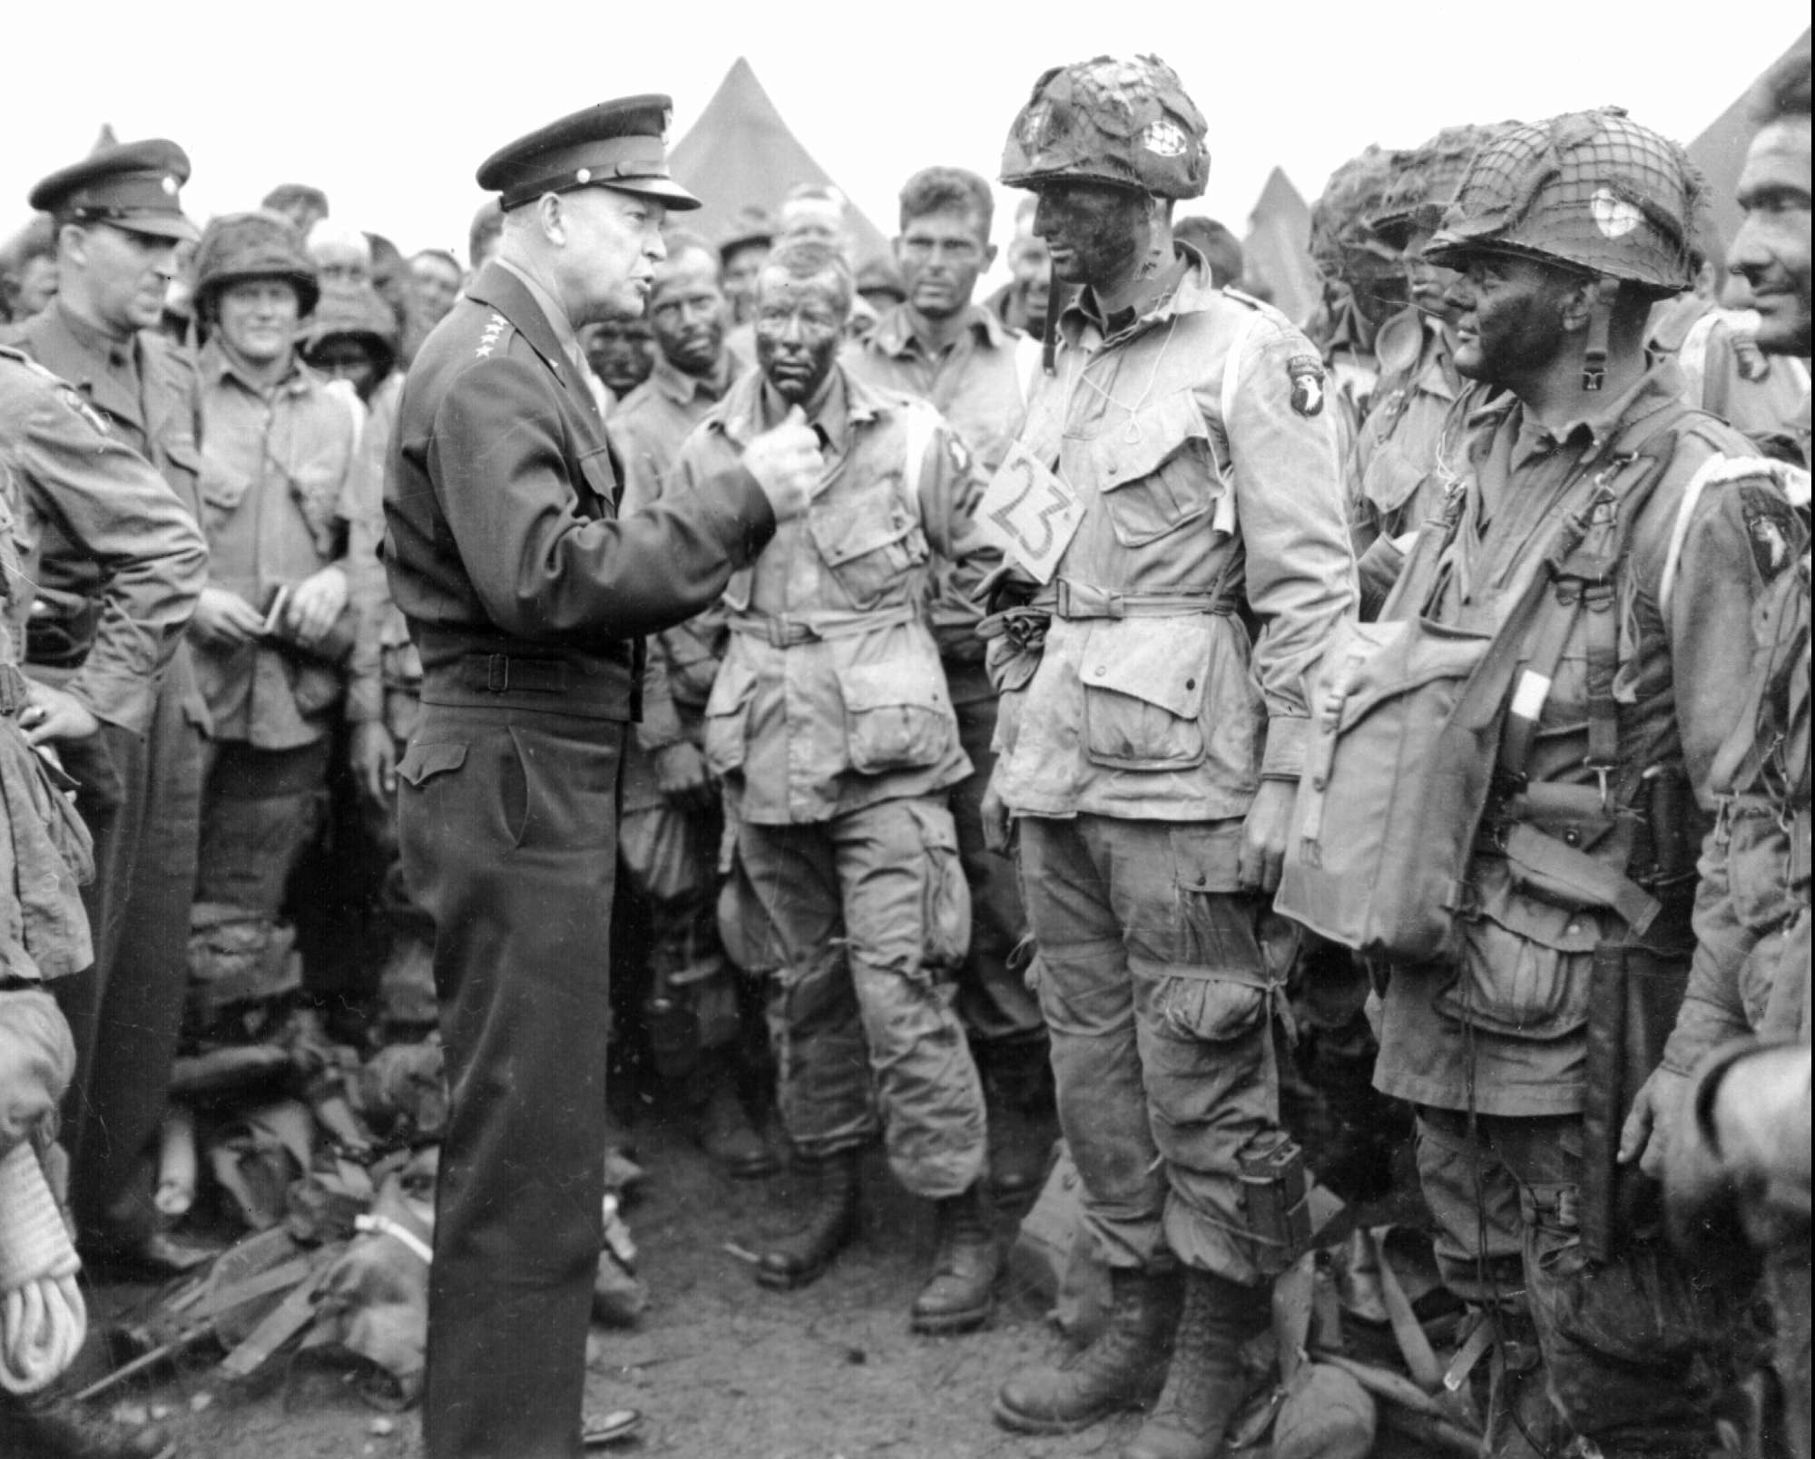
D-Day 6/6/44
http://www.youtube.com/watch?v=uPU4p7UQOtU

Slide 11
Sources
http://www.ddaymuseum.co.uk/d-day/d-day-and-the-battle-of-normandy-your-questions-answered
http://www.nationalww2museum.org/media/press-releases/d-day-fact-sheet.html
http://www.cnn.com/2013/06/03/world/europe/d-day-fast-facts/
http://www.britishlegion.org.uk/remembrance/d-day-65/history-of-d-day/facts-and-figures-of-d-day
http://members.shaw.ca/junobeach/

