Slide 1
The battle of Stalingrad
Liam Taylor

Slide 2
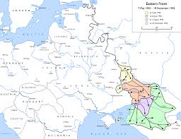
When and where it happened
The battle of Stalingrad happened in Stalingrad, Russian SFSR, Soviet Union.
The date of the battle was August 23, 1942 – February 2, 1943, it was 5 months 1 week and 3 days long before it ended in surrender..

Slide 3
Info
This battle was between Nazi Germany and the Soviet Union for Stalingrad.
The battle started in the summer of 1942 using the 6th army and the 4th panzer army (Nazi Germany).
The attack started by bombing the city to rubble, it was a building to building fight.
By mid November the Germans pushed the soviets back along the west bank of the Volga river.

Slide 4
Operation : Uranus
On November 19, 1942 the red army launched operation: Uranus.

