Slide 1
Women at War
Mackenzie Tucker

Slide 2
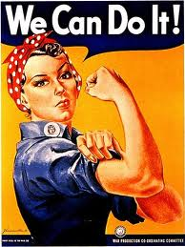
Roles of women in the war
Women played very important roles in WW2, without their help the war may not have went the way it did.
They worked and volunteered there time on the home front so that the men could go and fight for their county
They struggled to maintain there homes due to the poor economy
They gave there sons and husbands to go away and fight

Slide 3
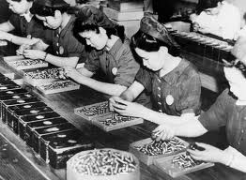
Roles at home
Women took over the jobs that men would usually do
They worked in factories, producing the goods that were needed for war (ex. Weapons and ammunition)
The women who worked on farms were called “Land Girls”

Slide 4
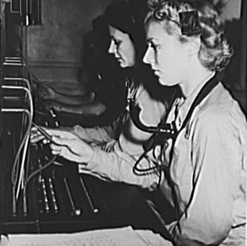
Switchboards
Switchboards were used to communicate between the home front and the soldiers at war
Many women were trained and hired to work these boards
They had to be bilingual (depending on were they lived)
Women being trained to use switchboards

Slide 5
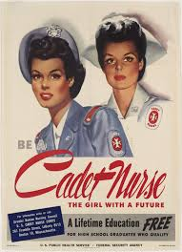
nurses
A lot of nurses were volunteers
They played a very important role in the war
Without them many more deaths would have occurred
Some nurses were killed because of the dangers of being so close to the war

Slide 6
Income
Women who took on men's jobs earned good money for the times.
But they would make less then a man would for doing the same job.
A lot of the women that were involved in war were volunteers
A lot of people struggled due to the poor economy, it was hard to get even simple things like food (sugar, bread, etc..)
Food rations

Slide 7
Women in Germany
Hitler did not agree with letting women work.
They lived a very strict and controlled lifestyle, they learned this at a young age
They were to stay home while men worked and be good wives and raise the children.
Women who had the most children were given an award
The Motherhood Cross

Slide 8
Sources
http://www.historyonthenet.com/WW2/home_front.htm
http://www.nationalww2museum.org/learn/education/for-students/ww2-history/at-a-glance/women-in-ww2.html
http://www.historylearningsite.co.uk/Women_Nazi_Germany.htm
http://germanhistorydocs.ghi-dc.org/sub_image.cfm?image_id=2044

