Slide 1
Introduction to Law

Slide 2
Crazy Laws
In Alabama, it is illegal for a driver to be blindfolded while driving a vehicle.
In New York, the penalty for jumping off a building is death.
In Florida, it is illegal to fart in a public place after 6 P.M. on Thursdays.
Washington, USA: It is mandatory for a motorist with criminal intentions to stop at the city limits and telephone the chief of police that he is entering the city.
England: A pregnant woman can legally relieve herself absolutely anywhere she wants; even, if she so requests, in a policeman’s helmet.

Slide 3
Crazy Laws in Canada
In Calgary you may not pay for a fifty-cent item with only pennies.
In Quebec the color of house and garage doors is regulated by city bylaws (a purple door get you a fine).
When raining, a person may not water his/her lawn.

Slide 4
What Is law?
“Where Law ends, tyranny begins.”
(William Pitt 1759-1806)
“Law is simply the rule of the stronger”
(Plato 427-347BCE)
“Law depends on its validity by having a penalty attached”
(Jane Austin 1775-1817)

Slide 5
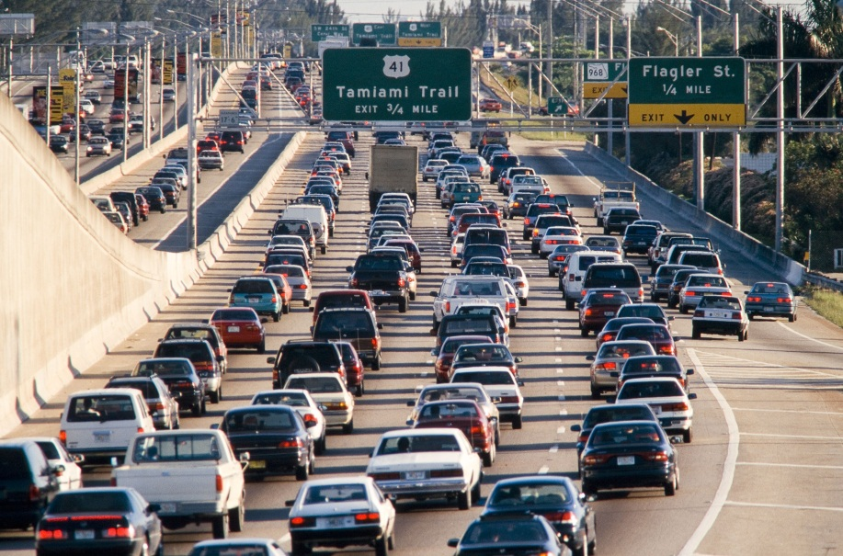
What is Law?

Slide 6
What is Law?
a binding custom or practice of a community.
(Webster)
Law comes from the Latin word Ligare- “Binding”
is a system of rules and guidelines which are enforced through social institutions to govern behavior
(Wikipedia)

Slide 7
Law Vs. Rules
Rules resemble Laws…
Laws are enforced by the courts.
(Class rules 5 minutes)

Slide 8
Why do we need Laws?
To ensure that the legal system continues to work.
To be informed.
To create meaningful change.
To serve and protect your generation.
Makes you a better citizen

Slide 9
Law and Morality
Cut and Dry or controversial?

Slide 10
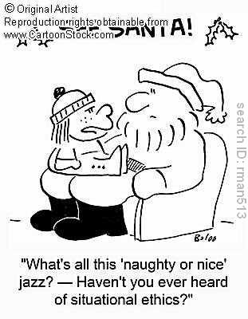
Law and Justice
(Case Page 13- Roncarelli vs. Duplessis)
(Case Page 16 MacIssac)

Slide 11
Rule of Law
“A principle of justice stating that the Law in necessary to regulate society, that law applies equally to everyone, and that people are not governed by arbitrary power.”

