Slide 1
Psychological Reasons for Consuming

Slide 2
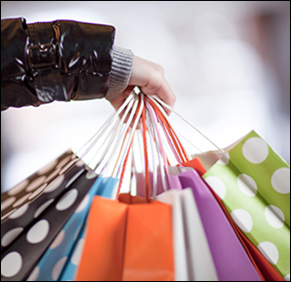
CONSUMERISM
Why do we buy so much?
How many cars in your driveway?
How many shirts in your closets?
How much food do you eat each day?
How many electronic devices are there in your home?
CONSUMERISM refers to our
spending habits.

Slide 3
“In our society, we don't buy things so we can just survive or barely live. Most of what we buy is so we can have a comfortable life and appear to be richer or more powerful and attractive to other people. Since this is why we spend our money, there's nothing wrong if advertisers promise to help make us feel richer or prettier or happier. Advertisers don't make us feel insecure or unhappy about our popularity, bodies or status—we do that to ourselves. Advertisers just offer ways we can feel better than we already do.”

Slide 4
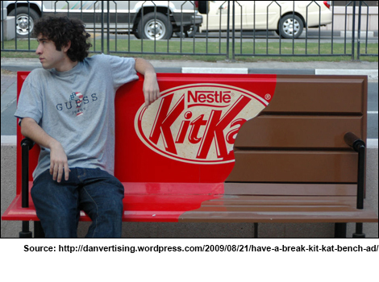
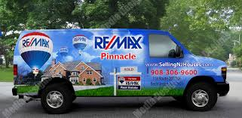
Marketers are targeting YOU
The competition to create an ad that catches your interest is fierce!
Ambient advertising describes advertising that uses new and imaginative locations and forms to take advantage of those spaces where traditional advertising doesn't usually appear.

Slide 5
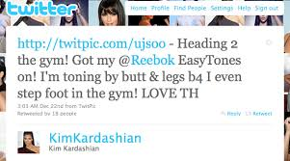
Stealth Endorsers: advertisers are using a new technique to use celebrities to sell products: stealth endorsement. The trend now is to brand celebrities with specific merchandise by having them use or wear products in public appearances or promote them in media interviews—without making it clear that the celebrities are paid

Slide 6
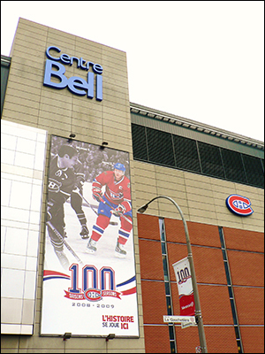
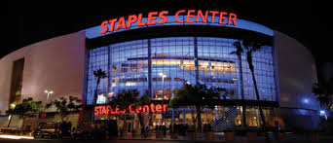
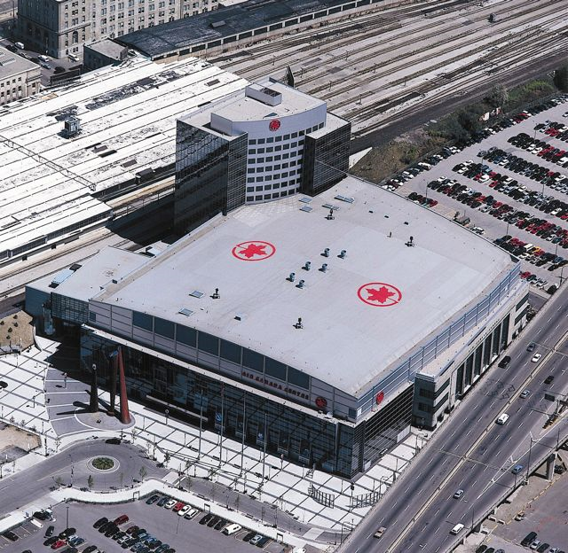
Corporations often pay to have the naming rights for high-profile public places (including parks, schools, libraries and museums) to keep their names in the public's mind, and associated with positive, trusted images.

Slide 7
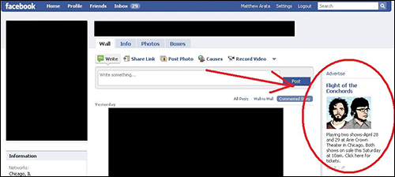
Targeted Advertising: advertisers collect information about you and then send targeted ads that match your interests directly to you.

Slide 8
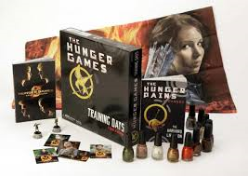
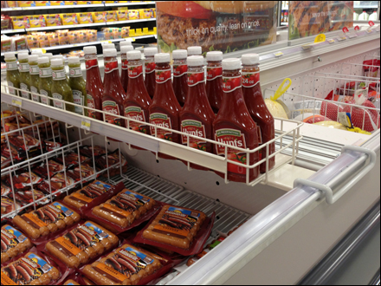
Cross merchandising is displaying products of similar or different categories in the same area, in order to increase sales. For example, displaying batteries next to flashlights. Another example would be a store mannequin dressed to display a featured brand of jeans also wearing a shirt and shoes that the store sells.

Slide 9
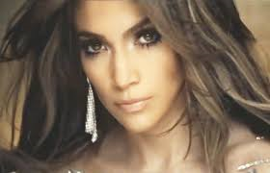
Product placement is as simple as it sounds: products are placed (for a fee) in movies, television shows, music videos and video games where they seem to be natural parts of the set or the action. Just as stealth endorsers are supposed to fool viewers into thinking a product appears naturally, rather than as a paid ad, product placements are designed to make you think a product "belongs" in a certain setting.
Britney Spears promoted her Radiance fragrance and reportedly made a cool half million for pitching Sony electronics, Make Up Forever cosmetics and the dating Web site PlentyOfFish.com and in her “Hold It Against Me” clip.
Jennifer Lopez advertised BMW, Swarovski crystals and Crown Royal whiskey in “On the Floor.”

Slide 10
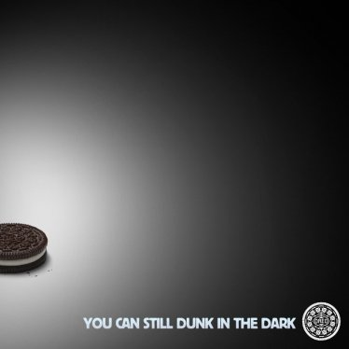
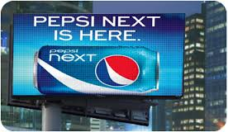
Digital advertising refers to using technology, social media and the Internet to attract consumers. This form of advertising includes electronic billboards in sports arenas, digitally inserting a product logo or content on the ice during a hockey game, and even inserting specialized ads into scenes from TV shows, movies, video games and apps. Custom or targeted digital ads can also be delivered to computers, tablets and smartphones.

