Slide 1
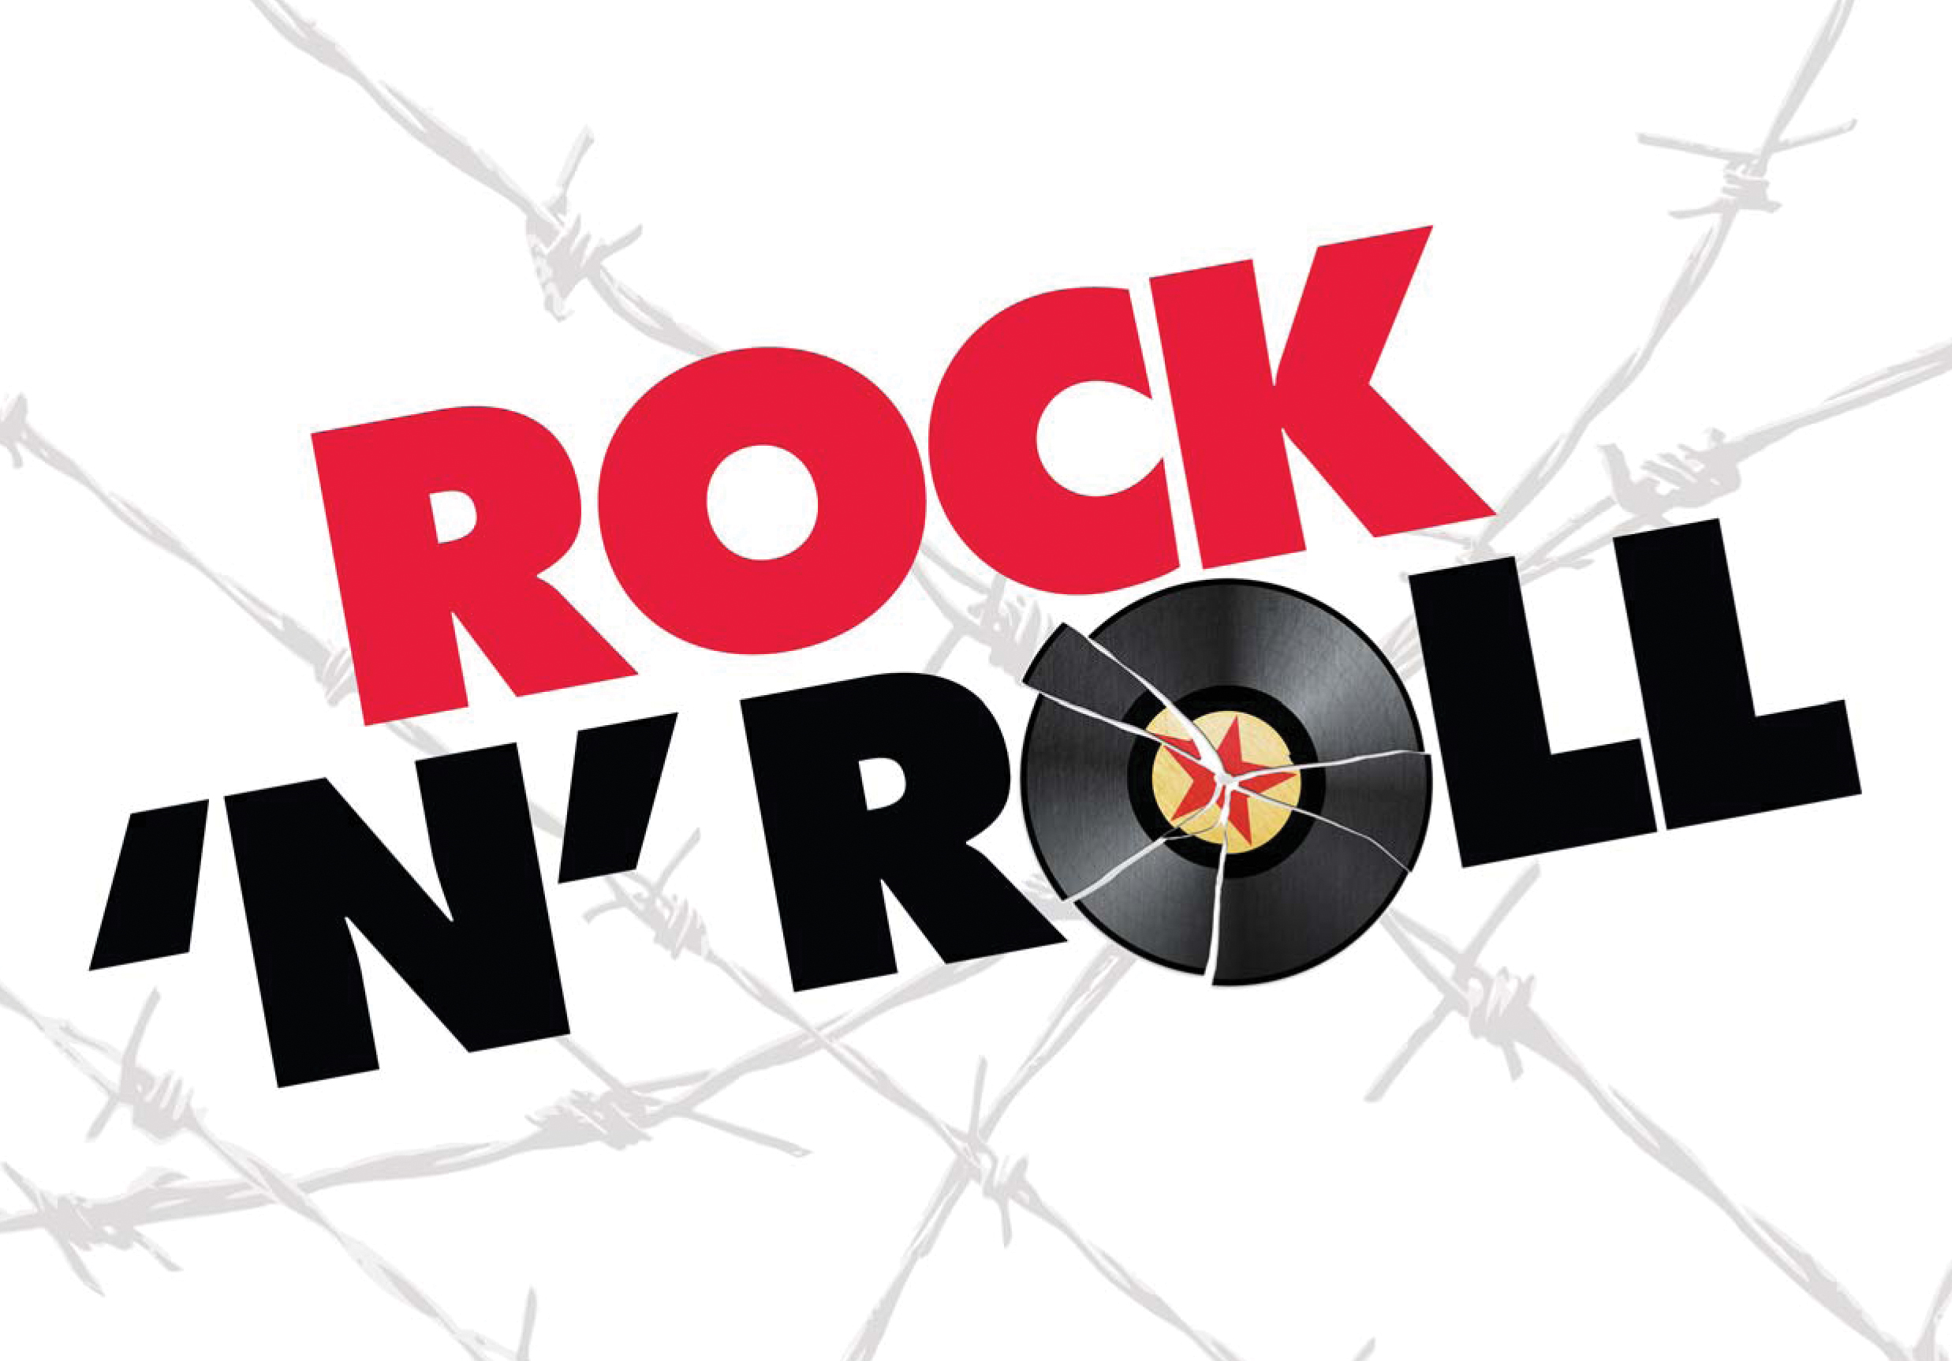

Slide 2
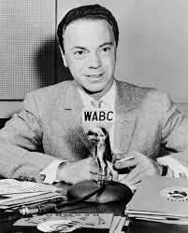
1950’s
Pop charts are dominated by Big Band artists such as Doris Day, Frank Sinatra, Nat King Cole
RnB charts feature African-American artists playing to primarily African –American artists.
Allan Freed is the exception with
his show “Moon Dog”, which attracts a
growing audience of white and black
teenagers alike. He plays up tempo
rhythm and blues hits.
Freed eventually names this
cross-current of musical styles and
influences - electric blues, boogie, jazz,
gospel, R&B vocal groups and country –
"Rock and Roll".

Slide 3
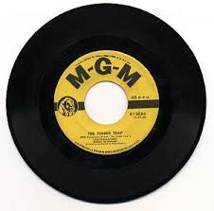
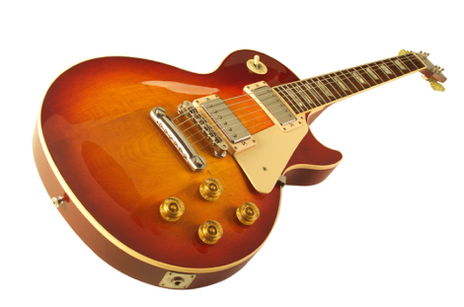
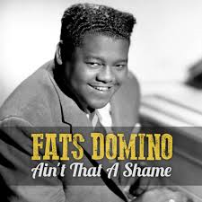
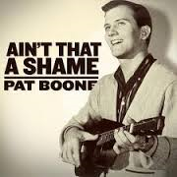
Solid body electric guitar is introduced
45 RPM single is introduced
Black R&B artists like Fats Domino begin to climb pop charts
White artists such as Pat Boone and The Crew Cuts begin to cover R&B songs and turn them into pop hits.

Slide 4
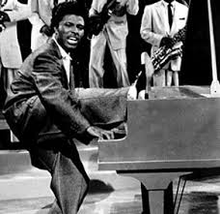
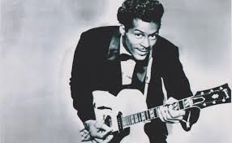
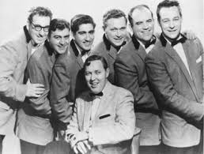
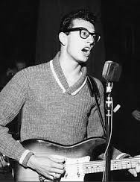
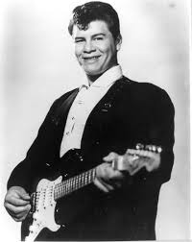
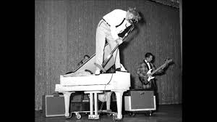
1950’s Artists

Slide 5
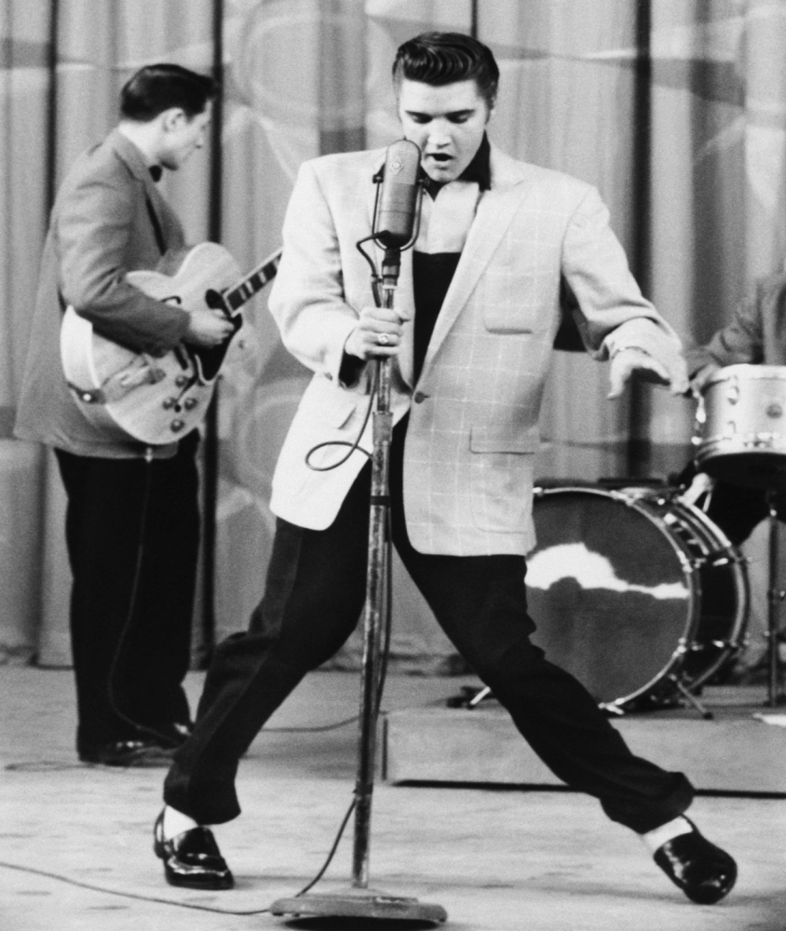
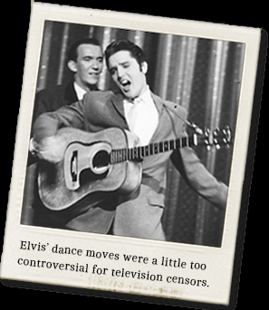
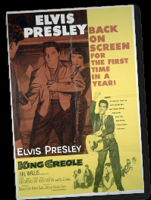
Elvis Presley
Tops the charts with his first
single release “Heart Break Hotel”
First artist ever to have
9 singles in the top 100
at one time.
Elvis goes on to make many
movies and records over 40
albums.

Slide 6
1960’s
Rock music dominates the pop charts
Rock music becomes diversified(folk, surf music, bubble gum rock)
By 1964, American artists are sharing the top of the charts with UK bands, like the The Beatles, and The Rolling Stones.
Garage bands emerge, inspired by the British invasion sound.
Song writing begins to include political statements and social consciousness.
Psychedelic music reflects growing hippie culture
Harder rock sound emerges, paving the way for heavy metal

Slide 7
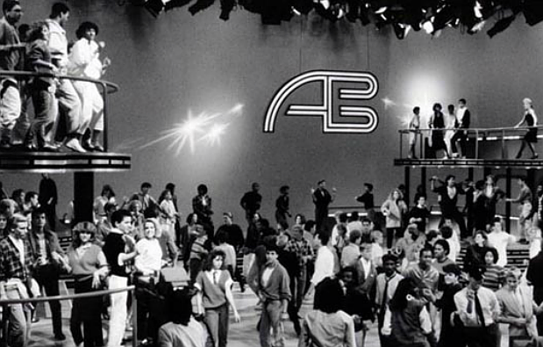
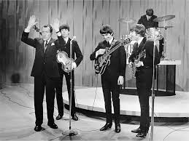
1960’s
Television plays a major role in attracting young audiences to rock ‘n roll
American Bandstand
Ed Sullivan Show

Slide 8
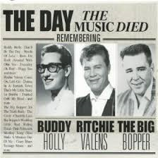
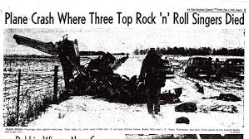
Facts
By 1957 rock and roll artists appear regularly on the popular music charts and by 1959 rock and roll records account for 43% of all records sold.
The end of the decade is marked by tragedy as a February 1959 plane crash takes the lives of rock and roll stars Buddy Holly,
The Big Bopper and
Ritchie Valens.

Slide 9
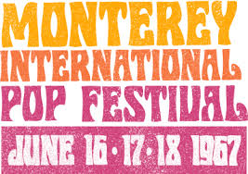
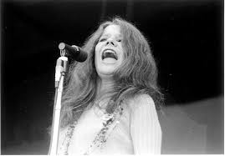
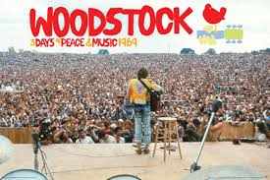
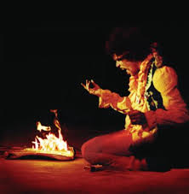
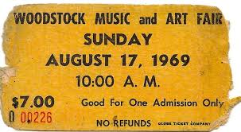
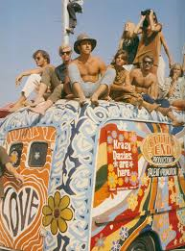
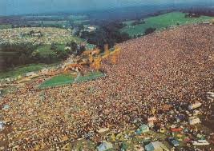
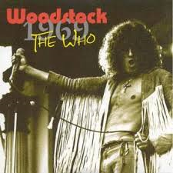
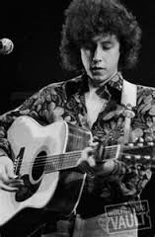
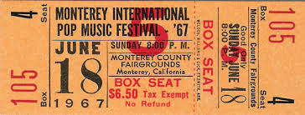
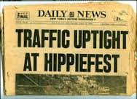
Outdoor Rock Music Festivals

Slide 10
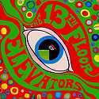
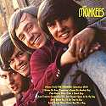
Top Artists
The Beatles dominate the sixties record charts with 6 of the top 10 albums of the decade and 21 of the decades' top 100 singles.
Their nearest competitor is Elvis Presley with 9 of the decades' top 100 singles and 4 of the decades' top 100 albums.
Psychedelic Rock: Grateful Dead,
Pink Floyd, Jefferson Airplane
Bubblegum Rock: The Archies, The Monkees

Slide 11
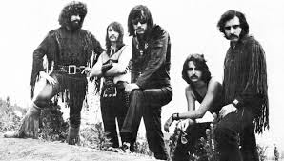
Top Rock Artists
Hard Rock: Cream, Led Zeppelin, Vanilla Fudge, Jimi Hendrix Experience, Steppenwolf, Deep Purple, Blind Faith, The Doors

Slide 12
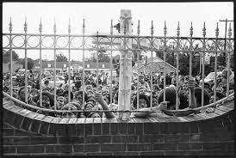
1970’s
Beatles break up, but all four continue to impact the decade with successful solo careers
Early 70’s are marked with deaths of Jimi Hendrix, Janis Joplin, and Jim Morrison, who all die at the age of 27.
Elvis Presley dies in 1977; people start flocking to his home, Graceland.
Psychedelic rock declines, but morphs into hard rock, progressive rock, and heavy metal.
Touring bands move from playing clubs and theatres, to sports arenas and outdoor stadiums, playing to thousands at a time.

Slide 13
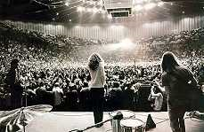
1970’s
Big time bands like the Rolling Stones,
Led Zeppelin, The Who, and Pink
Floyd travel in private jets.
Car stereos become important, first with FM radio stations, then the 8 track, followed with the cassette tape.

Slide 14
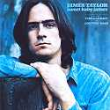
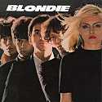
New Styles
Early 70’s are dominated by singer songwriters like James Taylor, Carole King, Don McClean, Cat Stevens, Jackson Browne, Joni Mitchell, Paul Simon, John Denver and
Soft Rock: Elton John, The Carpenters, Billy Joel, Chicago, Fleetwood Mac, Olivia Newton-John
Live albums are popular for bands such as KISS.
Reggae becomes a world wide genre
Disco dominates the radios and dance floors.
Bands start incorporating synthesizers in a style that was termed New Wave

Slide 15
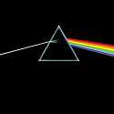
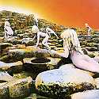
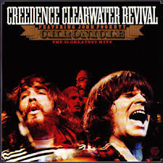
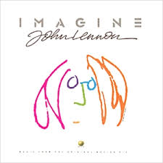
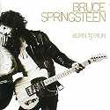
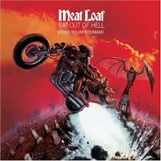
Hard Rock / Arena Rock / Heavy Metal: Led Zeppelin, The Who, The Rolling Stones, Deep Purple, Alice Cooper, Black Sabbath, Kiss, Blue Oyster Cult, Aerosmith, AC/DC, Rush, Boston, Journey, Peter Frampton, Nazareth, Styx, Queen, Van Halen
Progressive Rock: Yes, Genesis, Pink Floyd, Can, Gentle Giant, Soft Machine, King Crimson, Emerson, Lake and Palmer, Kansas, Utopia, Rush, Supertramp
Blues Rock: Eric Clapton, ZZ Top, George Thorogood, Steve Miller Band

