Slide 1
Rock ‘n Roll
1980-2000

Slide 2
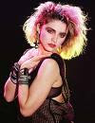
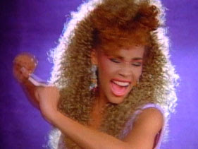
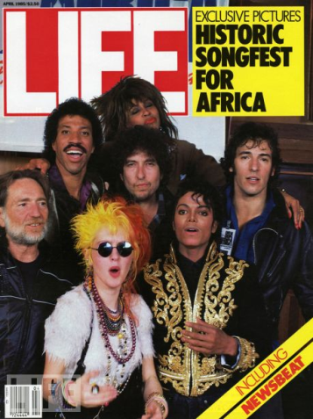
1980’s The Influence of TV and Technology
John Lennon is shot to death
The Music Video becomes a common marketing tool through programs such as MTV and VH1
Numerous new bands and styles emerge (new wave, synth, hip hop and rap)
Several successful female artists
Several records and concerts to benefit charity

Slide 3
80’s Mainstream Rock Artists
Heart
REO Speedwagon
Survivor
Tom Petty
Toto
Aerosmith
Journey
Europe
Rush
Bon Jovi
INXS
Genesis
Loverboy
Melissa Etheridge
Steve Winwood
Foreigner
Asia

Slide 4
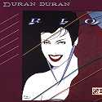
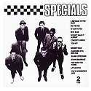
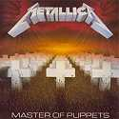
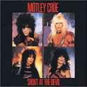
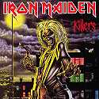
Emerging Styles of the 1980’s
New Wave Talking Heads, Duran Duran, Depeche Mode, The Eurythmics, Berlin, Simple Minds, Psychedelic Furs, Echo & The Bunnymen, Love & Rockets, Blondie, Squeeze, The Police, The Bangles, The Go Go's, Nena
Ska / Rockabilly Revival The Stray Cats, Matchbox, The Rockats, The Cramps, The Blasters, The Specials, Madness, The Beat, The Selecter
Thrash / Speed Metal Slayer,Metallica, Anthrax, Megadeth, Sepultura, Overkill, Gwar, Pantera, Suicidal Tendencies
Hair / Glam Metal Motley Crue, Poison, Warrant, L.A. Guns, Guns & Roses, Cinderella, Winger, Whitesnake
Heavy Metal Iron Maiden, Judas Priest, Skid Row, Tesla, AC/DC, Queensryche, Krokus, Scorpions, Accept, Pantera, Twisted Sister, Ozzy Osbourne, Def Leppard

Slide 5
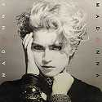
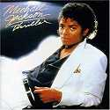
Other Popular Genres of the 1980’s
Pop Madonna, Bryan Adams, Debbie Gibson, Tiffany, Taylor Dayne, Millie Vanilli, Paula Abdul, Bette Midler, Billy Joel, Kenny Rogers, Phil Collins, Kylie Minogue, Expose, Huey Lewis, New Edition, Wham!, Paul Young
R&B / Urban: Michael Jackson, Stevie Wonder, Prince, Whitney Houston, Bobby Brown, Aretha Franklin, Janet Jackson, Lionel Richie
SynthPop / Electronic: Devo, Soft Cell, The Pet Shop Boys, Erasure, Gary Numan, The Human League, Swing Out Sister

Slide 6
1980's Top Best Selling Singles Worldwide
1 Pink Floyd - Another Brick in the Wall (part 2) - 1980
2 Irene Cara - Flashdance... What a Feeling - 1983
3 Michael Jackson - Billie Jean - 1983
4 The Police - Every Breath You Take - 1983
5 Kim Carnes - Bette Davis Eyes - 1981
6 Madonna - Like a Prayer - 1989
7 Survivor - Eye of the Tiger - 1982
8 Stevie Wonder - I Just Called to Say I Love You - 1984
9 Barbra Streisand - A Woman in Love - 1980
10 USA For Africa - We Are the World - 1985
11 George Michael - Careless Whisper - 1984
12 John Lennon - (Just Like) Starting Over - 1980
13 Joan Jett & The Blackhearts - I Love Rock 'n' Roll - 1982
14 Culture Club - Karma Chameleon - 1983
15 Lipps Inc - Funkytown - 1980
16 Diana Ross - Upside Down - 1980
17 The Human League - Don't You Want Me - 1982
18 Phil Collins - Another Day in Paradise - 1989
19 Prince - When Doves Cry - 1984
20 Whitney Houston
I Wanna Dance With Somebody - 1987
21 Michael Jackson - Beat It - 1983
22 Los Lobos - La Bamba - 1987
23 Rick Astley - Never Gonna Give You Up - 1987
24 David Bowie - Let's Dance - 1983
25 Cyndi Lauper - Girls Just Wanna Have Fun - 1984
26 Culture Club - Do You Really Want to Hurt Me? - 1983
27 Paul McCartney & Stevie Wonder
Ebony & Ivory - 1982
28 Men At Work - Down Under - 1982

Slide 7
1990’s The Internet and Digital Music
Advancements in computers and software allow for digital music creation and recording on home computers.
The internet and sound compression allow for digital distribution of music (mp3’s), often bypassing the need for a major label album release.
Napster (an mp3 file sharing service)has 57 million users
Napster is sued by Metallica, Dr. Dre and the RIAA
Grunge and Pop Punk expand in popularity and explode into the mainstream during the 1990's
Major labels begin luring independent bands away from small record labels

Slide 8
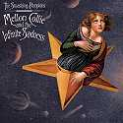
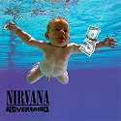
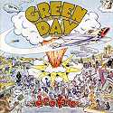
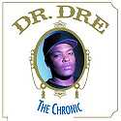
Emerging Genres of the 90’s
Alternative REM, Smashing Pumpkins, Red Hot Chilli Peppers, Pearl Jam, Radiohead, The Cranberries, The Verve, Depeche Mode, Beck
Grunge Nirvana, Soundgarden, Mudhoney, Alice in Chains, The Melvins, Hole, L7, Stone Temple Pilots, Bush
Pop Punk Green Day, The Offspring, Blink 182, MXPX, Bad Religion, NOFX, Lit, American Hi Fi, The Donnas, Good Charlotte
Hip Hop NWA, Public Enemy, Queen Latifah, Salt n' Pepa, Ice T, Dr. Dre, Geto Boys, Tupac Shakur, Cypress Hill, Wu-Tang Clan, Snoop Dogg, MC Hammer, Jay-Z, Eminem, Fugees, Coolio

Slide 9
Other popular Genres of the 1990’s
Hard Rock Guns n' Roses, Ozzy Osbourne, The Black Crowes, Van Halen, Aerosmith, Foo Fighters, Collective Soul, Bon Jovi, AC/DC, Creed, U2
Metal / Nu Metal / Industrial / Rap Metal Korn, The Deftones, Slipknot, Limp Bizkit, Kid Rock, Papa Roach, Nine Inch Nails, Rage Against the Machine, Sepultura, System of a Down, Metallica
Singer/Songwriters Norah Jones, Sarah McLachlan, Alanis Morissette, Tori Amos, Jewel, Natalie Merchant, Sheryl Crow
Pop, Contemporary R&B, Country Crossover, Brit Pop, Electronic/Trance, Reggae/Dance Hall/Jam Bands

Slide 10
Top Selling Artists of 1990’s
1: Mariah Carey
2: Madonna
3: Celine Dion
4: REM
5: U2
6: Nirvana
7: Whitney Houston
8: Pearl Jam
9: Metallica
10: Prince
11: Bryan Adams
12: Michael Jackson
13: Elton John
14: Bon Jovi
15: Oasis
16: Garth Brooks
17: Janet Jackson
18: The Backstreet Boys
19: Eric Clapton
20: Alanis Morissette

Slide 11
The 2000’s
A new, melodramatic teen soap opera, The O.C. features hot. new indie rock bands in its soundtrack like The Killers and Death Cab For Cutie
Guitar Hero debuts on Sony's PlayStation 2 ,allowing gamers to rock out on a plastic guitar; lead to a resurgence in popularity for many of classic rock acts.
Facebook and ITunes Gift Cards
Several other subgenres of Rock ‘n Roll continue to emerge and refine

Slide 12
Rock Artists of the 2000’s
Evanescence
Creed
The Killers
Papa Roach
REM
One Republic
Coldplay
Audioslave
U2
Three Days Grace
Kings of Leon
Muse
Linkin Park
White Stripes
Red Hot Chili Peppers

