Slide 1
Sensation

Slide 2
Sensation defined
Sensation is the process by which sensory systems (eyes, ears, and other sensory organs) and the nervous system receive stimuli from our environment.
Perception: The process of organizing and interpreting incoming sensory information.

Slide 3
How does this work?
Bottom –up processing: Information that analyzes the raw stimuli entering through the many sensory systems.
Top –down processing: Information processing that draws on expectations and experiences to interpret incoming sensory information.
Absolute threshold: The minimum amount of stimulation needed to detect a particular stimulus.

Slide 5
Signal Detection Theory: A theory that predicts how and when we detect the presence of a faint stimulus (signal) amid background stimulation (Noise)
Sensory Adaptation: Diminished sensitivity to constant and unchanging stimulation. (We adapt)

Slide 6
Selective Attention: Focusing conscious awareness on a particular stimulus to the exclusion of others.

Slide 7
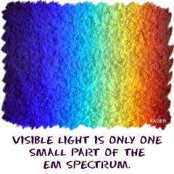
The Visual system
Light enters the eye as waves of Electromagnetic energy.

Slide 8
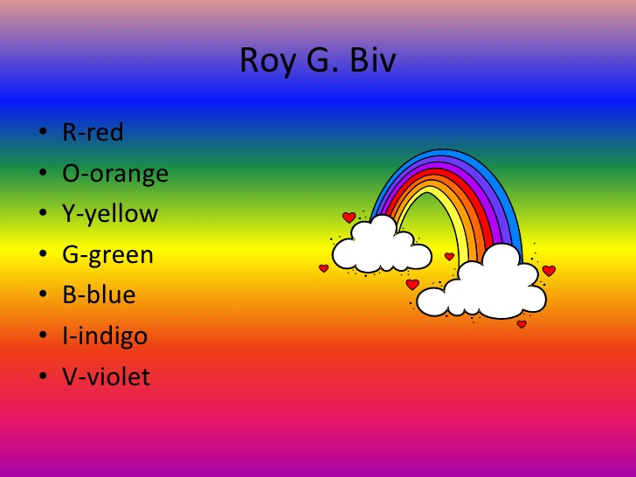
Characteristics of electromagnetic energy
#1-The length of the light wave determines the light’s colour or Hue.
Example: ROYGBIV
The colors are produced as wavelengths of
light (Red has a distance between peaks
of about 700 billionths of a meter, twice
as much as violet)

Slide 9
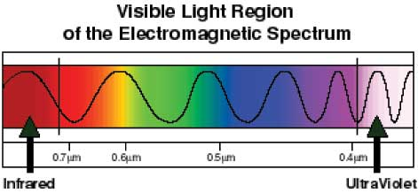
Characteristics of electromagnetic energy
#2- The amplitude or height of the wave determines brightness.

Slide 10
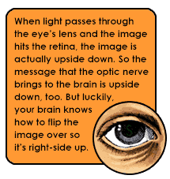
The EYE

Slide 12
Parts of the Eye
Cornea: The clear curved bulge on the front of the eye that bends light rays to begin focusing them.
Iris: The ring of muscle tissue that forms the colour portion of the eye and regulates the size of the pupil.
Pupil: The adjustable opening in the center of the iris, which controls the amount of light entering the eye.

Slide 13
Lens: A transparent structure behind the pupil in the eye that changes shape to focus images on the retina.
Retina: The light –sensitive surface at the back of the eyeball.
Receptor cells: Specialized cells in every sensory system of the body that can turn other kinds of energy into action potentials that the brain can process.

Slide 14
The nature of Sound
Sounds waves
are produced
by Vibrations in the air.

Slide 15
Sound Bytes
Pitch: the sound’s highness or lowness
Pitch is expressed as hertz, the number of sound waves that reach the ear per second.
The height or amplitude of the sound wave determines loudness, which is measured in Decibels (dB)

Slide 16
The auditory system

Slide 17
Auditory system
Tympanic membrane- (ear drum)- transfers sound vibrations from the air to three tiny bones of the middle ear.
Back of the ear drum is the ossicles, which consists of three small bones- hammer, anvil and stirrup.
The main organ for hearing is the Cochlea, a fluid-filled, snail shaped bony tube in the ear where sound waves are changed into neural impulses.

Slide 18
The point on the surface of the cochlea that receives sound vibrations from the ossicles is the oval window.
The oval window vibrates at the same frequency of the incoming sound.
This produces vibrations the fluid in the cochlea
The vibrating fluid stimulates the thousands of hair cells, the receptors for hearing. They send neural impulses to the brain.

Slide 19
Taste Vs Flavor
Taste is a chemical sense- receptors in the tongue
Receptors detect- salty, sweet, sour, bitter and Umami (savory, meaty taste)
We don’t have all the same sensory to taste.

Slide 20
Smell
Smell is a chemical sense
Olfactory cells that project from the brain processes smells.
These trigger odors and identify them to the brain.

Slide 21
Touch
Kinesthetic sense: The system sensing the position and movement of the individual body
Vestibular sense: The system for sensing body orientation and balance, which is located in the semicircular canals of the inner ear.

