Slide 1
All hail the Brain
Psychology and the Brain

Slide 2
Overview of the Nervous system
Nervous system: Processes thousands of bits of information from the body’s other organs and the outside environment.
Endocrine System: houses the production factories for hormones, which control growth, sexual development and other processes that keep us alive.

Slide 3
Definitions for the brain
Automatic Nervous System: Part of the peripheral nervous system that controls the muscles in the stomach, intestines and other organs.
Hormones: Chemicals used by the endocrine system that controls growth, emotional responses and physical changes.
Neuron: Nerve cell, the basic unit of the nervous system. A neuron is made up of a cell body, an axon and one or more dendrites,

Slide 4
Brain Definitions
Neurotransmitters: chemicals that carry information from one neuron to another,
Somatic Nervous system: Part of the peripheral nervous system associated with all the body's movements.

Slide 5
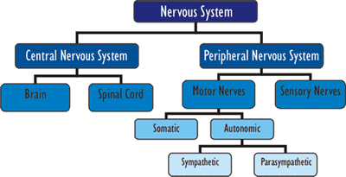

Slide 6
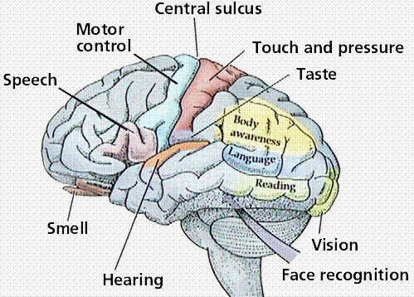

Slide 7
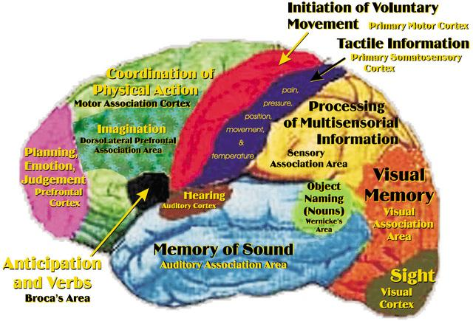

Slide 8
Parts of the brain

Slide 9
Heredity
Heredity is a term that refers to traits and features that are inherited from one's parents and ancestors. At birth a person inherits 50% of each parent's genetic material (genes) that are passed along through the chromosomes found in the DNA . These control not only physical traits like height, skin, hair and eye color, and susceptibility to some medical conditions, as well as a great many other individual mental, physical and psychological traits.

