Slide 1

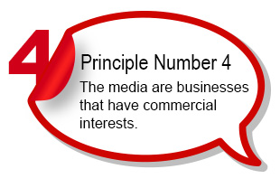

Slide 2

The actress looks completely unrecognizable in the promotional material, with her face notably slimmed, her eye colour changed, her skin heavily smoothed and even her facial expression altered

Slide 3
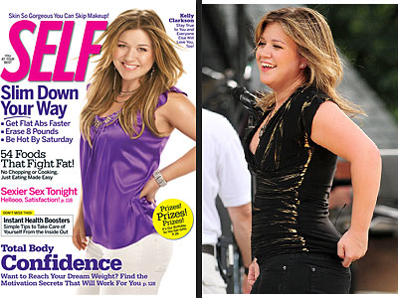
A singer's photo is manipulated to match a magazine's constructed reality.

Slide 4
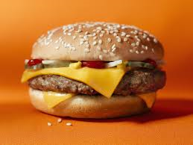
A burger and French fries are given special treatment for their photo.

Slide 5

Celebrities, beautiful women and flattery tell men that a razor will make them feel like a sex symbol.

Slide 6

Constructed Reality Can Be Complicated

Slide 7
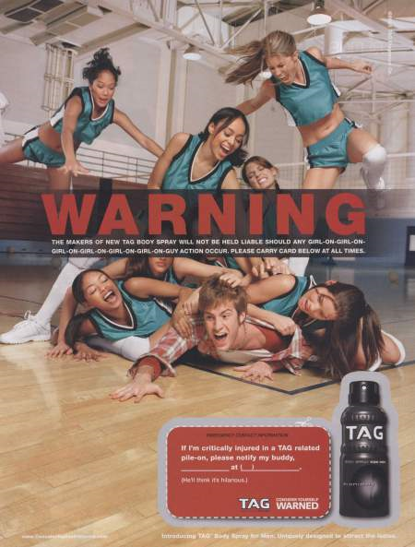

Slide 8

How do we understand a company investing in a Dove campaign to help young girls and women be comfortable with their bodies, while also producing Axe commercials selling a fantasy to insecure teen boys?

Slide 9
The salary of an American and Canadian network news anchor
Last year’s earnings of the top-five American entertainers
The cost of a 30 sec. Commercial the Super Bowl game (1.2 million in 1995)
•The cost of a 30-second commercial on a top-rated prime time Canadian television show
•The cost of placing a half page advertisement in a small community newspaper and a large national newspaper
•The cost of advertising your business on a billboard sign
The cost of advertising your business on an internet site
•The cost of placing an ad in the yellow pages
•The cost of advertising on Facebook

