Slide 1
Psychology 120

Slide 2
What is Psychology?
Two Greek words-Psyche- Self and logos- Mind(Rational thought)
Psychology is the scientific study of behaviour and mental processes.
The field is scientific in that psychologists approach their studies in an orderly and systematic way in order to obtain objective evidence.
Psychologists study:
Overt or observable behaviour, as well as
Covert behaviour – private mental processes that cannot be directly observed or measured and must be inferred from overt behaviour.

Slide 3
What is Psychology?
The primary goals of psychology are to:
Describe behaviour – what is the nature of this behaviour?
Understand and explain behaviour - why does it occur?
Predict behaviour– can we forecast when and under what circumstances it will occur?
Control behaviour - what factors influence this behaviour?

Slide 4
Varieties of Psychologists
Several types of psychologists exist. These include:
Cognitive psychologists:
study the ways humans perceive and understand the world around them.
Physiological psychologists:
study the role of brain functions in behaviour.
Developmental psychologists:
study how individuals grow and change throughout their lives.

Slide 5
Varieties of Psychologists
Social psychologists:
study how people influence and are influenced by others.
School psychologists:
test and evaluate students, analyze learning problems, and counsel teachers and parents.
Industrial/Organizational psychologists:
work on a wide variety of issues in work settings.

Slide 6
Varieties of Psychologists
Forensic psychologists:
work on behavioural issues in the legal, judicial and correctional systems.
Health psychologists:
focus on ways to improve health by altering behaviour.
Sports psychologists:
Study how psychological factors influence performance in sports, physical activity and exercise.

Slide 7
Varieties of Psychologists
Most psychologists are involved in the areas of clinical and counseling psychology.
The primary focus of clinical psychologists is the diagnosis and treatment of mental and behavioural disorders.
There is some overlap between clinical and counseling psychology but the latter typically involves working with people who have less severe social, emotional and vocational problems.

Slide 8
Psychology’s Rich History
Several schools of thought have helped to shape the field of psychology into what it is today. These include:
Structuralism
Functionalism
Psychoanalysis
Behaviourism
Gestalt psychology
Humanistic psychology
Positive psychology

Slide 9
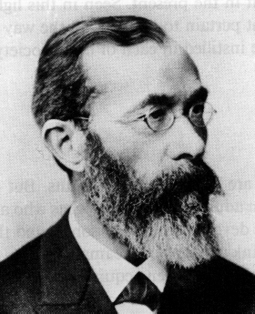
STRUCTURALISM
In 1879, Wilhelm Wundt established the first “psychological” laboratory in Germany. He is widely viewed as the founder of psychology.
He attempted to uncover the structure of consciousness by breaking down mental processes into their most basic components.
This was done through a process called introspection.
Wundt’s approach became known as structuralism.

Slide 10
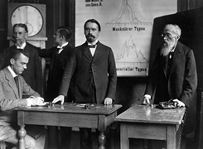
Wundt's Laboratory in Leipzig, Germany

Slide 11
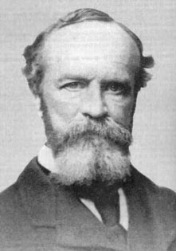
FUNCTIONALISM
William James argued that consciousness cannot be broken down into elements.
He was concerned with ongoing conscious experience and the functions of mental processes.
His views gave rise to another branch of psychology - functionalism

Slide 12
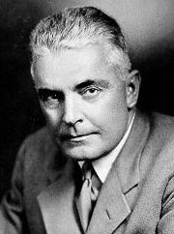
BEHAVIOURISM
Behaviourists held the view that only overt behaviour can be studied scientifically.
They advocated the use of strict experimental procedures in psychology.
Supported by B. F. Skinner, Ivan Pavlov and John B. Watson
John B. Watson

Slide 13
BEHAVIOURISM
Strict behaviourists believed that all behaviours are shaped by the environment.
Give me a dozen healthy infants, well-formed, and my own specified world to bring them up in and I’ll guarantee to take any one at random and train him to become any type of specialist I might select -- doctor, lawyer, artist, merchant-chief and, yes, even beggar-man and thief, regardless of his talents, penchants, tendencies, abilities, vocations, and race of his ancestors. --John Watson, Behaviorism, 1930

Slide 14
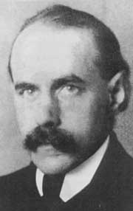
GESTALT PSYCHOLOGY
Gestalt psychology – founded by Max Wertheimer
Focused on studying mental processes and behaviours as ‘wholes’ rather than trying to separate them into discrete functions or parts.
Held the view that “the whole is greater than the sum of its parts.”

Slide 15
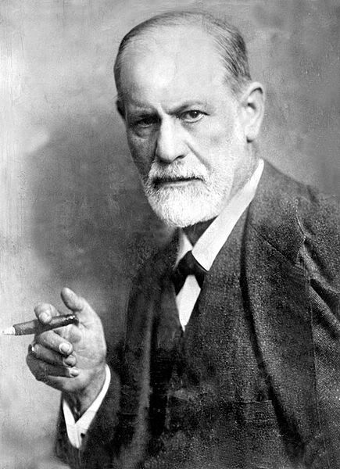
PSYCHOANALYSIS
While other theorists tried to explain varying aspects of conscious experience, Sigmund Freud argued for the role of the unconscious and other internal processes in human behaviour and mental disorders.
His work formed the foundation of psychoanalytic theory

Slide 16
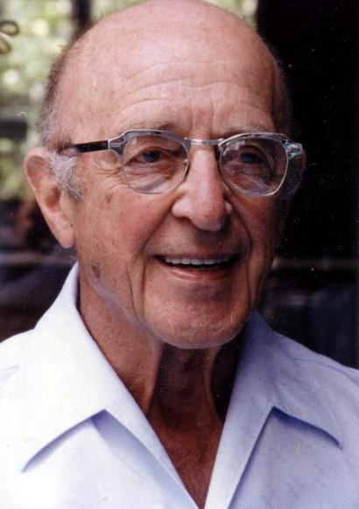
HUMANISTIC PSYCHOLOGY
Humanistic psychologists argued that humans are not helplessly controlled by unconscious or environmental forces – we have free will, goals, aspirations, and other positive motives which should be studied.
Influenced by Carl Rogers.

Slide 17
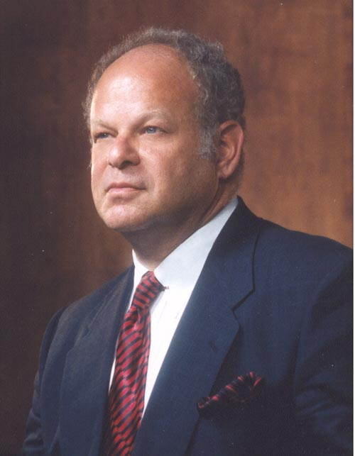
POSITIVE PSYCHOLOGY
Founded by Martin Seligman
Arose from the observation that psychologists generally focus on the negative side of human behaviour while largely neglecting the more positive aspects of human experience.
Focused on discovering and promoting factors that allow individuals and communites to thrive.

