Slide 1
Goin’ country
The evolution

Slide 2
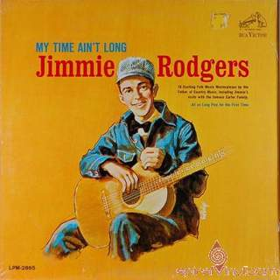
Early country music (or hillbilly music) *Early 1900’s * all about that fiddle, bout that fiddle, bout that fiddle

Slide 3
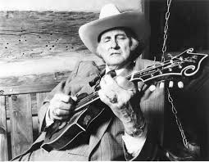
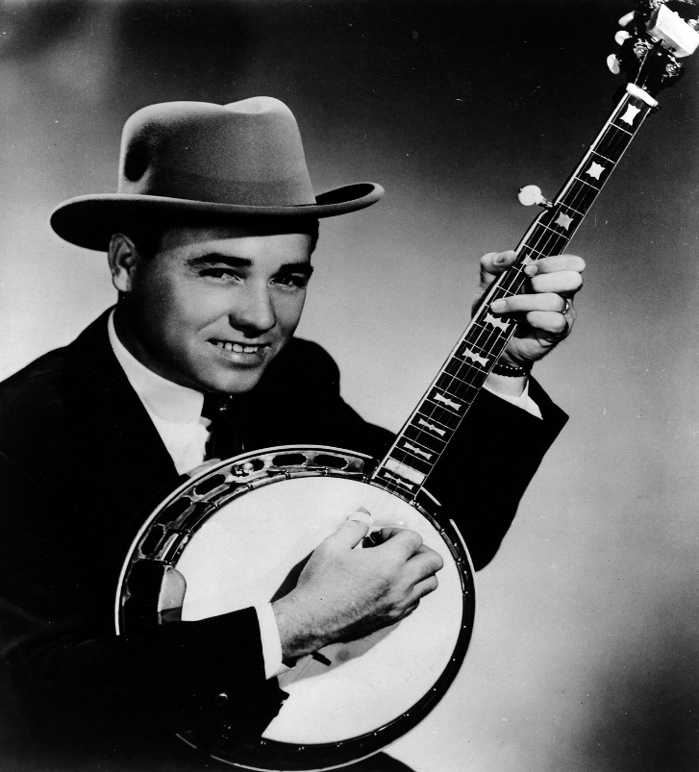
Bluegrass1930’s
Mandolin, fiddle, bass, vocals
Banjo, guitar

Slide 4
Cowboy music 1930’s * Western movies

Slide 5
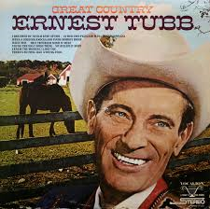
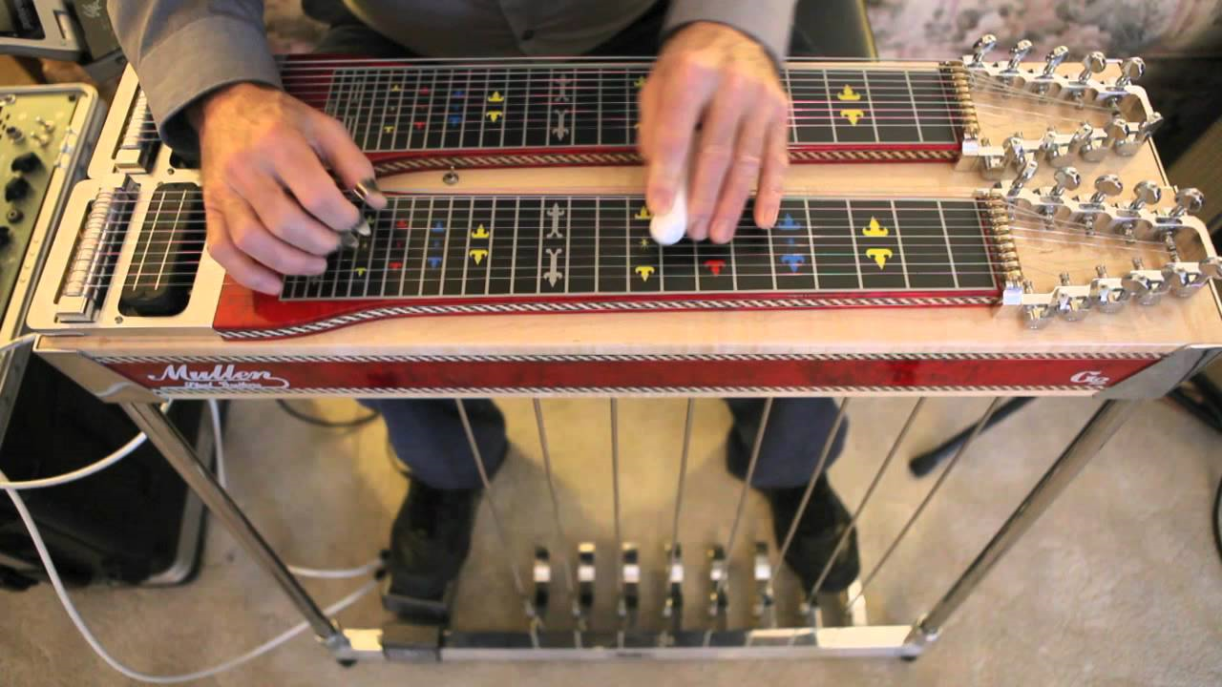
Honky- tonk 1950’s
*up-beat songs
*fiddle, pedal steel guitar
*drinking and infidelity
* Born out of bars

Slide 6
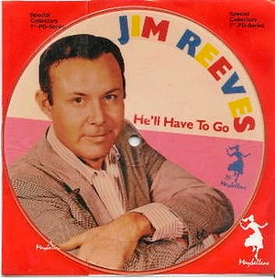
Nashville sound1950’s
*producers wanted to clean up “country”
*Background singers
* Orchestral sounds

Slide 7
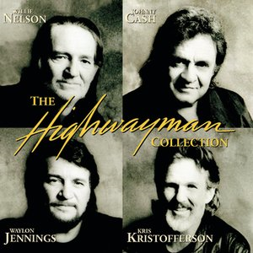
Outlaw country 1970’s and 80’s

Slide 8
Other greats from 70’s
Kenny rogers
Charlie pride

Slide 9
More country greats
Dolly Parton
Loretta Lynn

Slide 10
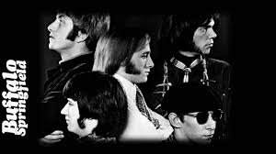
Country rock1960-1970’s
The fusion of rock and country
The Byrds
The Eagles
Lynard Skynard
Buffalo Springfield
Bob Dylan

Slide 11
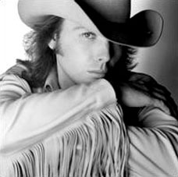
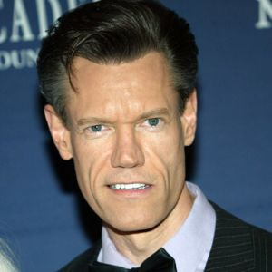
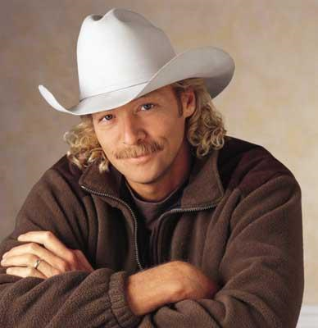
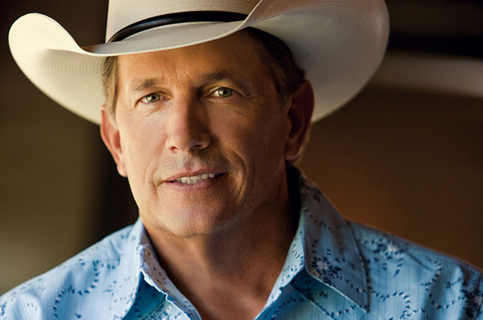
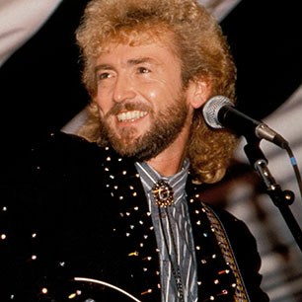
New traditionalist
1980’s
*Artists revived old country and mixed it with a new modern production sound
*new artists = new sound

Slide 12
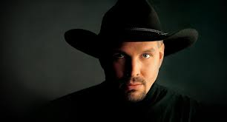
NEW COUNTRY 1990-2000
COUNTRY REACHES NEW POPULARITY WITH RECORD SALES
CROSSOVER ARTISTS
CONCERTS BECOMING HUGHLY ENTERTAINING (SPECIAL EFFECTS, ETC.)

Slide 13
SHANIA TWAIN
CANADIAN
CHANGED COUNTRY
SOLD OVER 85 MILLION RECORDS
ONE OF THE BEST SELLING ARTISTS OF ALL TIME

Slide 14
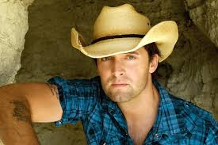
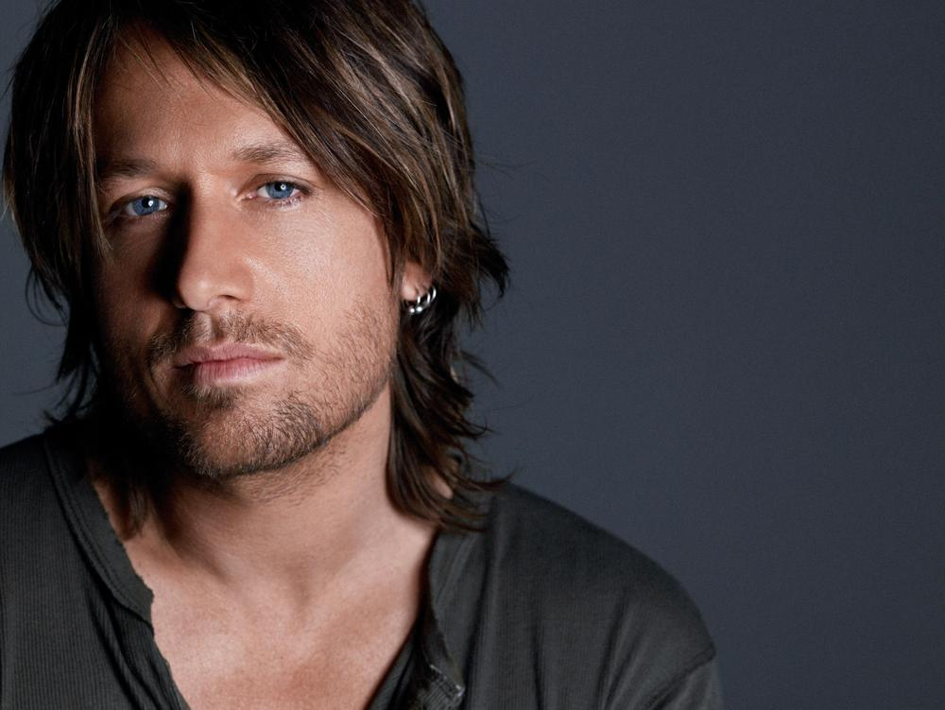
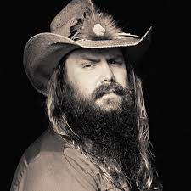
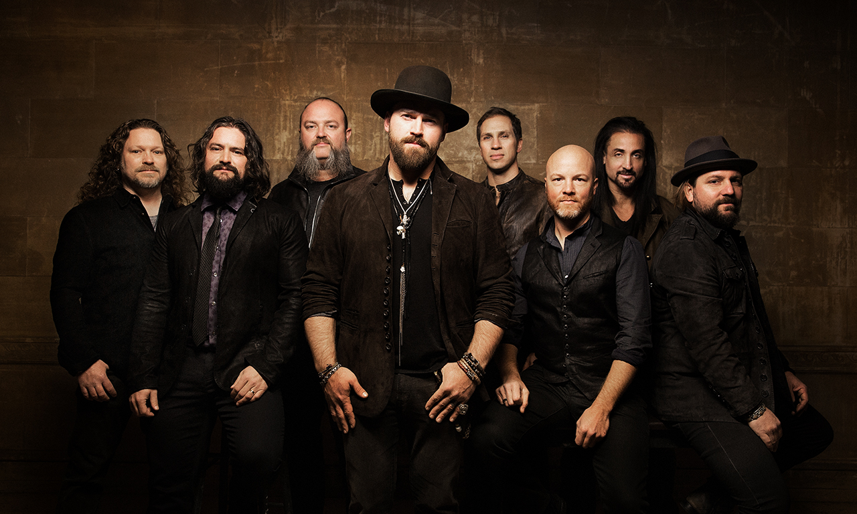
MODERN COUNTRY 2000-2017
CARRIE UNDERWOOD(AMERICAN IDOL)
KEITH URBAN
TAYLOR SWIFT
DEAN BRODY
JESS MOSKOLUKE (CANADIAN FEMALE ARTIST OF THE YEAR 2015, 2016)
Beyonce/Dixie Chicks

