Slide 1
Physics 122
The sequel

Slide 2
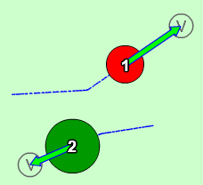
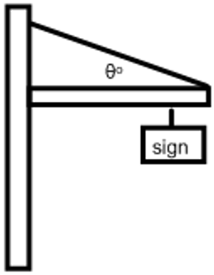
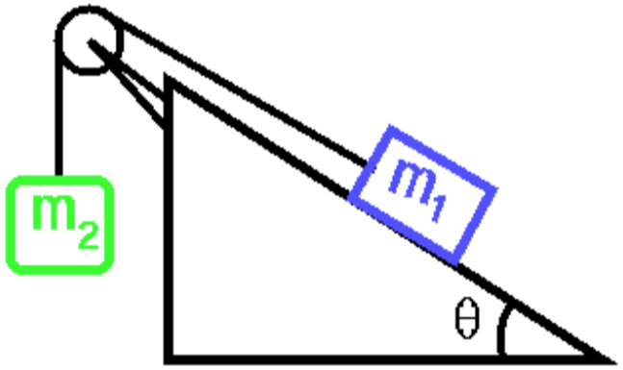
Mechanics in 2D

Slide 3
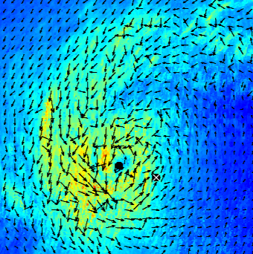
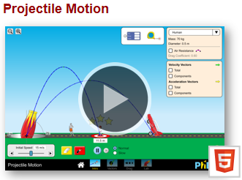
Representing Vectors

Slide 4
Motion in Two Dimensions
Scalars: Measurements independent of direction (time, distance, mass, speed). Magnitude only.
Vectors: Measurements that have a magnitude and direction (velocity, acceleration, force, position).
Vectors that are perpendicular to each other act independently. That is why the axes of our coordinate system meet at right angles.
Neglecting air friction, the horizontal motion of an object has no influence on an object’s vertical motion.
Each dimension can be analyzed independently.

Slide 5
Vectors: Perpendicular Components
In 2D, every vector has two component vectors that are perpendicular to each other.
To determine them, we use right triangle trigonometry.
F_{x} = Fcosθ
F_{y}
F
F_{y} = Fsinθ
+y
+x
θ
F_{x}

Slide 6
Perpendicular Components: Direction Matters
When using trig to calculate components, the component will be positive or negative depending on which way it points on the coordinate system.
y
A
B
x
D
C

Slide 7
Calculating Components
F = 450 N 25º above x-axis.
a = 31 m/s² 62º down from negative x-axis.
d = 3475 km [E78ºS]

Slide 8
Calculating Vectors from Components
If you know the two perpendicular components of a vector, the actual vector is the hypotenuse of that right triangle.
The Pythagorean Theorem and the tangent trig ration can be used to calculate the vector.
F
F_{y}
θ
F_{x}

Slide 9
Calculating Vectors
d_{fx} = 45 m, d_{fy} = -23 m
F_{x} = -266 N, F_{y} = 502 N
v_{ox} = 23 m/s, v_{oy} = 31 m/s

Slide 10
Mech1: Projectile Motion
Once launched, the object does not have its own source of propulsion.
The bulk of our analysis will neglect friction. Factors that influence air friction can be analyzed with PhET.
Gravity is the only force influencing ideal projectile motion. (neglecting air friction).

Slide 11
Projectile Motion
Gravity affects only the vertical motion, so apply concepts about uniform acceleration.
v_{fy} continually changes.
No forces affect horizontal motion, apply uniform motion concepts.
v_{x} never changes
Horizontal and vertical motion occur within the same time interval, so time is the link between the motion in two motions.

Slide 12
Qualitative Analysis
What affect does increasing the following have on maximum height and range:
Initial velocity
Initial height
Mass of object
Diameter of object
Acceleration due to gravity
Launch angle

Slide 13
Qualitative Analysis
If the initial height is zero, what angles result in the object landing in the same location?

Slide 14
Quantitative Analysis

Slide 15
Quantitative Analysis: Example 1
A soccer ball is kicked with an initial velocity of 42 m/s at 75º up from the horizontal. It lands 90 m down the field.
Calculate the time the ball was in the air.
Calculate the height of the ball above the ground 5.9 seconds after it was kicked.
Is the ball on the way up or on the way down at 5.9 seconds?

Slide 16
Quantitative Analysis: Example 2
A meatball rolls off a table that is 1.2 m high and lands 2.4 m away from the bottom of the table. Calculate the initial speed of the meatball.

Slide 17
Qualitative Analysis: Example 3
A cannon is placed atop a 25 m cliff and fires a cannonball with a velocity of 325 m/s 62º up from the horizontal. Calculate the travel time of the cannonball to the ground below.

Slide 18
Qualitative Analysis: Example 4
A cannon is placed atop a 25 m cliff and fires a cannonball with a velocity of 325 m/s 62º up from the horizontal. Calculate the velocity with which the cannonball strikes the ground.

Slide 19
Quantitative Analysis: Example 5
In a particular baseball game, the top of the fence is 2.5 m higher than where the ball is hit. Suppose the ball leaves the bat at an angle of 57º, with what speed does the ball need to leave the bat to clear the fence?

Slide 20
Quantitative Analysis: Example 6
A wide receiver is 2.5 m in front of a quarterback when he begins to run at 3.2 m/s. 4.7 seconds later, the QB throws the ball to the running WR. If the throwing angle was 35º, calculate the velocity necessary to have the ball land at the WR while he is still running. Assume the ball is caught at the same height it was thrown.

Slide 21
Quantitative Analysis: Example 7
A basketball net is 0.75 m higher than where a player releases the ball. If the player is 5.0 m from the hoop and launches the ball with a speed of 8.5 m/s, calculate the angle necessary for the ball to go in the hoop.

Slide 22
Word Problems: 2D Vectors
Like many physics problems, first go through the information given carefully, identify formulas and solve the problem.
What is different now is that we need to analyze the physics in the horizontal and vertical (or east and north) directions independently.

Slide 23
Word Problems: 2D Vectors
A car is driving 25 m/s [E] and turns to end up going 25 m/s [N]. This takes 5.0 seconds. Calculate the average acceleration acting on the car.
From this we can get net force, coefficient of friction, final position, etc.

Slide 24
Another Example
An object has an initial velocity of 52 m/s [W60ºN]. It experience an acceleration of 7.5 m/s² [W28ºS] for 35 seconds. Calculate the object’s final position.

Slide 25
Mech2: Vector Addition & Relative Velocity
When multiple vectors of the same type act on an object, the resultant vector, R, is determined through vector addition.
For example, three forces acting on an object.
Vectors are broken into their perpendicular components.
Components in the same dimension are added together, taking into account direction.
The resultant is calculated using Pythagorean Theorem and the inverse tangent.

Slide 26
Vector Addition & Relative Velocity
R_{x} (or d_{x}) = d_{1x} + d_{2x}
d₂
d_{2y}
R_{y} (or d_{y}) = d_{1y} + d_{2y}
R
d_{2x}
R² (or d²) = (d_{x})² + (d_{y})²
d₁
d_{1y}
θ
θ = tan⁻¹(d_{y}/d_{x})
Start
d_{1x}

Slide 27
Vector Addition Example
A person walks 25 m [E75N], 50 m [W20N] and finally 35 m [E40S]. Calculate the final, or resultant, position.

Slide 28
Missing Vector Problems
Sometimes you are given the resultant and must calculate for a missing vector.
Example: After a walk suppose you are located 2.75 km [W35N] from your home. Then you receive a call to visit a friend's house, located 4.3 km [E62N] from your home. How far and in what direction should you walk to get to your friend's house?

Slide 29
Relative Velocity
Relative velocity is vector addition of multiple velocities acting on an object at the same time. Many problems usually include boats or planes.
Example: A boat is aimed directly across a river and has a velocity of 13 km/h relative to the water. The current is moving 4.5 km/h [E] relative to the ground. Calculate the velocity of the boat relative to the ground.

Slide 30
Relative Velocity
On a day when the wind is blowing 62 km/h [W30ºS] you wish to fly to a destination 725 km [E40ºS] in 2.5 hours. What heading and speed should you fly your dragon?

Slide 31
Kinematics in 2D
These questions will read like questions involving accelerating objects from grade 11. The big difference is the vectors will be in two dimensions.
To solve, we calculate the perpendicular components of all vectors and apply the physics relationships, the math, in each dimension.
The final answer is determined with Pythagorean Theorem and inverse tangent of the components.

Slide 32
Kinematics in 2D
Calculate the acceleration of a car that changes its velocity from 32 m/s [E20N] to 32 m/s [W30S] in 7.5 seconds.
Calculate the final position of the car relative to its starting point.

Slide 33
Kinematics in 2D
A boat is sailing at 4.2 m/s [E63S]. The wind accelerates the boat with an acceleration of 1.7 m/s² [W33S] for 27 seconds.
Calculate the final velocity of the boat.
Calculate the final position of the boat.

Slide 34
Physics
Quantum
Waves
Mechanics
Kinematics
Dynamics
The study of how objects move.
The study of why objects move.

Slide 35
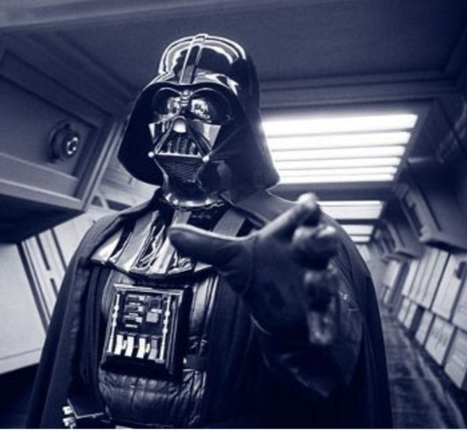
Force
A push or a pull.
Vector quantity.
Usually results in an acceleration.
Measured in Newtons, N.
Many forces can act on an object all at once.

Slide 36
Types of Forces: Contact or Non-Contact
Forces
Contact
Non-Contact
A force exerted in direct contact with another object.
A force exerted in over a distance.
Gravity
Magnetic
Electric
Friction
Tension
Normal
Applied
Elastic
All these forces can act on an object at the same time!

Slide 37
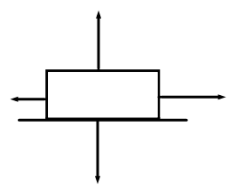
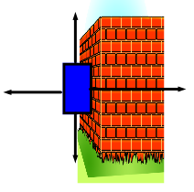
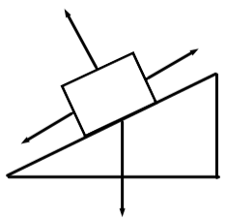
Common Types of Forces
F_{a}: applied force. Usually exerted by a person or a machine on an object.
F_{f}: friction. Acts between two surfaces.
F_{T}: force of tension. Usually along a string, rope or wire.
F_{g}: Force of gravity. Pull from an object’s mass.
F_{N}: Normal force. Acts perpendicular to a surface.
F_{N}
F_{N}
F_{N}

Slide 38
Forces: Types of Problems
Net Force and Equilibrium

Slide 39
Net Force – The Vector Sum
Vector addition, like with relative velocity, requires all the forces to be broken up into perpendicular components.
Example: Forces of 75 N [E23N], 105 N [E55S] and 85 N [W45S] act on an object. Calculate the net force.

Slide 40
Equilibrium and Equilibrant
Equilibrium: When the vector sum of all the forces acting on an object is zero. This occurs if the object is at rest or moving at a constant velocity.
Equilibrant: The vector that, when added, will result in the object achieving equilibrium.
Example: Forces of 75 N [E23N], 105 N [E55S] and 85 N [W45S] act on an object. Calculate the equilibrant.

Slide 41
Pushing at an Angle
+y
A 55 kg snow blower is pushed along the ground at an angle of 35º down from the horizontal with an applied force of 175 N. The μ_{k} is 0.19.
Calculate the perpendicular components of F_{a}
Calculate F_{N}
Calculate F_{f}
Calculate F_{netx}
Calculate a_{x}
-x
+x
-y
F_{N}
F_{f}
F_{ax}
F_{a}
F_{ay}
F_{g}

Slide 42
Pulling at an Angle
+y
A 35 kg wagon is pulled along the ground at an angle of 25º up from the horizontal with an applied force of 97 N. The μ_{k} is 0.22.
Calculate the perpendicular components of F_{a}
Calculate F_{N}
Calculate F_{f}
Calculate F_{netx}
Calculate a_{x}
-x
+x
-y
F_{ay}
F_{a}
F_{f}
F_{N}
F_{ax}
F_{g}

Slide 43
Hanging Objects and Tension
For hanging objects, we analyze how the force of tension breaks up into components.
Since there is no motion, the signs are in equilibrium; the net force is zero.
Two situations: When the wire lengths are the same or different (creates different angles)

Slide 44
Example Problem #1
A sign with a mass of 17 kg is supported by two ropes of identical length and make angles of 22.5º with the horizontal. Calculate the tension is each rope.
Because the ropes are equal in length, they will have equal tensions.
The upward components of tension must support the signs weight.

Slide 45
Example Problem #1
+y
-x
+x
A sign with a mass of 17 kg is supported by two ropes of identical length and make angles of 22.5º with the horizontal. Calculate the tension is each rope.
-y
F_{T}
F_{T}
F_{Ty}
F_{Ty}
F_{Tx}
F_{Tx}
F_{g}

Slide 46
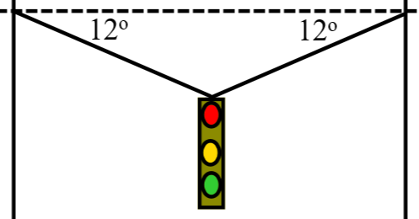
Example Problem #2
A 65 kg traffic light hangs in the middle of a wire.
Calculate the magnitude of the force of tension supporting the light.
Calculate the force of tension in the wire.

Slide 47
Example Problem #3
m = 75 kg
F_{T1} = 437 N
θ₁ = 20º
Calculate F_{T2} and θ₂.
437 N
F_{T2}
20º
θ₂

Slide 48
Challenge Question (You Can Do It!)
Mass = 125 kg
θ₁ = 32º
θ₂ = 48º
Calculate F_{T1} and F_{T2}.
F_{T1}
F_{T2}
θ₁
θ₂

Slide 49
Forces Along an Inclined Plane
A 25 kg box is pulled up ramp with an applied force of 205 N. The coefficient of friction is 0.33 and the ramp makes an angle of 41º with the ground. Calculate the acceleration of the block.
Determine the forces.
Apply Newton’s 2nd Law: F_{net} = ma
θ

Slide 50
Forces Along an Inclined Plane
F_{N}
+y
F_{a}
+y
-x
+x
-x
+x
F_{f}
-y
θ
-y
F_{gx} = F_{g}sinθ
F_{gy} = F_{g}cosθ
θ
F_{gy}
F_{g}
F_{gx}

Slide 51
Forces Along an Inclined Plane
A 25 kg box is pulled up ramp with an applied force of 205 N. The coefficient of friction is 0.33 and the ramp makes an angle of 41º with the ground. Calculate the acceleration of the block.
F_{N}
+y
F_{a}
-x
+x
-y
F_{f}
F_{gx}
θ
F_{gy}

Slide 52
Forces Along an Inclined Plane
A 55 kg block is sliding down an incline. μ_{k} = 0.13 and the ramp is angled 35º from the ground. Calculate the applied force up the ramp that will result in an acceleration of 0.83 m/s² down the ramp.
F_{N}
+y
F_{f}
F_{a}
-x
+x
-y
F_{gy}
F_{gx}
35º

Slide 53
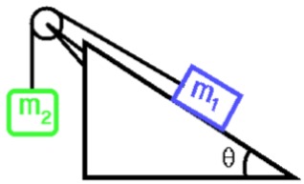
Connected Masses
Like the previous questions, but this time think of the second mass as an upward force on the mass located on the ramp.
We apply Newton’s 2nd Law with a slight adjustment to the additional mass(es):
There is Tension in the wire by each mass. Each tension is equal in magnitude, opposite in direction.

Slide 54
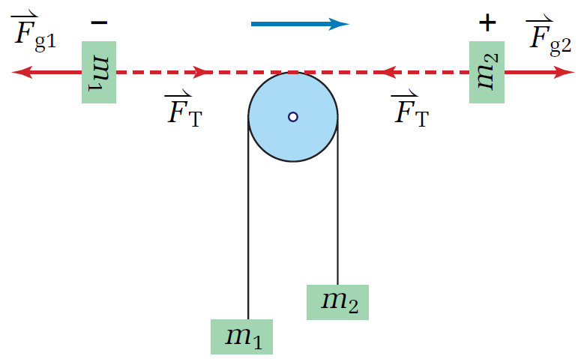
Connected Masses

Slide 55
Connected Masses on a Ramp
A 35 kg counterweight is attached to a mass on the ramp. μ_{k} = 0.23. Calculate M₁ that results in an acceleration of 0.42 m/s² up the ramp.
+y
F_{T1}
F_{N}
F_{T2}
M₁
F_{f}
-x
+x
M₂
F_{g1y}
F_{g1x}
-y
F_{g2}
35º

Slide 56
Connected Masses on a Ramp
B) Calculate the force of tension in the rope.
Apply Newton’s 2nd Law to one of the masses only.
F_{T1}
F_{N}
F_{T2}
M₁
F_{f}
M₂
F_{g1y}
F_{g1x}
F_{g2}
35º

Slide 57
Torque
Torque occurs when a force is applied to an object and that force causes the object to rotate.
r = the distance the force is applied from a pivot point (not a vector).
F⊥ = The component of the force perpendicular to the lever arm or beam.
Counterclockwise rotation = positive torque
Clockwise rotation = negative torque

Slide 58
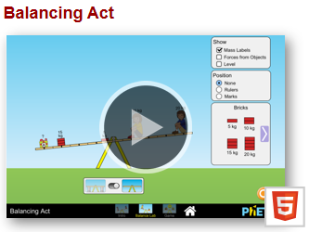
Torque
For an object to experience a torque, there must be a force perpendicular to the lever arm and not be located at the pivot point.
Lever Arm

Slide 59
Net Torque
Net Torque = The sum of all torques acting on an object.

Slide 60
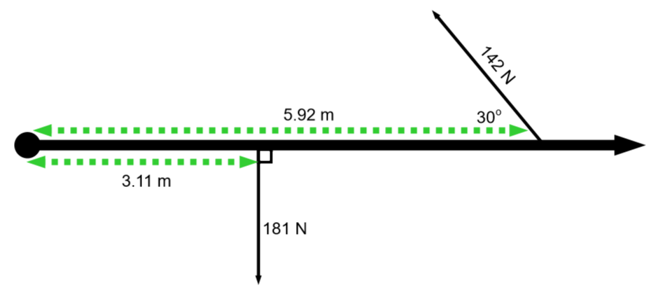
Net Torque Example
Calculate the net torque.

Slide 61
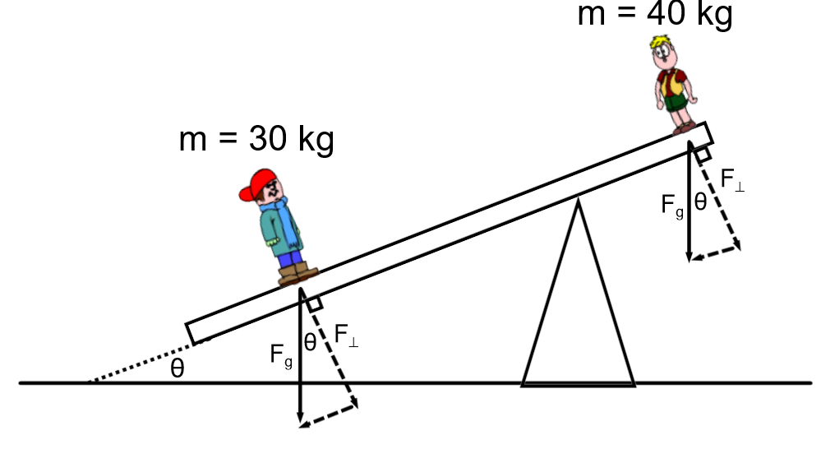
Angled Beam & Torque
Like the inclined plane questions, if the beam is inclined then the trig functions for the components switch. The mainly occurs for problems in which a force acting on a beam is an object’s weight.

Slide 62
Static Equilibrium
Net force is zero
Net torque is zero
Both concepts are applied to analyze and solve problems.
Center of mass: for torque calculations, an object (like a beam) can be analyzed as if all of its mass is contained at one point.
Objects rotate about their center or mass.

Slide 63
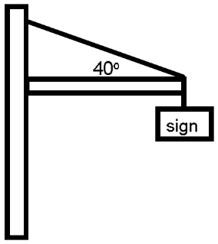
Static Equilibrium
The beam has a mass of 125 kg and is 8.0 m long. The sign has a mass of 75 kg and is located at the end of the beam.
Calculate the tension in the wire.
Calculate the force acting on the hinge, where the beam meets the pole.

Slide 64
Static Equilibrium
A 55 kg person walks across a bridge that is 10 m long plank of wood atop a pillar at each end. The plank has a mass of 12 kg. At a point when the person is 2.5 m from one end, calculate the upward force provided by the pillars to support the bridge.

Slide 65
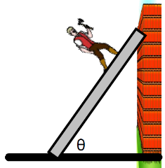
Static Equilibrium
Calculate the coefficient of static friction necessary for the ladder not to slip along the ground. The ladder has a mass of 21 kg, the person has a mass of 58 kg, the ladder is 8.5 m long, a man is 7.0 m from the base of the ladder. The ladder makes an angle of 55º with the ground. There is no friction between the ladder and the wall. {μ_{s} = 0.52}

Slide 66
Uniform Circular Motion
Objects traveling in a horizontal circular path.
Same speed at every instance, however, the direction is continually changing.
Velocity is continually changing at the same rate.
Object is experiencing a constant acceleration.
This is called Centripetal Acceleration (meaning center seeking).
Force to accelerate is called the Centripetal Force.

Slide 67
Centripetal Force
Is the force required to keep an object moving in a circular path.
It could be tension, friction, gravity, lift or a combination of force components that points along the radial direction (along the radius of the circle).
Velocity is perpendicular to the centripetal acceleration and force (tangent to the circle).
v
a_{c}
a_{c}
F_{c}
F_{c}
v

Slide 68
Formulae
T = Period, the time to travel the circle once.
r = radius of the circle.
f = frequency in Hz, the number of circles traveled per unit time (revolutions per second).

Slide 69
Example Questions
A 1.5 kg toy is tied to a string and swung in a circle. The toy makes one circle in 0.65 seconds and the length of the string is 0.37 meters.
Calculate the tangential speed of the toy.
Calculate the centripetal acceleration.
Calculate the centripetal force used to move the toy in a circle.
The string breaks under a tension of 62 N. Calculate the shortest period possible before the string breaks.
Keeping the same period as given in the initial problem, calculate the longest length of string that can be used before it breaks.

Slide 70
Example Question: Friction
The period of a spinning record is 1.82 seconds. A 0.25 kg object is placed 0.35 m from the center.
Calculate the rotational (tangential) velocity of the object.
Calculate the centripetal acceleration of the object.
Calculate the centripetal force acting on the object.
If the coefficient of static friction is 0.58, will the object remain in place or move outward?
How far from the center will the object’s static friction be just strong enough to keep it in place?

Slide 71
Example: Friction (no mass given)
The coefficient of static friction between a car’s tires and the dry road is 0.74. Calculate the maximum speed the car can have to safely make a 45 m radius turn.
Centripetal force comes from static friction.
If F_{f} < F_{c}, the car will not make the turn.
F_{N}
F_{c}
F_{f}

Slide 72
Banked Turns: No Friction
An object on the ground is banked when traveling perpendicular to the slope of an incline (i.e. not traveling up or down the incline).
A component of the Normal force is radial.
An airplane is banked when its wings make a non-zero angle with the ground.
A component of the lift is radial.

Slide 73
Banked Turns: Vehicles, No Friction
+y
Banked turns are important because it is possible for objects, like vehicles, to turn a corner without relying on any friction.
-x
+x
F_{Ny}
F_{N}
-y
θ
F_{Nx}
F_{Nx} = F_{N}sinθ
F_{Ny} = F_{N}cosθ = F_{g}
θ
F_{g}
θ

Slide 74
Banked Turn: Example
A 92-meter radius turn is banked at 19º.
Calculate the maximum speed to make the turn without relying on friction.
Calculate the bank angle necessary to have a maximum speed of 25 m/s for the 92-meter turn.

