Slide 1
Chemical Bonding
Ionic, Metallic and covalent bonds

Slide 2
Learning Target #1

Slide 3
Core and Valence Electrons
The electrons are responsible for chemical properties of atoms are those in the outer/highest energy level (principle quantum number n).
Valence e⁻: The s and p orbital electrons in the highest energy level.
Core e⁻: All the electrons in the energy levels below the highest.

Slide 4
Modeling Valence Electrons: Electron Dot Structures
Electron dot structures are used to represent the valence electrons in a atom.
They are represented as dots on the top, bottom an sides of an element symbol.
When creating an electron dot structure, place a dot at one of the sides of the element and continue placing dots around the symbol but not pairing them up until you have to (Hund’s rule)
This is very important because the bonds that form incorporate paired and unpaired electrons in different ways.

Slide 5
Electron Dot Structure/Diagram
Place first dot.
Next dot is placed at an adjacent side.
Continue the pattern.
Never more than 8 dots.
Use Periodic Table for the number of valence e⁻.
N
Br

Slide 6
Octet Rule
When forming compounds, atoms tend to achieve a noble gas configuration; 8 e- in the outer level is the most stable.
There are exceptions, but we will only work with compounds that obey this rule.
Metals lose valence electrons.
Nonmetals gain (or share) one or more electrons to fill their highest energy level.

Slide 7
Pseudo Noble Gas Configuration
Many transition metals would need to lose or gain many (like 6 or more) electrons to achieve a noble gas configuration – this is just not possible.
Some transition metals will aim for a pseudo noble gas configuration, which has 18e⁻ in the highest energy level.
The s, p and d orbitals are filled.
3s²3p⁶3d¹⁰ for a total of 18e⁻.

Slide 8
Cation
A positive ion, formed by losing one or more electrons.
# of electrons lost
+
K
Loses valence e⁻
Potassium
Ion
2+
Ca
Loses valence e⁻
Same # of e⁻ as the noble gas Argon
Calcium
Ion

Slide 9
Anion
# of electrons gained
2-
O
Gains 2 valence e⁻
Oxygen
Same # of e⁻ as the noble gas Neon
Name Change
Oxide

Slide 10
Visualizing Electron Transfer
In this case, you can see how the one e⁻ from Na can complete the octet for Cl.
Formula Unit
Na
Cl
NaCl
+
-
Sodium Chloride
Forms the ions
Na
Cl
Positive and negative charges hold the compound together!

Slide 11
Ionic Compound between Nickel and Phosphorus
Ni has 2 valence e⁻, Phosphorus wants 3 more.
2+
3-
Ni
P
P still needs 1 more e⁻!
P is full! Ni has one more!
2+
Ni
Ni needs to give this e⁻!
Same problem as before!
3-
P
Formula Unit
2+
Ni₃P₂
Ni
Nickel Phosphide

Slide 12
Ionic Compound
Electrons are transferred to achieve a noble gas configuration (8e⁻ in the highest energy level).
-
+
Na
Cl
1s²2s²2p⁶
1s²2s²2p⁶3s²3p⁶
Noble Gas Configuration

Slide 13
Cations
The name for atoms (or compounds) that have a positive charge due to the loss of one or more electrons.
3s
2p
2s
1s
Loss of valence e⁻
Na
+
Sodium Ion
Neutral Sodium Atom

Slide 14
Anions
The name for atoms (or compounds) that have a negative charge due to the gain of one or more electrons.
3p
3s
2p
2s
1s
Gain 2 valence e⁻
S
2-
Sulfide
Neutral Sulfur Atom

Slide 15
Cations With More Than One Ion
3d
4s
3p
3s
2p
2s
1s
Half-filled orbital is a lower energy/more stable configuration
Loss of Valence e⁻ and one from the 3d orbital
Loss of Valence e⁻
2+
3+
Fe

Slide 16
Predict Tin’s Possible Ionic Charges
5p
4d
5s
Pseudo noble gas configuration
Sn
4+
2+
Filled orbital is a lower energy/more stable configuration

Slide 17
Ionic Compounds
Are compounds composed of cations and anions.
Also called salts.
Electrically neutral (charges are present, but they balance out.
Cations transfer electrons to the anions, the electrostatic force between the ions creates the ionic bond.
Simplest ratio of ions is called the formula unit.

Slide 18
Formula Unit vs Chemical Formula
A chemical formula communicates the kinds and number of atoms in the smallest part of a substance.
Ionic compounds don’t have a “smallest part”
Ionic compounds have a formula unit, the lowest whole-number ratio of ions to have a neutral charge.
NaCl is a 1:1 ratio
Fe₂O₃ is a 2:3 iron-to-oxygen ratio

Slide 19
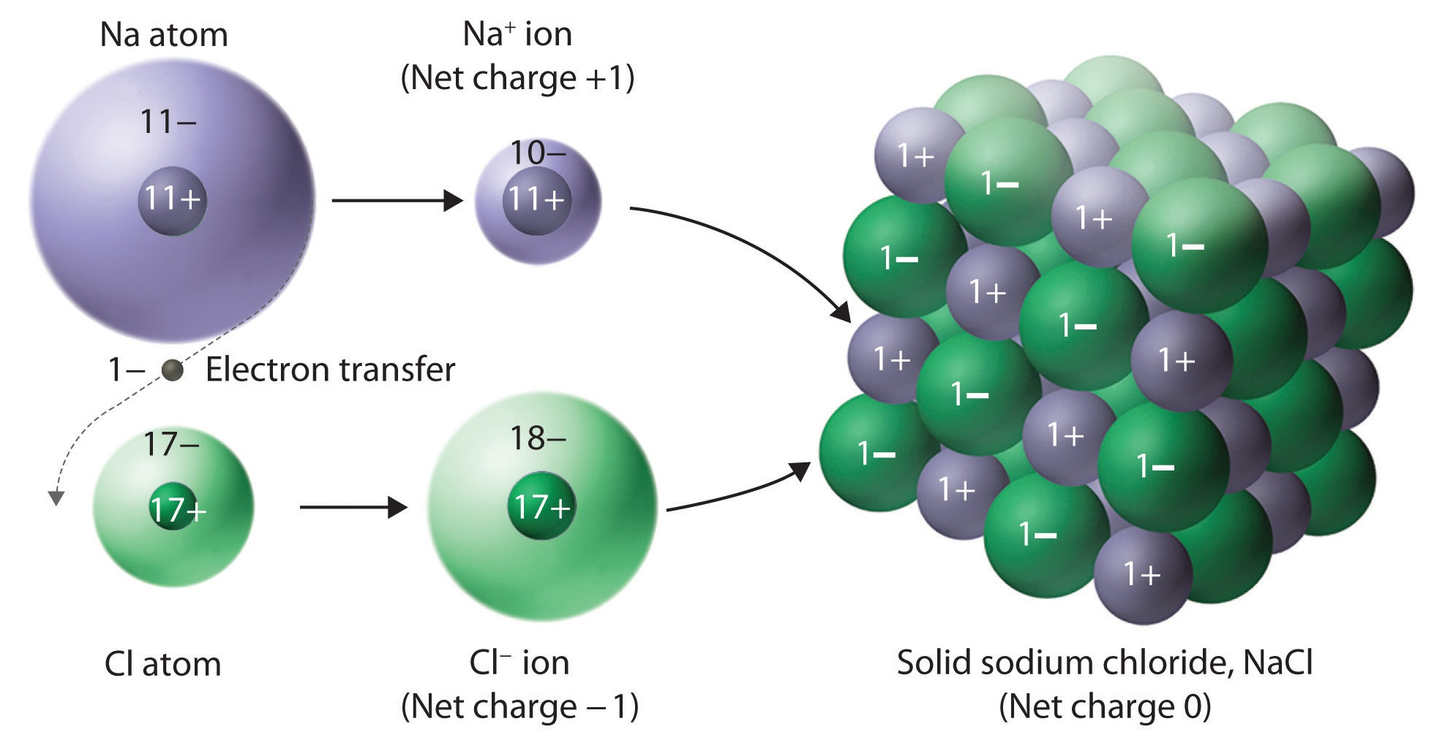
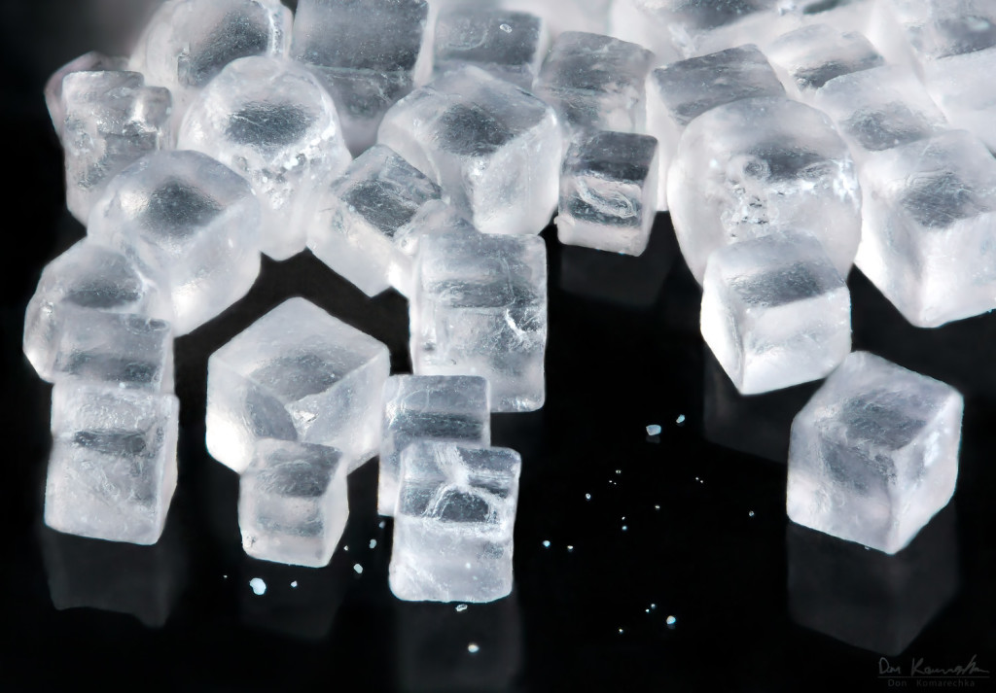
Structure of Ionic Compounds
Exist as a crystalline solid – a regular repeating arrangement of ions.

Slide 20
Properties of Ionic Compounds
Crystalline solids at room temperature.
The alternating of + and – ions results in a very stable structure.
The electrostatic force between the ions is very strong.
Brittle when an external force is applied.
Very high melting points.
Conduct electric current when melted or dissolve.

Slide 21
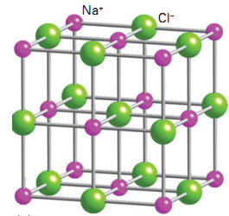
Crystalline Structure
The arrangement of ions in ionic compounds is an alternating of + and – ions, but the varying sizes of the atoms the number of electrons involved lead to varying internal structures.
Internal structures are summarized by an ion’s coordination number. That is the number of ions of opposite charge that surround it. In sodium chloride, they each have a coordination number of 6.

Slide 22
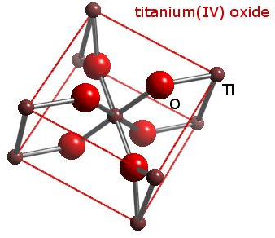
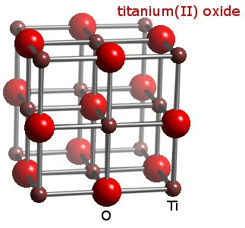
Other Crystalline Structures

Slide 23
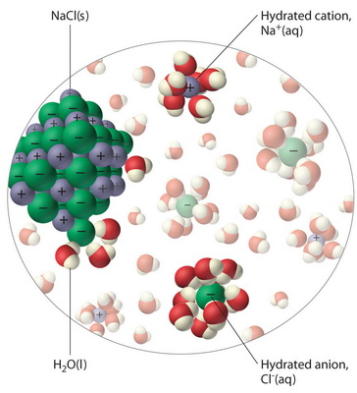
Conductivity When Melted and Dissolved
Ionic compound separate into their ions when placed in water or melted.
The ions are then capable of conducting an electric current as they orient within an electric field.

Slide 24
Bonding in Metals
Valence e- in metals can be modeled as a sea of electrons.
They are mobile and change positions as needed.
Explains the physical properties of metals.
High melting points (strong electrostatic bonds).
Malleable and ductile.

Slide 25
Sea of Electrons

Slide 26
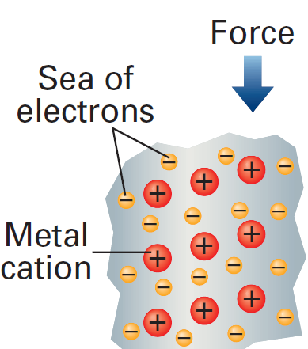
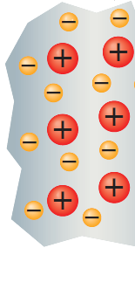
Electron Insulation

Slide 27
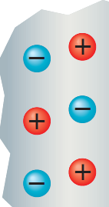
No Electron Insulation: Ionic Compounds
Force
Strong repulsion from like charges

Slide 28
Crystalline Structure of Metals
Metal atoms are arranged in very compact and orderly patterns.
Body-centered cubic
Face-centered cubic
Hexagonal close-packed

Slide 29
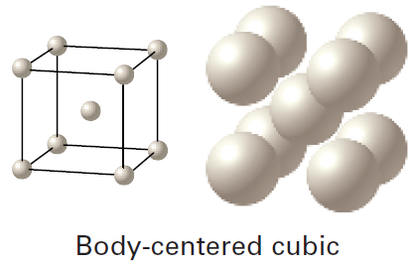
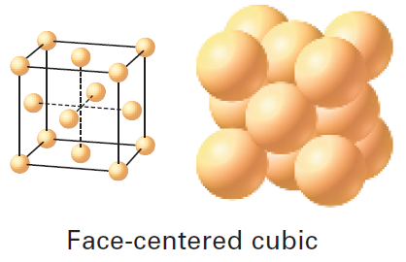
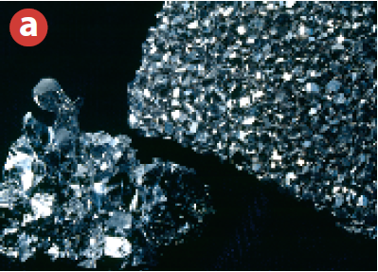
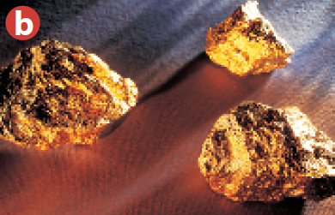
Crystalline Structure of Metals

Slide 30
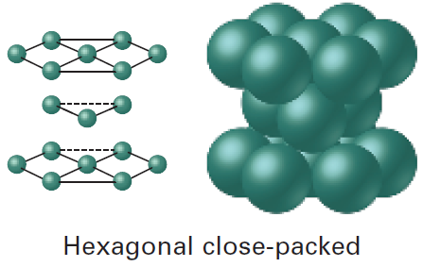
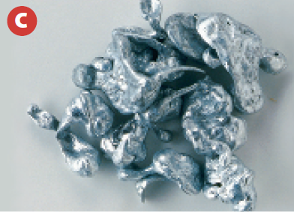
Crystalline Structure of Metals

Slide 31
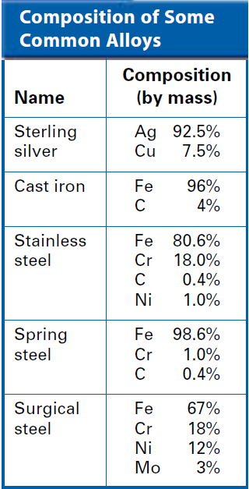
Alloys
Alloys are physical mixtures composed of two or more elements, at least one of which is a metal.
Important because their properties are often superior to those of their components.

Slide 32
Shorthand e⁻ Configuration
The first part of the electron configuration is represented by the preceding noble gas in square brackets. Ex. [Kr]5s²4d⁸ would be for Palladium.
Pd = 1s²2s²2p⁶3s²3p⁶4s²3d¹⁰4p⁶5s²4d⁸
Krypton’s e⁻ Configuration
Pd = [Kr]5s²4d⁸

Slide 33
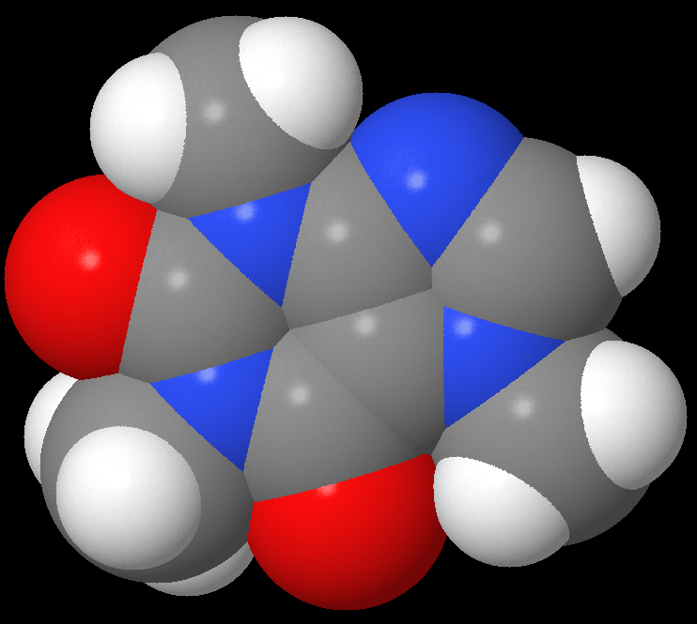
Molecular Compounds

Slide 34
Molecular Compounds
Formed through the sharing of electrons between non-metal atoms.
A bond formed through the sharing of electrons is called a covalent bond.
Exist as individual molecules with a chemical formula.
CH₄, CO₂, N₂O, CO

Slide 35
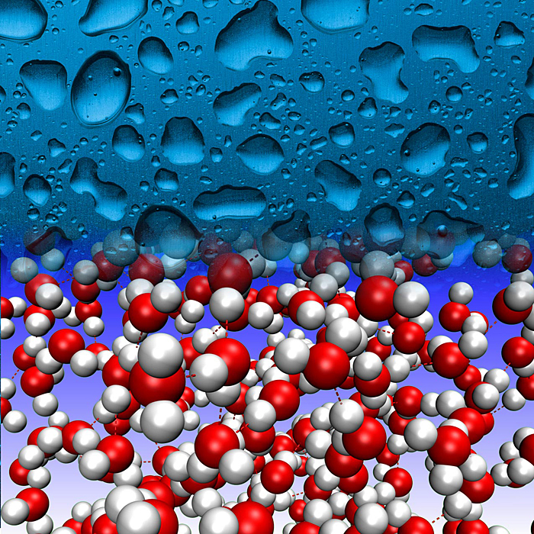
Molecular Compounds
Relatively low melting and boiling points.
Many are liquids or gases at room temperatures.
Exist as individual molecules.
Commonly represented with a molecular formula (how many of each atom). CH₄, N₂O, H₂O

Slide 36
Representing Molecular Compounds

Slide 37
Covalent Bonds
A covalent bond is formed when electrons are shared between two non-metals.
Occurs so that atoms can attain the electron configuration of a noble gas (octet rule).
Single covalent bond
Double covalent bond (second strongest)
Triple covalent bond (strongest)
Coordinate covalent bond

Slide 38
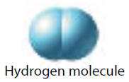
Single Covalent Bond
Two atoms held together by share one pair of electrons.
Each atom supplies one electron for a total of two.

Slide 39
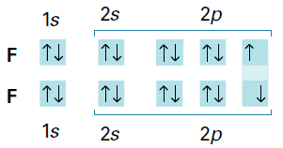
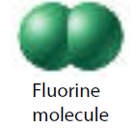
Single Covalent Bond: Structural Formula
Fluorine needs one more electron to complete the octet; which it can get from another fluorine atom.
Structural formula: Covalent bonds are represented as dashed lines.

Slide 40
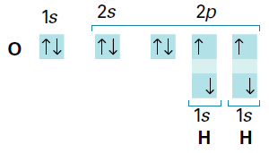
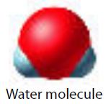
Unshared Pairs of Electrons
Atoms want to have 8 electrons, but they don’t all have to partake in covalent bonding.
Such pairs of electrons are called unshared pairs.
Influence other aspects of the molecule like its shape and interaction with its brethren molecules.

Slide 41
Review

Slide 42
Double Covalent Bond
Atoms share two electrons each, for a total of four, creating two pairs of electrons. Ex: CO₂
Double Bond
Double Bond
O
C
O
Remember, only unpaired electrons will be contributed from each atom to form a bond.

Slide 43
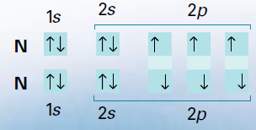
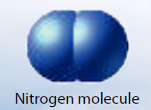
Triple Covalent Bond
Two atoms each provide three electrons, for a total of six, to create the triple bond.
Triple Bond
N
N

Slide 44
Coordinate Covalent Bond
A bond in which one atom contributes both bonding electrons required for a covalent bond.
C
O
C
O
Oxygen has no more unpaired electrons.
However, being awesome, it will share a full pair!

Slide 45
Polyatomic Ions
Atoms that covalently bond together to have an ionic charge. Ex: SO₃²⁻, often have a coordinate covalent bond.
2-
O
S
O
Sulfur has 8e-
Clue that a coordinate covalent bond is required
O

Slide 46
Polyatomic Ion: SO₃²⁻ Structural Diagram
2-
O
S
O
O

Slide 47
Structural Diagram Algorithm
Formula to calculate how many bonds are needed:
Have = Add up all the valence electrons including any electrons gained or lost by a polyatomic ion.
Want = Count up the total # of electrons to achieve a noble gas configuration (2 for hydrogen, 8 for all other elements).
Subtract the Want - Have; then divide by two (each bond is two electrons)
The answer is how many bonds to draw.
Fill in the rest of the valence electrons, don’t forget any extra electrons if it is a polyatomic ion.

Slide 48
Example: Structural Diagram for HCN (Cyanic Acid)
Given that C is the central atom.
N – has 5 valence electrons, wants 8.
C – has 4 valence electrons, wants 8.
H – has 1 valence electron, wants 2.
Have = 5 + 4 + 1 = 10
Want = 8 + 8 + 2 = 18
Math: (Want – Have)/2
= (18 – 10)/2 = 4 bonds required

Slide 49
Structural Diagram for HCN
The molecule requires 4 bonds
H
C
N
H can’t have more than two electrons
Other bonds must be between C & N
Add remaining electrons
Check for coordinate covalent bonds

Slide 50
Structure Diagram for PO₄³⁻
Given that P is the central atom (surrounded by all O).
P – has 5 valence electrons, wants 8
O – has 6 valence electrons x 4, wants 8 x 4
Anion Charge – 3 additional electrons
Have = 5 + 6x4 + 3= 32
Want = 8 + 8x4 = 40
Math: (Want – Have)/2
= (40 – 32)/2 = 4 bonds required

Slide 51
Structure Diagram for PO₄³⁻
3-
O
O
O
P
O
O
P
O
O
O
Is a coordinate covalent bond necessary?

Slide 52
Learning Target Review

Slide 53
Molecular Compounds Bonding Theories and Shapes

Slide 54
Bonding Theories
Covalent bonds are created when electron orbitals overlap. The overlapping orbitals create molecular orbitals.
Molecular orbitals belong to the entire molecule, not just a particular atom.
A molecular orbital that can be occupied by two electrons of a covalent bond is called a bonding orbital.
There are two types of bonds that create molecular orbitals:
Sigma bonds, σ-bonds
Pi bonds, π-bonds

Slide 55
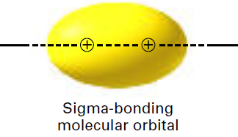
Sigma Bonds
Occurs when two atomic orbitals combine to form a molecular orbital along the bonding axis connecting the two atomic nuclei.
Can occur with two s-orbitals, two p or an s and p-orbital.
Bonding axis

Slide 56
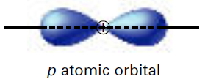
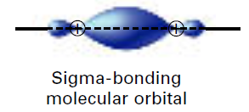
Sigma Bonds: With p-orbitals
Like atomic orbitals, they are regions with a high probability of finding an electron around the molecule.

Slide 57
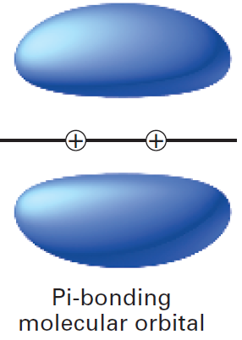
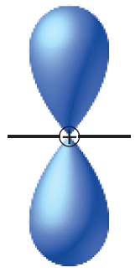
Pi Bonds
The electrons are most likely to be found in bean-shaped regions above and below the bonding axis.
p-orbitals only.
Pi bonds overlap less than sigma bonds, so pi bonds tend to be weaker.

Slide 58
VSEPR Theory
Valence Shell Electron-Pair Repulsion
Theory governing the shape a molecule takes.
Their shape plays a major role in physical properties such as melting and boiling points.
VSEPR Theory: The repulsion between lone electron pairs causes molecular shapes to adjust so that the valence-electron pairs stay as far apart as possible.

Slide 59
Visualizing e⁻ Pairs: Molecular Shapes

Slide 60
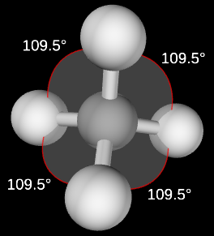
Types of Shapes
Tetrahedral

Slide 61
Determining Molecular Shapes: Gr. 11
For a given molecule, draw its structural diagram and locate the electron pairs that are not part of a covalent bond.
If lone pairs of electrons exist on the central atom, the molecule will bend, otherwise it will not.
Count how many atoms in the molecule and determine the shape.
Note, we will use this only for linear triatomic, bent triatomic, trigonal planar, or pyramidal.
Many molecules do not obey the octet rule for all atoms. So how they bond together is more complicated and hence we will stick to octet obeying molecules.

Slide 62
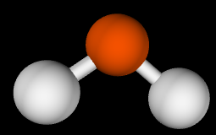
Bent vs Linear: H₂O vs CO₂
H
O
H
Lone Pairs:
Molecule will bend.

Slide 63
Bent vs Linear: H₂O vs CO₂
No Lone Pairs on C:
Molecule will not bend.
O
C
O

Slide 64
CBLT3 Review

Slide 65
Molecular Compounds: Polar Bonds and Their Applications
When two different atoms bond covalently, there could be an unequal sharing of the electrons.
The more electronegative atom will have a stronger pull on the electrons and will acquire a slight negative charge.
Electronegativity is the ability of an atom to attract shared electrons to itself. It is a number from 0 to 4.
Such a bond is called a polar bond.

Slide 66
Periodic Table: Electronegativity

Slide 67
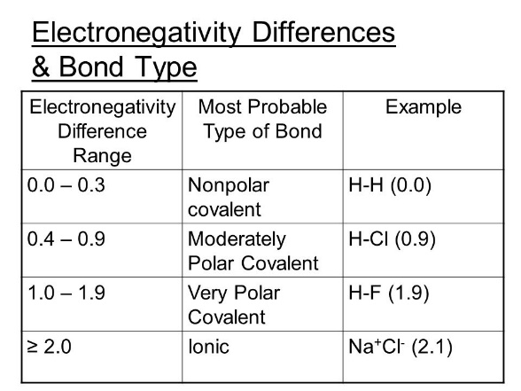
Determining Bond Type
Use the periodic table of electronegativity to find the electronegativity of each atom and subtract lowest from the highest (have a positive answers).
Use the chart to determine the bond type.
Molecular polarity effects the physical state of molecules.

Slide 68
Labeling Bond Polarity
Atoms obtain partial charges, much less than a ±1 charge like in an ionic bond.
Partial charges are represented with the lowercase Greek letter delta, δ. δ+ if positive, δ- if negative.
For example, HCl:
δ+
δ-
H
Cl

Slide 69
Labeling Bond Polarity
Can also be shown using an arrow above the structural diagram:
H
Cl

Slide 70
Polar Molecules
Polar bonds may make the entire molecule polar.
If areas of charge are created through the existence of polar bonds.
A molecule that has two poles is called a dipole (like small magnets).
For example, HCl is a polar molecule.
Area of positive charge
Area of negative charge
H
Cl

Slide 71
Polar Molecule Interactions: HCl
H
Cl
H
Cl
H
Cl
H
Cl
H
Cl

Slide 72
Molecular Polarity
Polar bonds don’t necessarily result in a polar molecule. The shape of the molecular plays a role in determining areas of charge difference.
For example, CO₂
No distinct positive and negative regions.
Try to draw a line through the molecule so the areas of positive and negative are on either side.
O
C
O
3.5
2.5
3.5
Very Polar Bonds

Slide 73
Molecular Polarity: Water, H₂O
3.5
δ-
δ-
Due to the bent shape, water is a polar molecule.
O
H
H
2.1
2.1
δ+
δ+

Slide 74
Attractions Between Molecules
Forces exist between molecules of a compound, called intermolecular forces.
Weaker than both covalent and ionic bonds.
Responsible for the state (solid, liquid or gas) of a molecule at a particular temperature.
Three types of intermolecular forces:
Dispersion Forces
Dipole Interactions
Hydrogen Bonds
Called Van der Waals forces

Slide 75
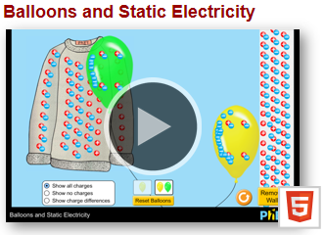
Dispersion Forces
Caused by the motion of electrons.
Force between molecules increases as the number of electrons increase.
Weakest of all intermolecular forces.
Most prominent effect is that of the state of the halogens at room temperature and normal pressure:
Fluorine and chlorine are gases.
Bromine is a liquid.
Iodine and astatine is a solid.

Slide 76
Dipole Interactions
Polar molecules are attracted to one-another.
Positive area of one molecule attracts the negative area of another, and vice-versa.

Slide 77
Dipole Interactions
H
Cl
H
Cl
H
Cl
H
Cl
H
Cl

Slide 78
Hydrogen Bonding
Two conditions for hydrogen bonding to occur:
A hydrogen is covalently bonded to a very electronegative atom (creates a very polar bond).
With no other electrons to shield it, the positive nucleus is exposed.
The electronegative atom has at least one lone pair of electrons.
The hydrogen bond is between the hydrogen in one molecule and the lone pair of electrons in another molecule.

Slide 79
Hydrogen Bonding
Extremely important in determining the properties of water and biological molecules like proteins.
Relatively high melting and boiling points of water.
The surface tension of water (how it beads and does not spread out).
δ⁻
This hydrogen is bonded covalently to:
the highly negative oxygen, and
a nearby unshared pair.
δ⁺
O
δ⁻
H
δ⁺
δ⁺
H
H
O
H
δ⁺

Slide 80
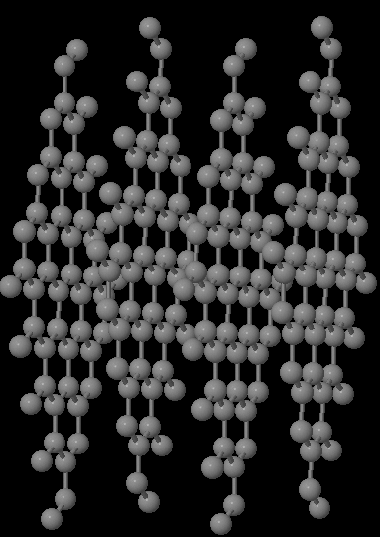
Network Solid

Slide 81
Network Solid
All the atoms are covalently bonded together.
There are no individual molecules.
Think of it as one big molecule.
Very high melting points as all the covalent bonds throughout the solid must be broken (as opposed to only the intermolecular bonds of other compounds)
Diamond, graphite (carbon atoms)
Silicon Carbide

Slide 82
Summary of Ionic and Covalent Bonds
Learning Target Complete

