Slide 1
The Evolution of Fitness Trends
Wellness Through Physical Education 110

Slide 2
Learning Objectives
G.C.O. 1.0 : Students demonstrate an understanding of the concept of wellness.
S.C.O. 1.3 : Students analyze how society, media and culture influence wellness.
Students will research popular fitness trends.
Students will predict future fitness trends
Students will compare and contrast their experience trying a past fitness trend

Slide 3
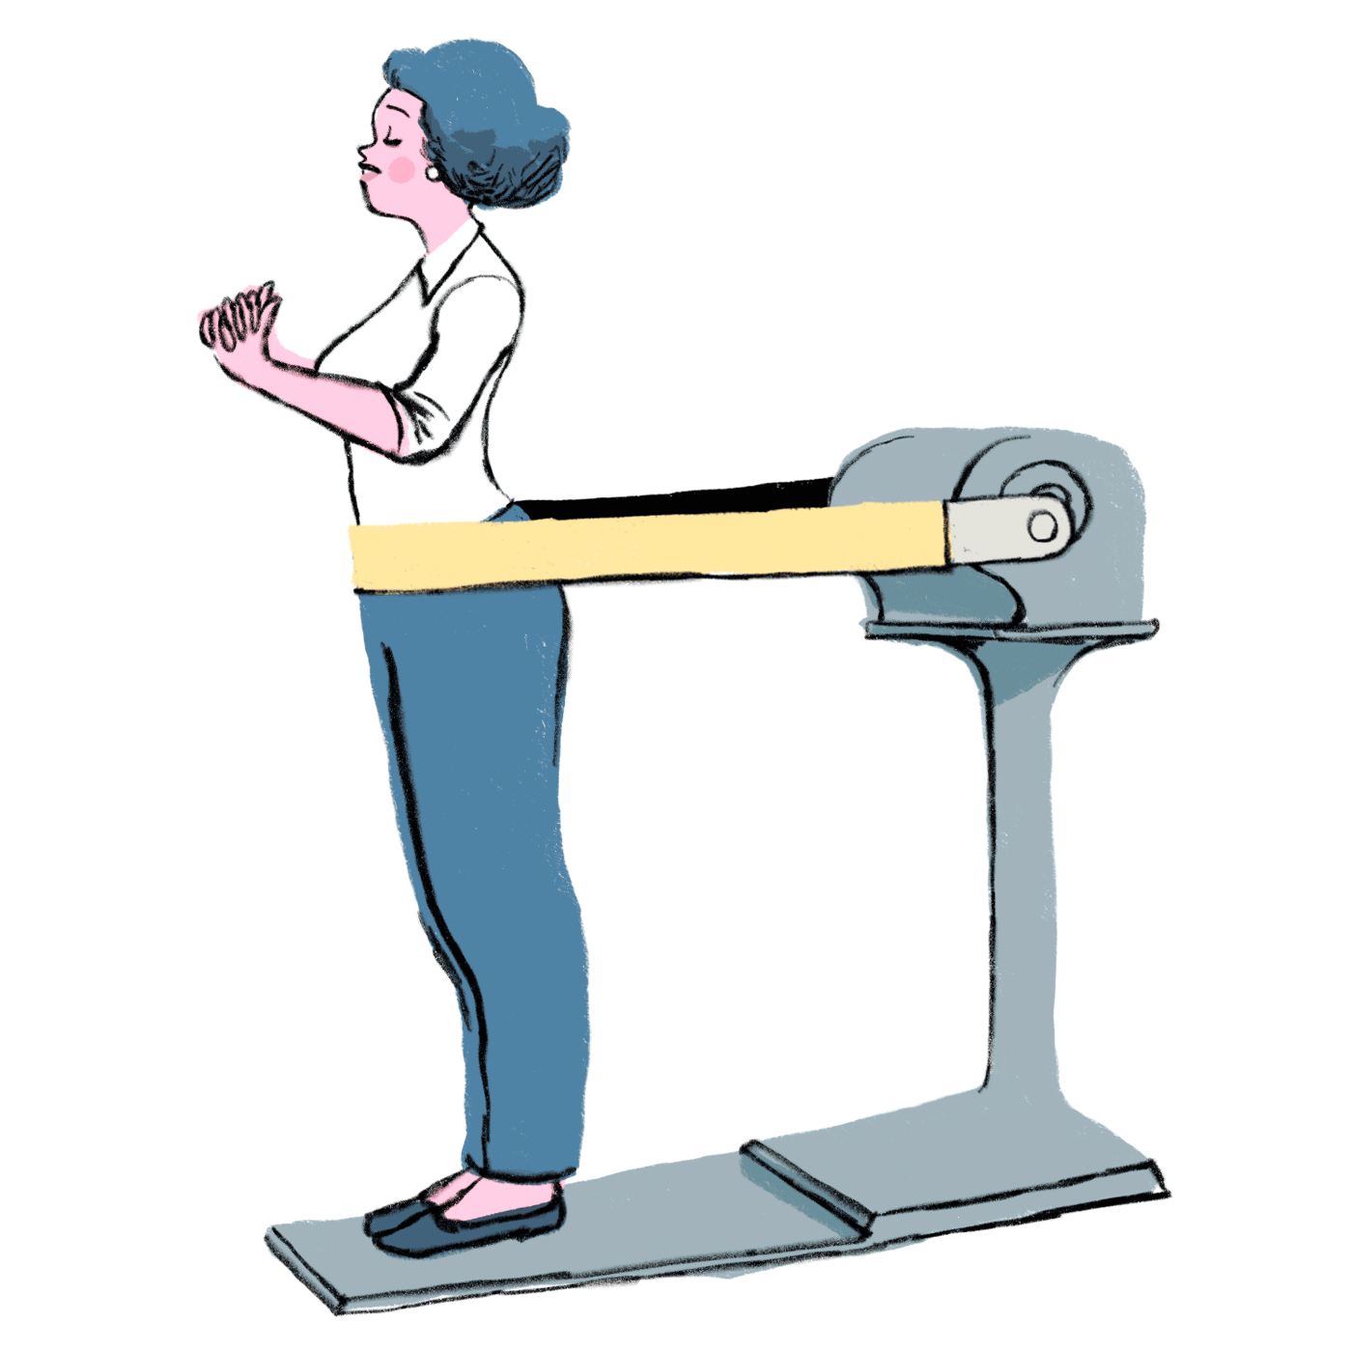
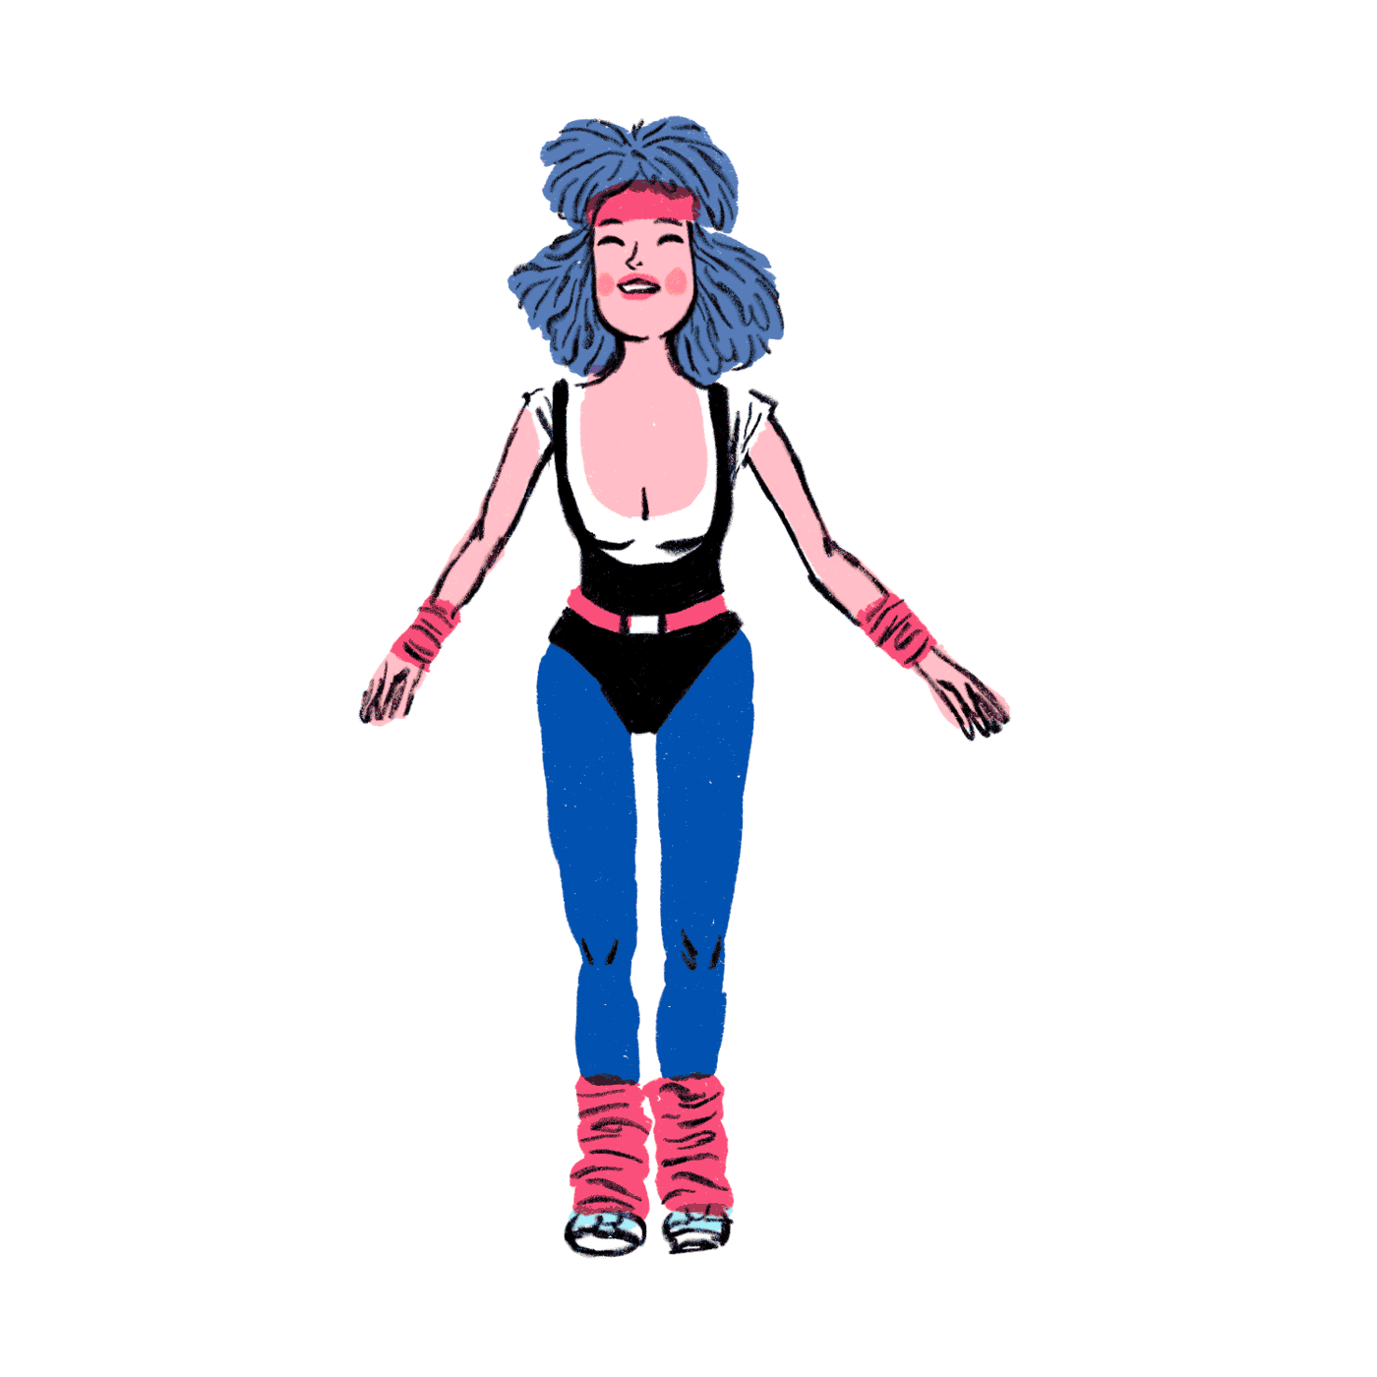
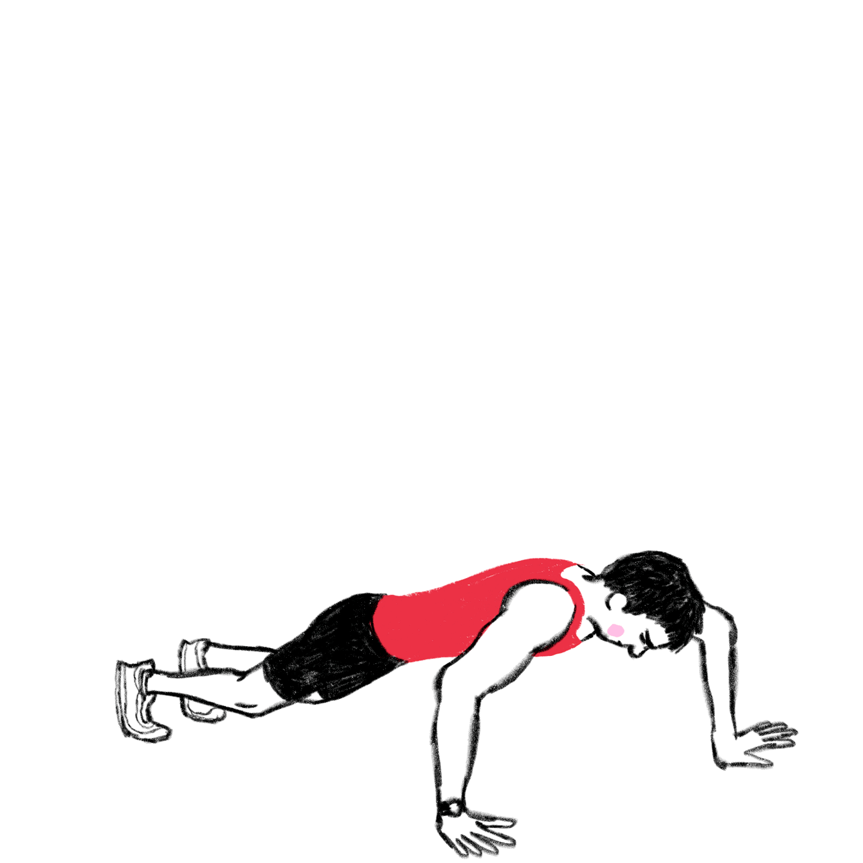
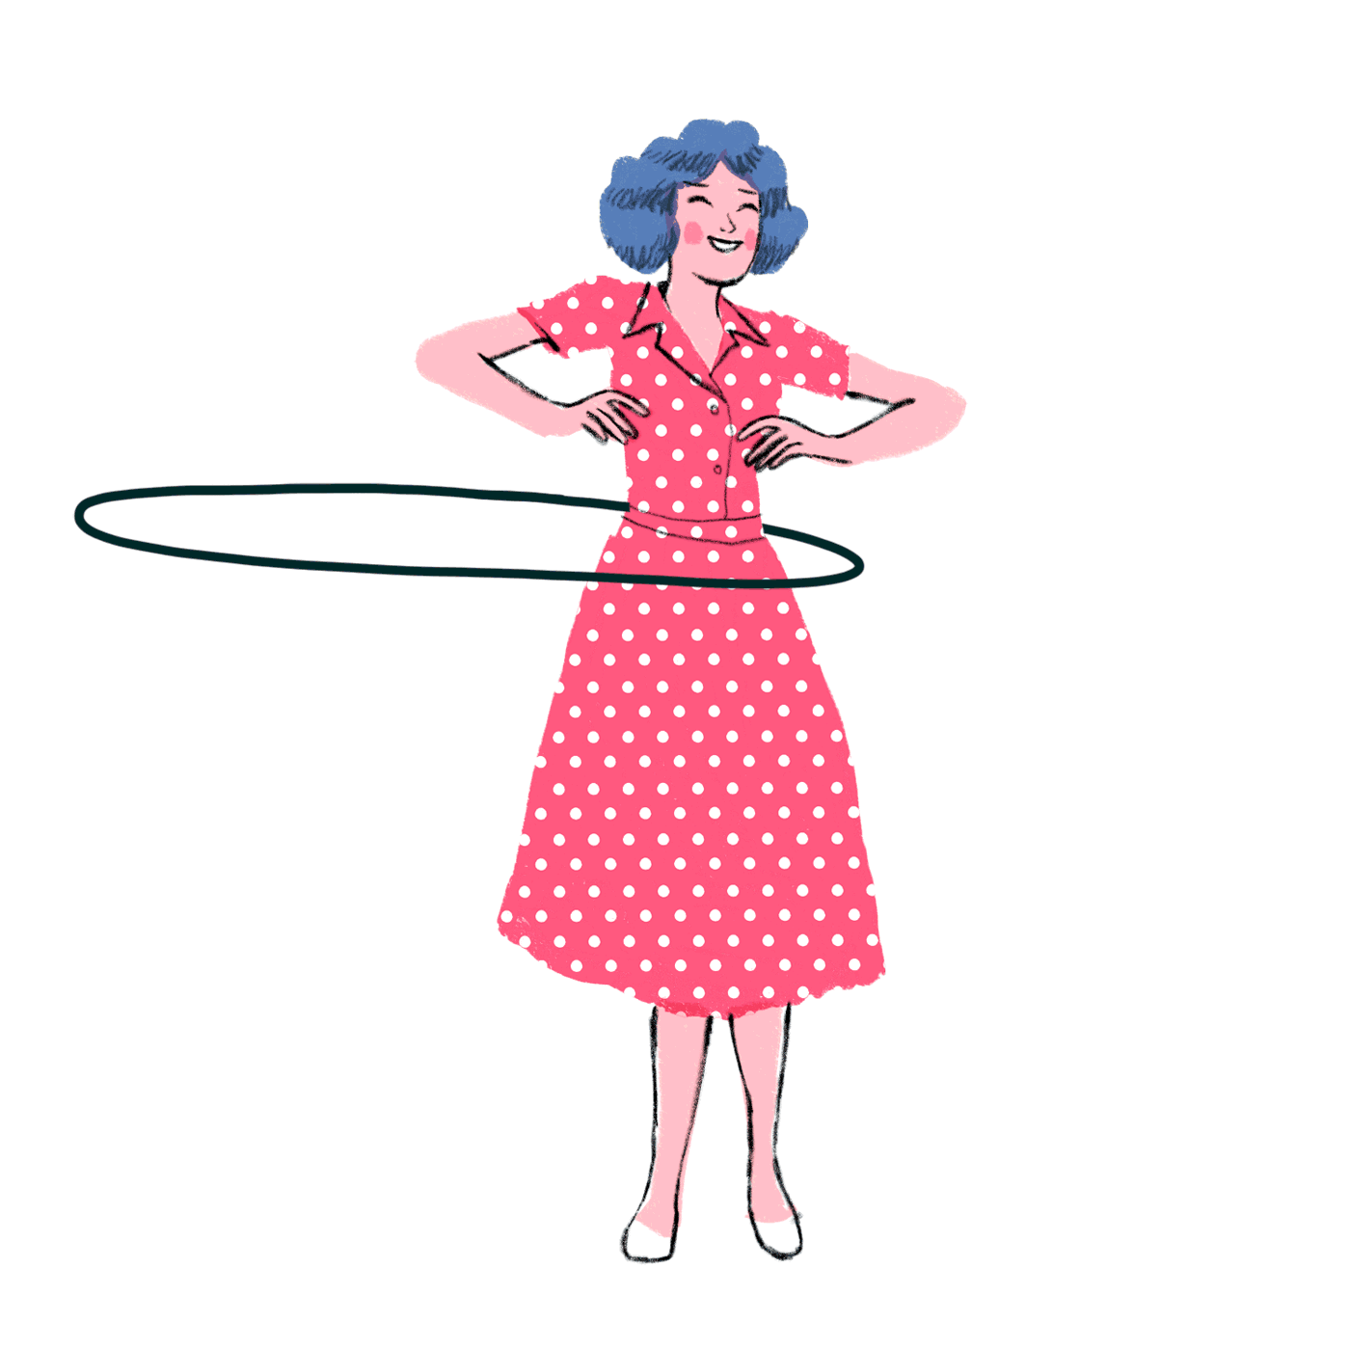
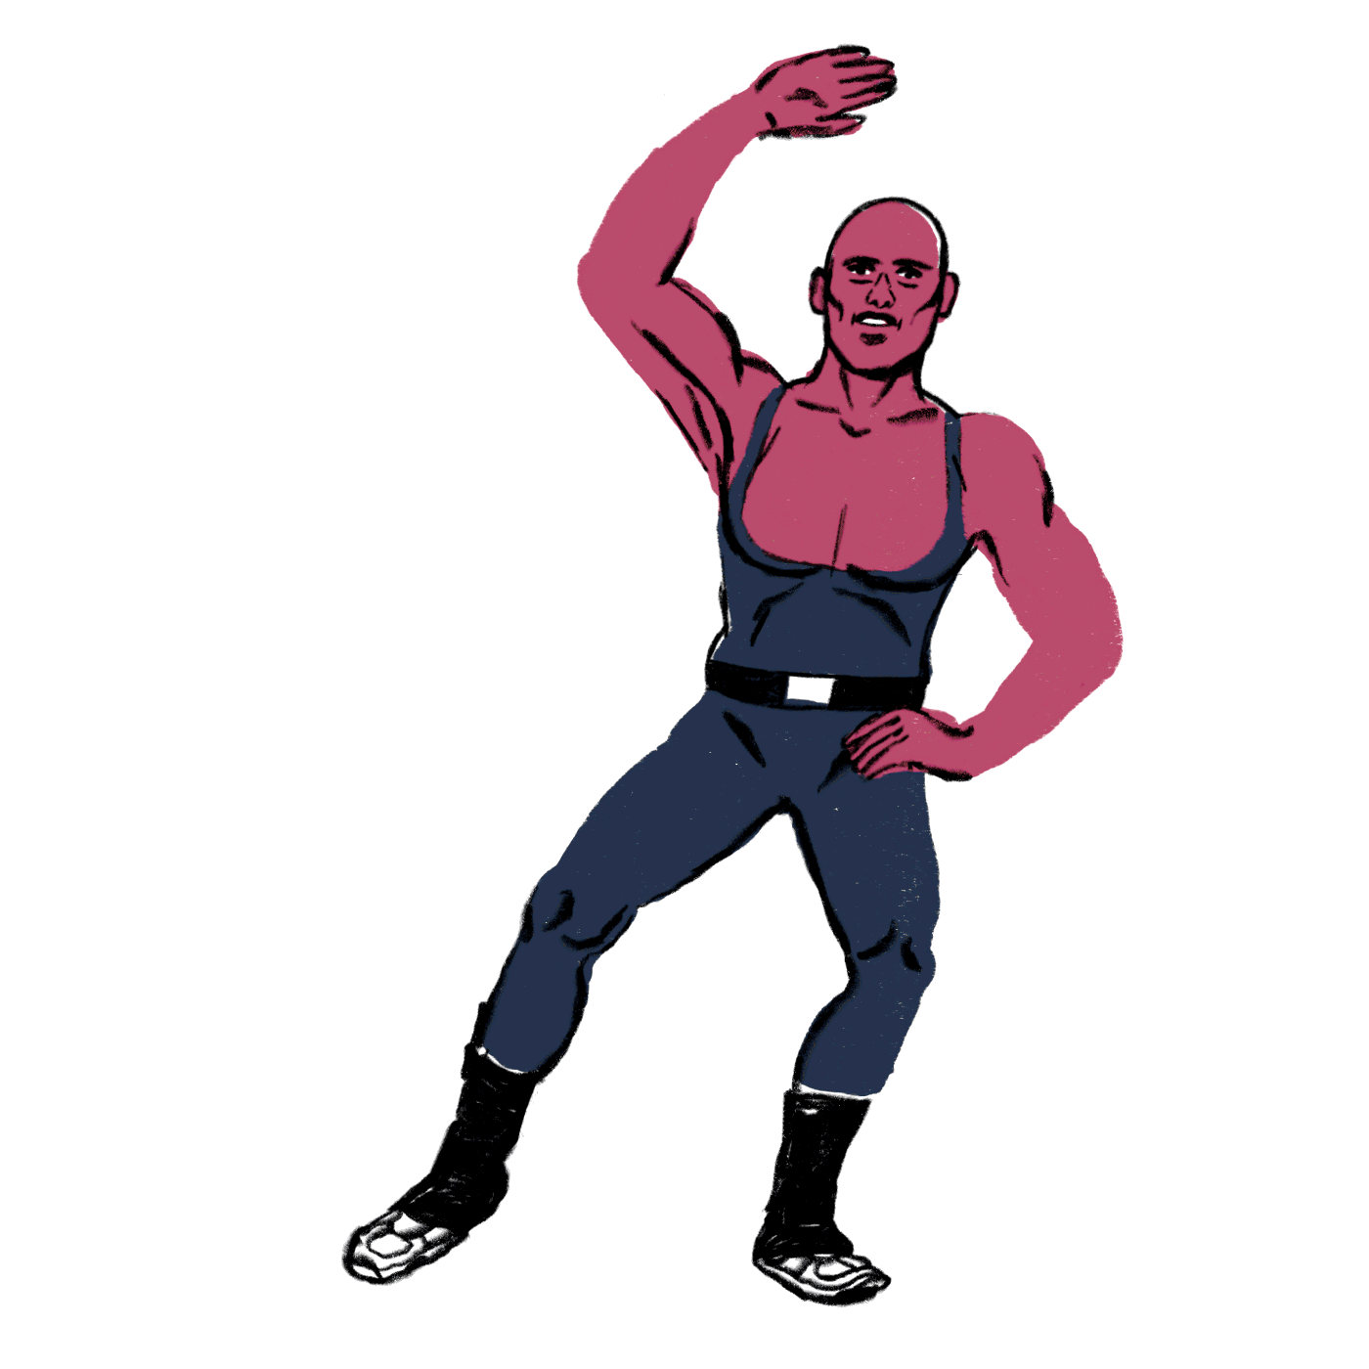
Overview
Travel through time as you explore the evolution of fitness of trends. You will begin in the 1950s where you will progress through the decades until you reach 2020.
Many of the fitness trends you will research in this assignment have laid the foundation for some of the modern exercises we do today.

Slide 4
Getting Started: 100 Years of Fitness
Step 1: The description may include how this trend came to be and who was responsible for creating or popularizing the trend (e.g. Jane Fonda’s Workouts in the 1980s).
Your description may also include information regarding equipment, workout gear or music the trend introduced or popularized.
Step 2: Insert a video or picture of the trend .

Slide 5
1950s
Trend:
Description of Trend
Delete this text box and insert Video or Picture.

Slide 6
1960s
Trend:
Description of Trend
Delete this text box and insert Video or Picture.

Slide 7
1970s
Trend:
Description of Trend
Delete this text box and insert Video or Picture.

Slide 8
1980s
Trend:
Description of Trend
Delete this text box and insert Video or Picture.

Slide 9
1990s
Trend:
Description of Trend
Delete this text box and insert Video or Picture.

Slide 10
2000s
Trend:
Description of Trend
Delete this text box and insert Video or Picture.

Slide 11
2010s
Trend:
Description of Trend
Delete this text box and insert Video or Picture.

Slide 12
2020 Current Trend:
Although the new decade has just begin, what is a current fitness trend popular right now?
Delete this text box and insert Video or Picture.

Slide 13
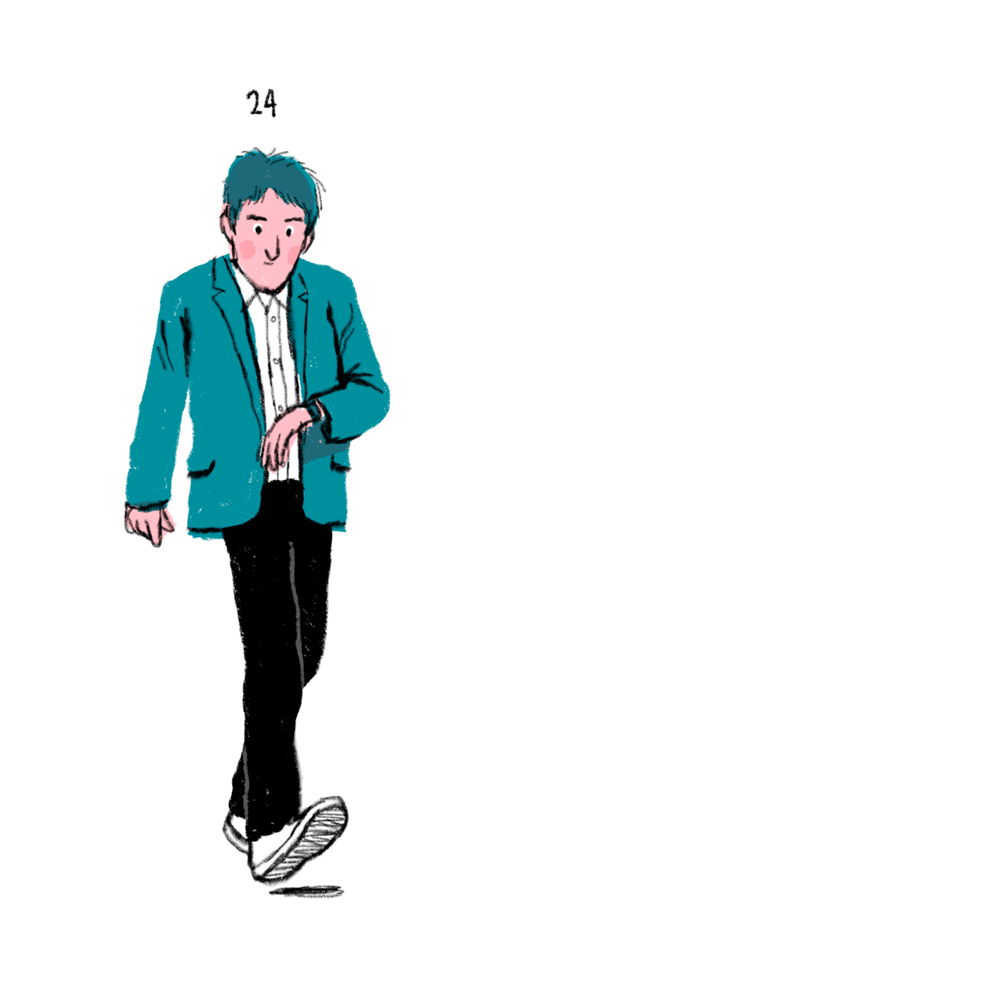
Future Predictions
What do you predict the future fitness trends will look like?
Example: Fitness Tracking

Slide 14
Compare and Contrast: Give it a try!
Of the all the fitness trends you have researched, select one and try it out on your own or with a family member.
Write a brief compare and contrast about your experience trying a past fitness trend to one you do now.

