Slide 1
Chemical Reactions
Chemical changes, factors and equations

Slide 2
Chemical Reactions
Chemical Reactions are what happens when new compounds are produced.
They are represented by a chemical equation.
A chemical equations summarizes what compounds are reacting and what compounds are produced.
Reactants Products

Slide 3
Chemical Reactions
Represented by three types of chemical equations:
Word Equation – uses the chemical names
Skeleton Equation – uses the chemical formulas
Balanced Equation – upholds the law of conservation of mass
Law of Conservation of Mass
Atoms in a chemical reaction can not be created nor destroyed, but they can be transferred to, or exchanged, with other atoms to produce new compounds.

Slide 4
Law of Conservation of Mass
In a non-nuclear chemical reaction, the total mass of the reactants is always equal to the total mass of the products.
Atoms are not destroyed, just rearranged.
Not possible to “lose” two hydrogen atoms and gain a third oxygen.
Methane + Oxygen Water + Carbon Dioxide
CH₄ + O₂ H₂O + CO₂

Slide 5
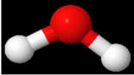
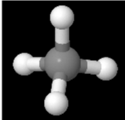
Law of Conservation of Mass
To conserve mass we need more molecules!
Methane + Oxygen Water + Carbon Dioxide
+
+
2
CH₄ + O₂ H₂O + CO₂
2
This chemical equation is now balanced.

Slide 6
Balancing Chemical Equations
Refers to the act of conserving mass.
We use a skeleton equation to represent the reaction.
Skeleton equations are balanced by changing the coefficients until mass is conserved.
Skeleton Equation
CH₄ + O₂ H₂O + CO₂
Balanced Equation
CH₄ + O₂ H₂O + CO₂
2
2
coefficients

Slide 7
Balancing Chemical Equations

Slide 8
Balancing Chemical Equations: Examples
Fe + S → Fe₂S₃
MgO → Mg + O₂
Fe₂O₃ + C → Fe + CO
2
3
2
2
3
2
3

Slide 9
Balancing Chemical Equations: Examples
2
Na₂CO₃ + Ca(OH)₂ → NaOH + CaCO₃
BaBr₂ + Na₃PO₄ → Ba₃(PO₄)₂ + NaBr
3
2
6

Slide 10
Types of Chemical Reactions: Combination and Decomposition
Combination (synthesis): The combination of smaller atoms and/or molecules into larger molecules.
Two or more reactants combine to create one product.
Example: 2H₂ + O₂ → 2H₂O
Decomposition: Splitting a large molecule into elements or smaller compounds.
One reactant produces two or more products.
NH₄NO₃ → N₂O + 2H₂O

Slide 11
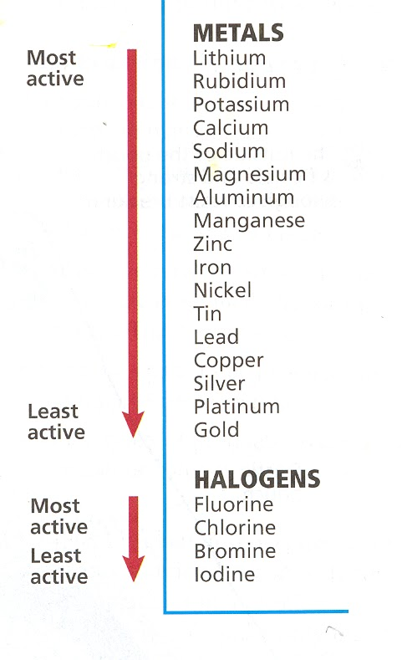
Types of Chemical Reactions: Single Replacement
Single Replacement: One element replaces another element in a compound.
Below, lithium replaces calcium.
Example: Ca(OH)₂ + 2Li → 2LiOH + Ca
Such reactions will only occur if the single element is more reactive than what is would replace.

Slide 12
Types of Chemical Reactions: Double Replacement
Double Replacement: The exchange of positive ions between two ionic compounds.
Na₂S + Cd(NO₃)₂→ CdS + 2NaNO₃

Slide 13
Combustion Reactions
The very rapid reaction of a substance with oxygen that produces oxides and heat.
Many substances do this, but we will focus on the combustion of hydrocarbons.
Hydrocarbons are compounds of carbon and hydrogen and sometimes oxygen. For example:
Butane: C₄H₁₀, Butanol: C₄H₉OH
Propane: C₃H₈, Propanol: C₃H₇OH
Methane: CH₄, Methanol: CH₃OH
Glucose: C₆H₁₂O₆, Sucrose: C₁₂H₂₂O₁₁

Slide 14
Combustion Reactions
Complete Combustion:
hydrocarbon + oxygen → carbon dioxide + water
CH₄ + O₂ → CO₂ + H₂O
Incomplete Combustion (low O₂ levels or cold) – 2 Types:
hydrocarbon + oxygen → carbon monoxide + water
CH₄ + O₂ → CO + H₂O
hydrocarbon + oxygen → carbon + water
CH₄ + O₂ → C + H₂O

Slide 15
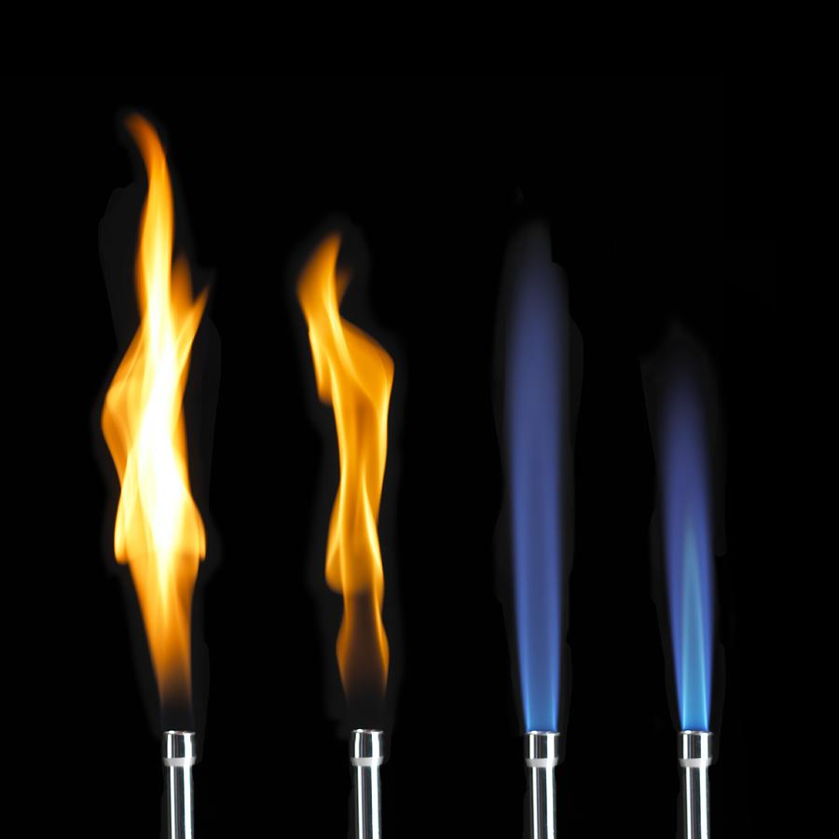
Incomplete vs Complete Combustion: Butane
Incomplete:
Orange flame
Releases CO or C.
Releases less heat
Complete:
Blue flame
Releases CO₂
Releases more heat

Slide 16
Balancing Combustion Reactions
These can be tricky as there are a high number of atoms. One strategy is to balance the O₂ term last by using a fraction coefficient (if necessary), then multiplying to remove the fraction.
Complete Combustion of Propane:
C₃H₈ + O₂ → CO₂ + H₂O
5
3
4

Slide 17
Balancing Combustion Equations
Complete Combustion of Ethane:
7
2
2
3
C₂H₆ + O₂ → CO₂ + H₂O
2
4
6
C₂H₆ + O₂ → CO₂ + H₂O
2
7

Slide 18
Balancing Combustion Reactions
Incomplete combustions of methane: Same Strategy
Carbon atoms
Hydrogen atoms
Oxygen atoms
3
2
CH₄ + O₂ → CO + H₂O
2
Double Every Coefficient!
4
CH₄ + O₂ → CO + H₂O
2
3
2

Slide 19
Stoichiometric Calculations
In a balanced chemical equation, the coefficients are the minimum number of atoms/molecules necessary.
Chemistry calculates in moles, so the coefficients are the number of moles of each reactant and product.
This gives mole ratios between all chemicals in the reaction.
Mole ratios are used to calculate the amount of any chemical knowing how much of another is used.

Slide 20
Mole Ratios
Take the complete combustion of ethane, for example:
4
6
C₂H₆ + O₂ → CO₂ + H₂O
2
7
In the above, there exists six unique mole ratios between all the chemicals being used.
When solving a problem, use the ratio involving the chemicals in the question. (examples on next slide)

Slide 21
Stoichiometric Calculations
4
6
C₂H₆ + O₂ → CO₂ + H₂O
2
7
Calculate the number of moles of water if 3.5 moles of ethane react with an excess of oxygen.
Calculate the number of moles of oxygen required to react with 8.35 moles of ethane.

Slide 22
Stoichiometric Calculations: Mass of a Product
4
6
C₂H₆ + O₂ → CO₂ + H₂O
2
7
Calculate the mass of (a) carbon dioxide and (b) water produced by burning 785 g of ethane in excess oxygen.
Calculate the mass of oxygen used up in the reaction.
It is possible to measure other quantities, such as # of particles or volume, using mole ratios.

Slide 23
Calculating # Molecules & Volume
4
6
C₂H₆ + O₂ → CO₂ + H₂O
2
7
Calculate the number water molecules when 321 g of ethane are completely combusted.
Calculate the volume of carbon dioxide produced if 143 L of oxygen gas is burned when reacting with ethane at STP.

Slide 24
Limiting Reagent
Limiting Reagent: Determines the amount of product that can be formed by a reaction.
Excess Reagent: The reactant not completely used up in a reaction.
We will again use the ethane combustion as an example.
4
6
C₂H₆ + O₂ → CO₂ + H₂O
2
7

Slide 25
Determining Limiting Reagents
4
6
C₂H₆ + O₂ → CO₂ + H₂O
2
7
Suppose you have 835 g of ethane and 3250 g of oxygen. Determine the limiting reagent.
Convert each mass into moles.
Determine how many moles of oxygen are required to react with the number of moles of ethane (stoichiometric calculation).
If # moles required is less than we have, then it is the excess reagent and ethane is the limiting reagent and vice-versa.

