Slide 2
Learning: A relativity permanent change in behavior caused by experience
Stimulus: Anything in the environment that one can respond to.
Response: Any behavior or action

Slide 3
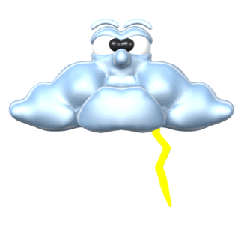
What is Classical Conditioning?
It is learning by associating two events that occur together in time and space.
This means that two stimuli appear together in such a consistent and reliable way that one stimulus gains the power to predict the response that the other stimulus already produces.
• We associate LIGHTNING
and THUNDER as being
related events because they
occur together
• After awhile, you will begin
to wince when you see
lightning because you’re
anticipating thunder next

Slide 4
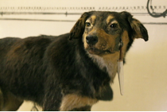
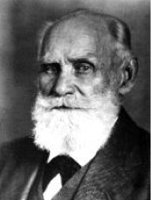
How it All Began
Ivan Pavlov
Russian
Psychologist
1849-1936
Discovered classical conditioning
on accident; he was just measuring
how much dogs salivated
Did You Know? Pavlov won the Nobel Prize in 1904 for his work with studying digestive systems…. years before he even worked on classical conditioning!

Slide 5
Unconditional Stimulus: A Stimulus that triggers a response reflexively and automatically.
Unconditioned Response: An automatic response to the unconditioned stimulus
Conditioned Stimulus: A previously neutral stimulus that through learning, gains the power to cause a response.
Conditioned Response: The response to the conditioned stimulus

Slide 6
Components of Classical Conditioning
In a classically conditioned response, the unconditioned stimulus (US) triggers the unconditioned response (UR) automatically. The previously neutral conditioned stimulus (CS) is repeatedly paired with UR, and eventually the CS triggers the conditioned response (CR).

Slide 7
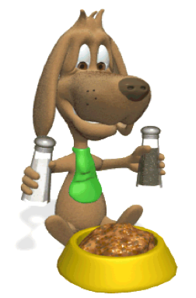
Ivan Pavlov's Discovery
Pavlov discovered the basic principles of classical conditioning during his research on the digestive process.
Pavlov would ring a bell to capture the dog's attention, present its food, and then collect its saliva
He began noticing that sometimes the dog would start salivating when it heard the bell or even when it saw Pavlov...
This was classical conditioning! the dog learned to associate the food with the sound of the bell!
He found that he could classically condition dogs to salivate (CR) to the sound of a tuning fork (CS) by pairing the tuning fork with meat (US), a stimulus that produced salivation automatically (UR).

Slide 8
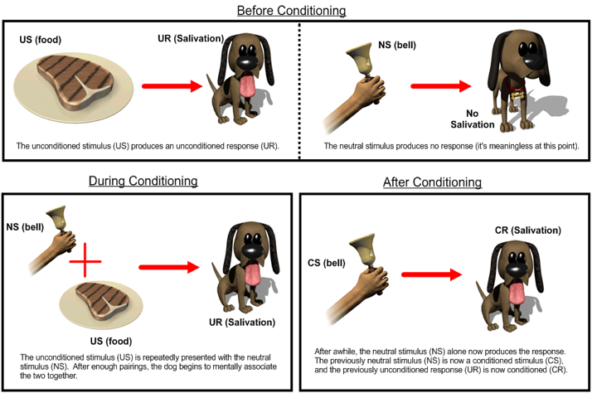
A Stimulus elicits a Response

Slide 9
Other Examples?
Come up with your own examples of Classical Conditioning!
Remember: the US and UR needs to start out as an UNLEARNED, NATURALLY OCCURRING, BIOLOGICAL STIMULUS/RESPONSE
Write it out (paragraph) AND try to label it in the diagram.
I’ll ask you to report out in five minutes.

