Slide 2
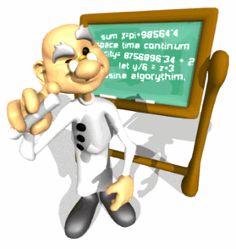
What are the Extensions?
After “discovering” classical conditioning, Pavlov spent the rest of his life expanding upon his ideas. He came up with some “extensions” that further develop/add on to his theory.
•Acquisition
•Extinction
•Spontaneous Recovery
•Generalization
•Discrimination
•Higher-Order Conditioning

Slide 3
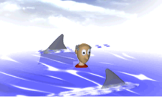
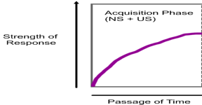
Acquisition
•The preliminary stage of learning.
•This is when the organism first
connects the events together
in its mind (it goes from
unconditioned to conditioned)
–When Pavlov’s dog figured out that a bell meant
food was coming
–When you watch Jaws and associate the theme
song with a shark attack
•TIMING MATTERS! The CS should come before the UCS
•They should be very close together in timing.
•Why????

Slide 4
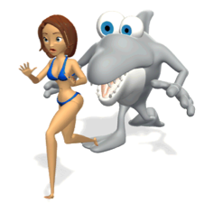
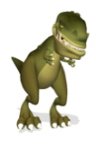
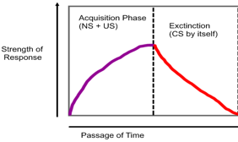
EXTINCTION
•The withdrawing of a conditioned
response.
•Occurs when you stop pairing
the US & NS/CS and time passes
–Eventually Pavlov’s dog will stop salivating to
the sound of the bell
–If you watch Jaws enough times with the sound
muted, eventually just hearing the “theme song”
won’t produce any fear in you
•Is Extinction permanent?! No, unless you’re a dinosaur. I’ll explain why on the next slide.

Slide 5
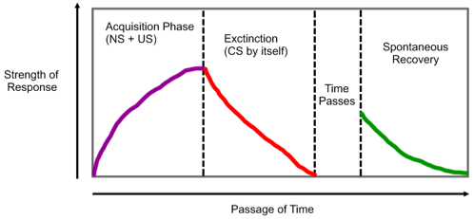
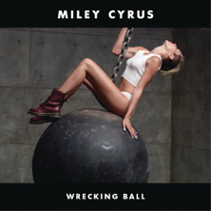
Spontaneous Recovery
•The recurrence of a conditioned response
after a rest period following extinction.
•(You have to connect the CS & NS again for
it to re-appear)
–If it’s already been conditioned previously, it won’t take the organism as long to learn it a second time, but it also won’t start out as strong of a connection
–You hear “Wrecking Ball” on the radio and love it. Then it plays five million times over the next week. Now you hate it. It stops playing. Ten years from now it randomly comes on the radio—what will your reaction be?

Slide 6
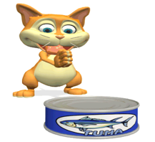
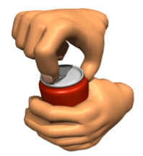
Generalization
Generalization is a process in which we make the same response (a high five, for example) to two similar stimuli (a touchdown in football and a volleyball kill). Discrimination is a process in which we make different responses to two stimuli (high five for winning a state championship, tears for losing).
“Yay! I love when Ms. Mitton feeds me canned food!
NOM NOM NOM NOM NOM NOM NOM NOM”
•When stimuli similar to the neutral stimulus bring forth similar responses as the neutral stimulus
–Usually happens to “less intelligent” animals
–My cat Toothless is conditioned to come running if he hears his canned food opening. He also comes running when I open a soda can sometimes.

Slide 7
Discrimination
•When an organism doesn’t respond to similar stimuli as the neutral stimulus
•Opposite of generalization
•Don’t confuse this with social psych’s discrimination
–Usually happens to “more intelligent” animals; the opposite of generalization
–You’ve been conditioned through school to leave when the bell rings. If I rang my own personal bell in front of the class, I doubt anyone would leave.
–If Toothless was smart instead of dumb, he wouldn’t get excited
when my soda can opens.

Slide 8
Cognitive Processes Of CC
•Does classical conditioning work as well on humans as it does on animals?
•NO, because of our cognition and intelligence
–Let’s say we want to “cure” an alcoholic through alcohol therapy. We put a nausea-inducing drug in their beer. Through classical conditioning, we hope they begin to associate the beer with feeling sick.
–Unfortunately, people are too smart. Their experiences/knowledge prevent it from being effective.

