Slide 1
unconsciousness
vs
Behavior

Slide 2
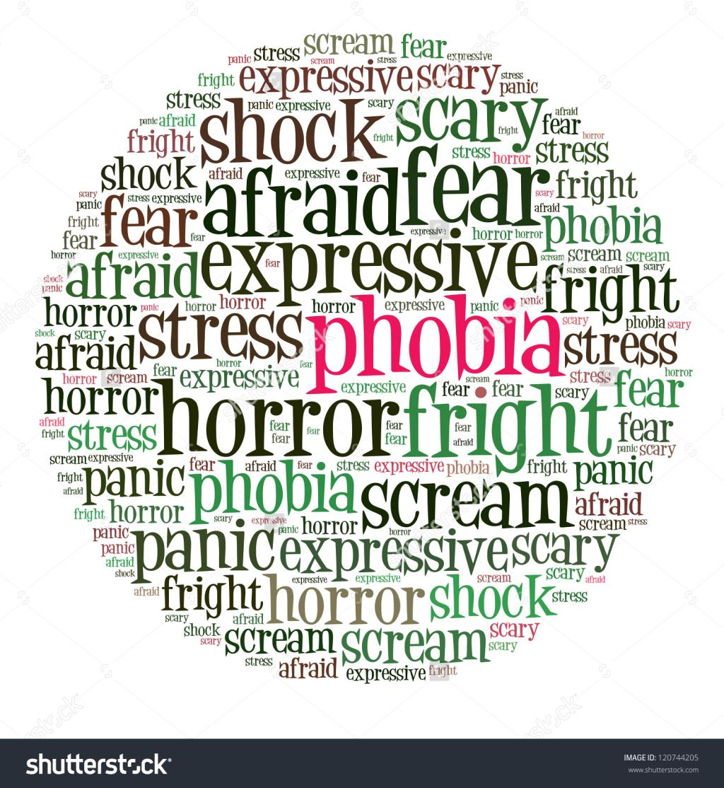

Slide 3
John Watson and the Classical Conditioning of Emotions
Watson established the perspective of behaviourism, the view that psychology should restrict its efforts to studying observable behaviours, not mental processes.
Watson and Rayner extended the study of classical conditioning to emotional responses. In an ethically troubling set of experiments, they conditioned a child, Little Albert, to fear white rats by applying the principles of classical conditioning. Watson and Rayner demonstrated that whenever you associate an emotional response with a particular stimulus, classical conditioning is probably involved.

Slide 4
Biological Predispositions
Biological predispositions- our inborn tendencies- make us less likely to do things (like playing with snakes and spiders) that might threaten our lives.
John Garcia and Robert Koelling showed how classically conditioned taste aversion could develop quickly, demonstrating that some species are more likely to learn some responses than to learn others based on their biological predispositions.

