Slide 1
Chapter 5
Prenatal Development

Slide 2
Conception
About one a month, an ovum (egg) is released from a women’s ovaries. It travels through the fallopian tubes to the uterus (womb). It is usually takes 2 or 3 days. Once it reaches the uterus, it disintegrates and is flushed out of the body by means of the menstrual flow.
However, sometimes the egg, is met and fertilized by a sperm cell. When they unite, this is called conception and pregnancy begins.
Fertilization can take place only two or three days after the ovum is released, however sperm can live up to 7 days so there is a 10 day window each month where pregnancy can occur.

Slide 3
Period of Zygote
Baby’s development is grouped into three stages.
The first stage is the Period of Zygote (fertilized egg).
No menstruation.
Last about two weeks
Zygote travels down the Fallopian tube and attaches itself to the thickened wall of the uterus, where it is kept warm and fed off the nutrients of the mother.
The Zygote grows by cell division, a single cell divides to become two, the two become four and so on until there is a mass of cells.
After 2 weeks, the zygote is the size of a pinhead.

Slide 4
Period of the Embryo
Stage two of pregnancy is the period of the embryo.
The embryo is the developing baby from about the third through eighth week of pregnancy.
During this time there is rapid growth in the embryo.
This is also when amazing and important changes occur.
Firstly, the mass of cells develop into all the major systems of the human body- heart, lungs, bones, muscles- though none of the internal organs are ready to function, the brain begins to take control of these body systems.
Secondly, a sac filled with fluid forms around the embryo- the amniotic fluid protects the developing baby and cushion the baby from any bumps or falls that might occur.
Thirdly, a tissue called the placenta develops. It is very rich in blood vessels and carries oxygen and flood from the mother’s blood stream.
Lastly, we have the development of the umbilical cord. It carries the nutrients from the mother to the baby and takes waste away.

Slide 5
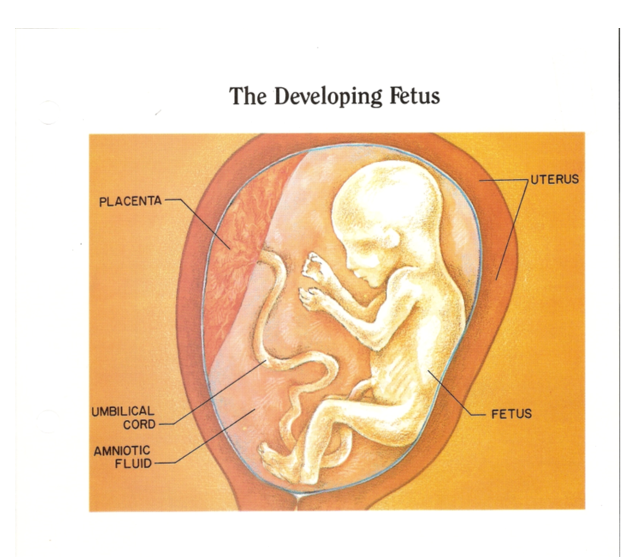

Slide 6
Period of the fetus
The third and final stage begins about the eight or ninth week and last until birth.
During the fourth or fifth month the mother can begin to feel the baby’s movements.
Also, as the fetus grows so does the uterus and the mother’s abdomen. As the fetus continues to grow, there’s not a lot of room to stretch out so they curl up into the fetal position.
At the 7 month mark the fetus is capable to live outside of the womb with a lot of medical assistances.
As the fetus continues to grow, their internal organs are ready to function without their mother, fat deposits develop under the skin which keeps them warm after they arrive.
They also store nutrients and builds immunity to diseases and infections, during the final weeks.
They can also suck their thumb, cough, sneeze, yawn and hiccup.

Slide 7
Human fertilization and Early Development
https://youtu.be/-7WKUNG9v-w
https://www.youtube.com/watch?v=XEfnq4Q4bfk

Slide 8
Preparing for birth
During the ninth month of pregnancy, the baby’s weight seems to shift down and the mother feels more comfortable in her upper abdomen. This shift is called “lightening” it means that the baby has dropped into the birth canal.
When this occurs the baby is usually upside down and ready to be delivered. It is the easiest and safest position for the birthing process.

Slide 9
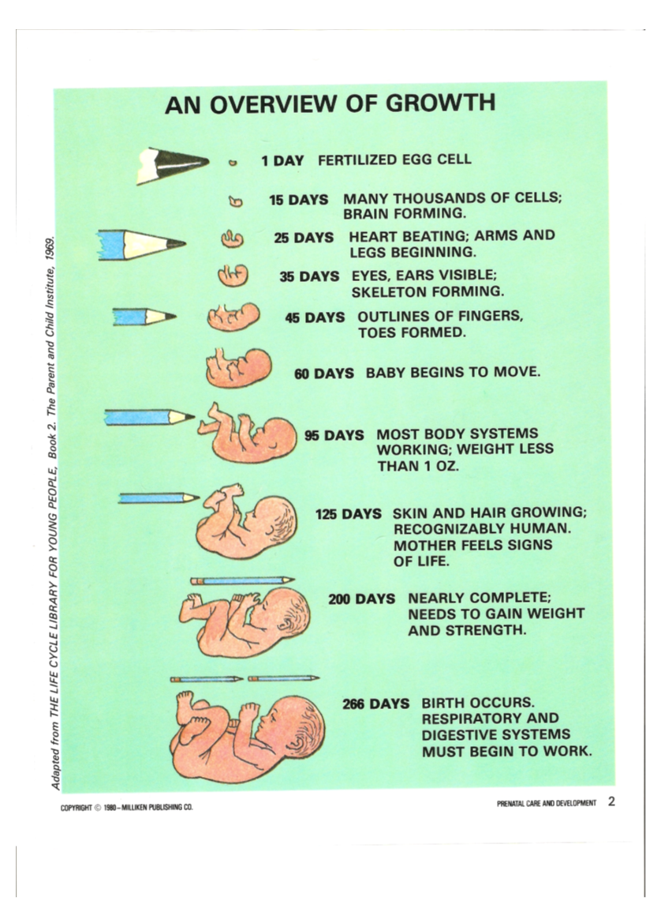

Slide 14
Journal #8
Draw a diagram showing the uterus, amniotic sac, placenta, umbilical cord, and fetus. Label these parts.

Slide 15
Check your understanding questions
What cells join to cause conception?
What happens during the zygote stage? How long does it last?
What changes might a pregnant women feel between the zygote and embryo stage?
If a women doesn’t have her period what may have taken place? What should she do?

