Slide 1
A closer look at conception

Slide 2
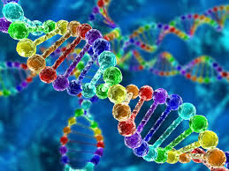
The Genetic Package
We inherit many characteristics from our parents, they include physical build; skin colour; hair texture and colour; colour and shape of our eyes; shape and size of our hands, ears, and feet; our blood type.
How this works is at conception, every human baby will receive 46 chromosomes. They come in 23 pairs and are coming from our father’s sperm and our mother’s ouvum.
Each chromosome has thousands of genes, the units that determine the child’s inherited characteristics.
A person receives two copies of a gene- one from the mother and one from the father. When they are both the same, the child has that characteristics. Thus, two genes for blue eyes give the child blue eyes.
If a person receives two different genes, the characteristic that will be expressed will be controlled by the dominant or stronger gene.
The recessive or weaker gene will not be expressed.
Heredity explains why brothers and sisters often resemble each other and why they can look quite different

Slide 3
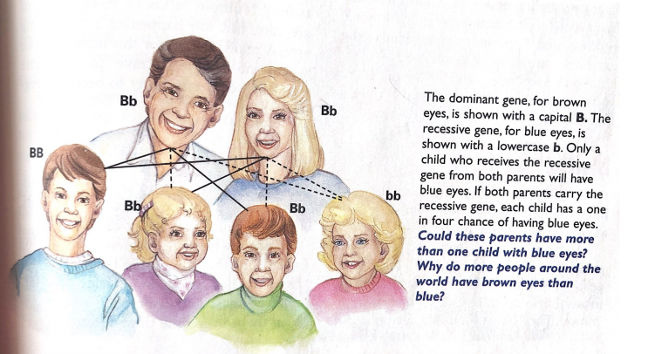

Slide 4
The Genetic Package
The sex of a child at birth is created by the sex chromosomes, which come in two types X and Y.
Every egg cell contains an X chromosomes.
Each sperm cell contains either an X or Y chromosomes.
If the sperm that fertilizes the egg carries an X chromosome, an XX combination results in the child being born a girl.
If the sperm that fertilizes the egg carries a Y chromosome, an XY combination results in the child being born a boy.

Slide 5
Multiple Births
When a pregnant women gives birth to more than one baby, since too is at conception or soon after.
A fertilized egg starts growing by dividing into two cells, the cells continue to divide.
Sometimes the mass of cells splits in half soon after fertilization, then each clump of cells continue to divide and grow into a separate embryo, this results in identical twins.
Identical twins are the same sex and have very similar characteristics because both began as one zygote.
Fraternal twins form when two eggs are released at the same time and each is fertilized. They grow side by side in the uterus, since they result from the union of different eggs and sperm, fraternal twins are no more alike in terms of heredity than any other siblings.
With twins, it depends on whether one fertilized egg splits or more than one egg is fertilized at the same time.

Slide 6
Infertility
Not all couples who want to have a baby are able to get pregnant.
There are medical advances that have helped many of these couples overcome infertility:
Adoption: the couple legally takes all responsibilities and rights for raising a child already born
Artificial insemination: In this process, a doctor injects sperm into a woman’s uterus with a special needle. The sperm may be the husbands. If he has a history of genetic disorders, the sperm may come from another male, whole is called a donor.
In vitro fertilization: This process is used when a women has damages Fallopian tubes that prevent pregnancy. In a small glass dish, a doctor combines a mature egg from the woman and sperm from her husband. If fertilization takes place, the doctor places the zygote in the woman’s uterus. If the zygote attaches itself to the uterus, a normal pregnancy takes place.
Ovum transfer: This procedure uses an egg taken from a female donor and in vitro fertilization. It may be used by women who lack working ovaries or who have inherited disorders.
Surrogate mother: A surrogate or substitute, mother is a women who becomes pregnant for another couple. She may carry a couple’s fertilized egg, removed from the biological mother because she is unable to carry to completion. Other surrogates are artificially inseminated with sperm from the husband of an infertile woman. This usually includes legal arrangements and must meet laws.

